Slide 1
Capitalism
Essential Lecture

Slide 2
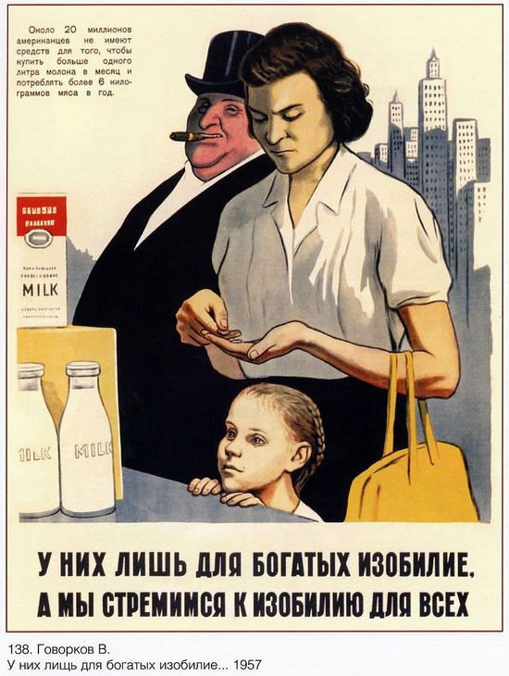
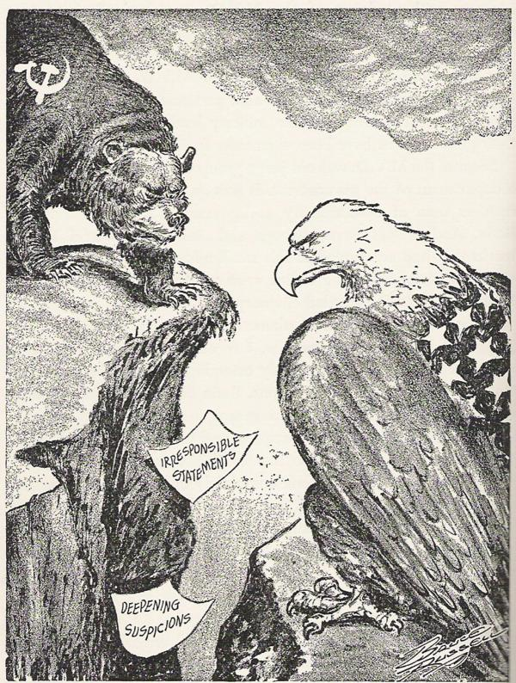
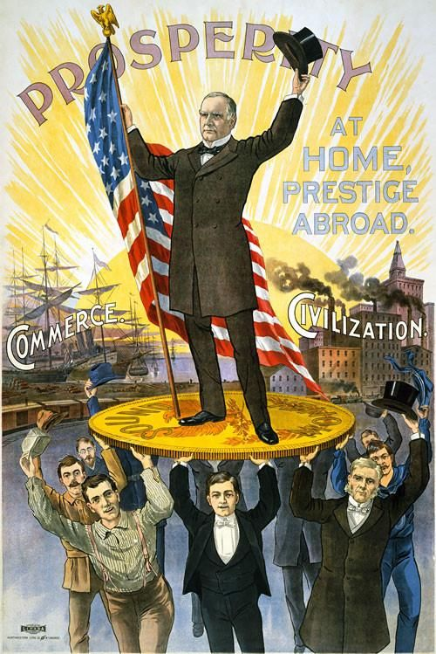
Capitalism has been at the centre of politics and people’s daily life ever since its existence
“A man who thinks that economics is only a matter for professors forgets that this is the science that has sent men to the barricades.”
Robert Heilbroner (1953, p. 14)

Slide 3
Learning objectives and transferable skills
Understanding capitalism’s basic institutions.
Being aware of different ideas and views on capitalism by key thinkers and citizens.
Explaining and discussing complex ideas verbally with others.
Conducting and analysing interviews.

Slide 4

Capitalism Quiz
  Go to: https://learningapps.org/watch?v=pytzh32na23

Slide 5
What did Smith and Marx agree on?
One answer is correct.
The division of labour, market competition and trade caused unprecedented wealth
In markets, actors receive relative to their functional contribution and productivity
Capitalism is inherently unstable and prone to crises

Slide 6
Who had a quarrel with his parents because he drank and fought too much during his studies?
Two answers are correct.
Smith
Marx
Weber
Schumpeter
Keynes

Slide 7
What made the emergence of capitalism possible according to Weber?
Three answers are correct.
The capture of the state by capitalists enabling the commercialization of economic life
The establishment of a monopoly over the means of coercion by a bureaucratic state
The Protestant ethic of frugality, seeing your work as religious calling and success as a possible sign of being chosen for salvation
The means of production came to be seen as the disposable property of private autonomous enterprises

Slide 8
What makes capitalism so dynamic according to Schumpeter?
Two answers are correct.
Entrepreneurial innovation
Price competition
Money creation by commercial banks through credit

Slide 9
What did Keynes think the government had to do to preserve liberalism?
One answer is correct.
Get rid of government regulations as they inhibit entrepreneurial innovation
Cut government spending and reduce public debt to restore private sector confidence
Ensuring sufficient effective demand through countercyclical fiscal policies
Force wage cuts on workers so that markets could clear optimally

Slide 10
Who wrote this:
Capitalism “has accomplished wonders far surpassing Egyptian pyramids, Roman aqueducts, and Gothic cathedrals; it has conducted expeditions that put in the shade all former Exoduses of nations and crusades.”
Smith
Marx
Weber
Schumpeter
Keynes

Slide 11
Who wrote this:
“Civil government, so far as it is instituted for the security of property, is in reality instituted for the defense of the rich against the poor, or of those who have some property against those who have none at all.”
Smith
Marx
Weber
Schumpeter
Keynes

Slide 12
Exercise 1: Explaining capitalism’s basic institutions in duos
Take turns to explain the institutions (4 minutes each):
State: Why is it important that the state enforces private property rights and legal contracts for capitalism?
Markets: Why is it important that not only final products but also factors of production are sold on markets for capitalism?
Firms: Why is it important that capital owners control firms and employ workers to make profit for capitalism?
Money: Why is it important that commercial banks create money through credit for capitalism?

Slide 13
Capitalism as a political-economic system
More than an economy with:
Market mechanisms are dominant:
Origin of its name:
The economy is organised around the pursuit of profit.
Markets
Money, or
Profit-seeking
Not only goods and services
But also land, labour and capital are bought and sold on markets.
Those that own capital legally control firms.
Not around:
Political obligations, reciprocity,
social norms, or subsistence farming.

Slide 14

Capitalism as…
1
Civilising
2
Destructive
3
Feeble
Capitalism creates: growth, freedom, and fair and efficient outcomes.
Capitalism creates:
exploitation, alienation, and poverty alongside riches.
Capitalism is not inherently good or bad.

Slide 15
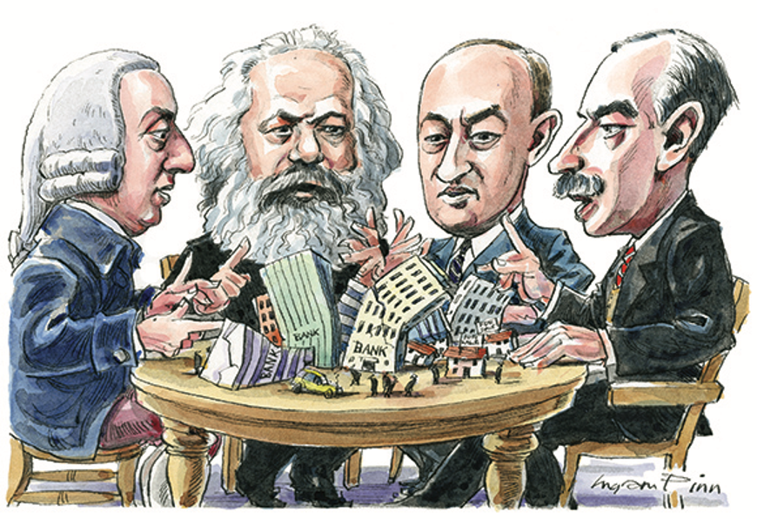
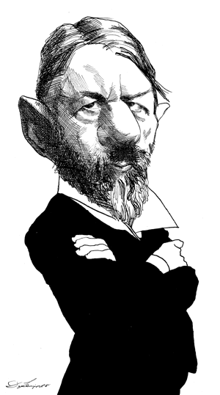
Key thinkers on capitalism
Smith Marx Schumpeter Keynes Weber

Slide 16
J. Schumpeter
J. M. Keynes
Max Weber
Adam Smith
Karl Marx
Capitalism, Socialism and Democracy (1946)
Economy and Society (1922)
1750
1780
1810
1840
1870
1900
1930
1950
Das Kapital Vol I (1867)
An Inquiry into the Nature and Causes of the Wealth of Nations (1776)
The General Theory of Employment, Interest and Money (1936)

Slide 17




State
Enforcement of private property rights and legal contracts
Markets
Market exchange of products and factors of production
Firms
Production by workers for enterprises owned by profit-seeking capitalists
Money
Money creation by commercial banks through credit

Slide 18
Markets
Smith: Division of labour based on expanded markets creates wealth and harmony as prices convey information on scarcity.
Marx: Workers are forced to sell their labour and work for capitalists to earn a living and survive.
Keynes: Markets rarely lead to full employment due to a lack of effective demand.

Slide 19


Firms
Weber: Continuous ‘rational’ calculation by bureaucratic enterprises to maximise profit.
Schumpeter: Capitalist entrepreneurs don’t simply compete, they change the nature of the competition through innovation.

Slide 20
Money
Schumpeter: The money markets are the ‘headquarters of capitalism’ as access to credit-money drives the ‘capitalist engine’.
Keynes: Because the future is uncertain people's preference for liquidity can change rapidly and profoundly which can destabilise the economy.

Slide 21
State
Marx: Capitalism is founded on unequal property relations created and maintained by violence of the state.
Weber: The ‘memorable alliance’ between states and capitalists is loose enough to allow capitalists to operate freely both within and between states.
Keynes: The state can prevent depression and unemployment without sacrificing economic and political liberalism with counter-cyclical fiscal and monetary policies.

Slide 22
Exercise 2: Conversations between key thinkers
Each duo: Choose two key thinkers and each pick one to play to enact how a conversation between the two thinkers could have looked like.
5 minutes: Discuss a point the two thinkers disagree on
5 minutes: Discuss a point the two thinkers agree on

Slide 23
Discuss homework: Friends and family on capitalism
Public opinion data
Discussion time

Slide 24
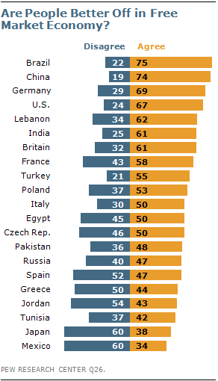
Notes:
Source: https://www.pewresearch.org/global/2012/07/12/chapter-4-the-casualties-faith-in-hard-work-and-capitalism/

Slide 25
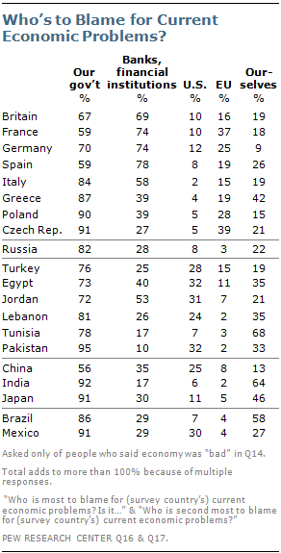
Notes:
Source: https://www.pewresearch.org/global/2012/07/12/chapter-1-the-national-report-card/

Slide 26
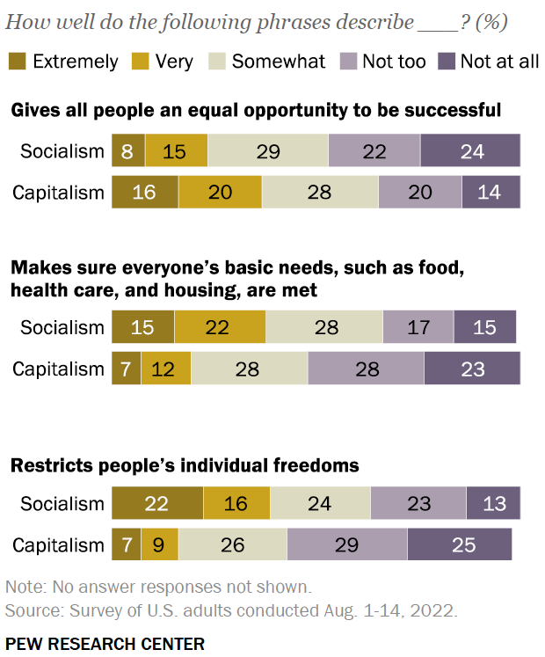
Notes:
Source: https://www.pewresearch.org/politics/2022/09/19/modest-declines-in-positive-views-of-socialism-and-capitalism-in-u-s/

Slide 27
Discussion time
In the same duos: compare and discuss the interviews (with the help of the homework sheets) with each other and the public opinion data.

Slide 28
Wrap up

