Slide 1
Economic Introduction to the Ecological Crisis
Notes:
The first section starts with laying the foundation of what the issue is, and the extent of it. As many students are likely to be at least partially aware of this already, and to engage them, we suggest starting each section with a wordcloud for each question (1. What are the main ecological challenges we face, 2. What are the main drivers, 3. Who is accountable) to start a dialogue with the students. Mentimeter, Slido and Poll Everywhere all offer free tools for making collaborative word clouds.

Slide 2
Overview
What are the main ecological challenges we face?
  Planetary boundaries
  Trade-offs
What are the main drivers of environmental degradation?
  Carbon emissions
  Biodiversity Loss
Who is accountable for it?
  Anthropocene
  Inequality of Emissions

Slide 3
What are the main ecological challenges we face?
Notes:
Wordcloud using tools such as mentimeter.com
Try identifying the key ecological challenges we are upon. Do they suggest causes or consequences?

Slide 4
Defining the boundaries: concepts showing at which point do we cause (irreversible) ecological harm?
Ecological Ceiling
Planetary Boundaries
Material footprint maximum boundary
IPCC Reports (1.5°C)

Slide 5









Notes:
The concept of planetary boundaries refering to the limits within which human societies can operate safely and sustainably on the Earth. Itwas introduced by a group of scientists in 2009, and it refers to the limits within which human societies can operate safely and sustainably on the Earth. These boundaries are defined by a set of environmental parameters agreed upon between this group of international scientific experts. However, these limits could have been set higher/lower.

Slide 6
1. Climate Change
Global average temperature rise
Increases the rate of soil erosion, natural disasters and sea level rises
2. Ocean acidification
CO2 emissions cause the oceans to acidify
Negatively impacts marine life
3. Chemical pollution
Emissions of toxic substances
Negative impact on health (animals and humans)
Notes:
Planetary boundaries put simply, are thresholds within which humanity can survive, develop and thrive for generations to come. These nine boundaries created a safe operating limit for survival.
Climate Change is the global average temperature rise compared to pre-industrial times. IPCC scientists agree that temperatures have now risen at least 1.2C above pre-industrial times.
Ocean acidification refers to the increase in carbon dioxide emissions is causing the pH of the oceans to decrease, which has negative impacts on marine life.
Chemical pollution is the release of synthetic chemicals (toxic long-lived substances such as heavy-metals, radioactive materials) into the environment is causing negative impacts on human and animal health.

Slide 7
4. Nitrogen & phosphorus loading
Excessive use of fertilizers
Causes pollution of waterways and dead zones in the ocean
5. Freshwater withdrawals
Unsustainable use of freshwater
Depletion of aquifers and water scarcity in many regions
6. Land conversion
Conversion of natural habitats into agricultural, urban areas, and infrastructure
Disrupts ecosystem
Notes:
4. Nitrogen & phosphorus loading (also known as biogeochemical flow): The excessive use of fertilizers has led to a disruption of these cycles, causing pollution of waterways and dead zones in oceans.
5. Freshwater use is currently unsustainable, there is depletion of aquifers and water scarcity in many regions.
6. Land conversion (Land-use change) is one of the driving forces towards reduction in biodiversity, impact waterflows, and affects the biogeochemical cycling of carbon, nitrogen and phosphorus and other important elements. That is, land conversion has direct impact on 3 other planetary boundaries.

Slide 8
7. Rate of Biodiversity loss
Rate of extinction of species
Direct effect on ecosystem and all life on earth
8. Air pollution
Caused by activities such as burning fossils fuels and land-use change
Direct effect on climate change
9. Ozone layer depletion
Thinning of the ozone layer through the release of substances
Increases the risk of skin cancer and other health problems.
Notes:
7. Biodiversity loss: The rate of extinction of species is currently estimated to be 100 to 1000 times higher than the natural background rate.
8. Air pollution (also known as atmospheric aerosol loading): Is caused by activities such as burning fossils fuels and land-use change and has a direct effect on climate change.
9. (Stratospheric) Ozone layer depletion: The release of chlorofluorocarbons (CFCs) and other ozone-depleting substances has led to a thinning of the ozone layer, which increases the risk of skin cancer and other health problems.

Slide 9
Notes:
These are the planetary boundaries that we have exceeded already, causing severe ecological damage.

Slide 10
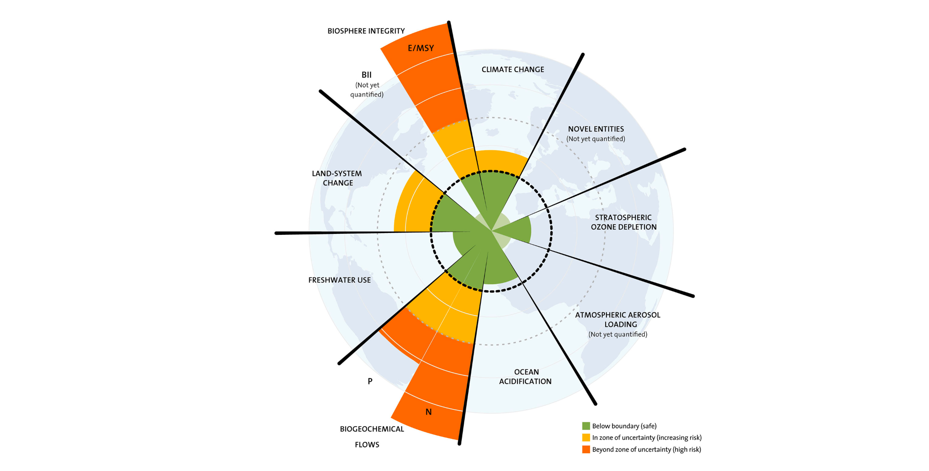
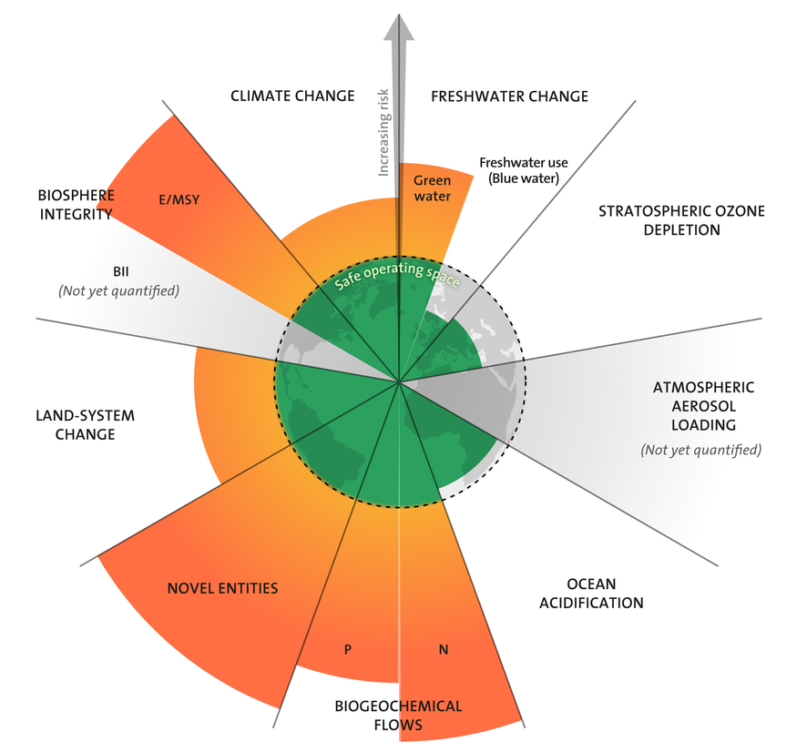

Slide 11
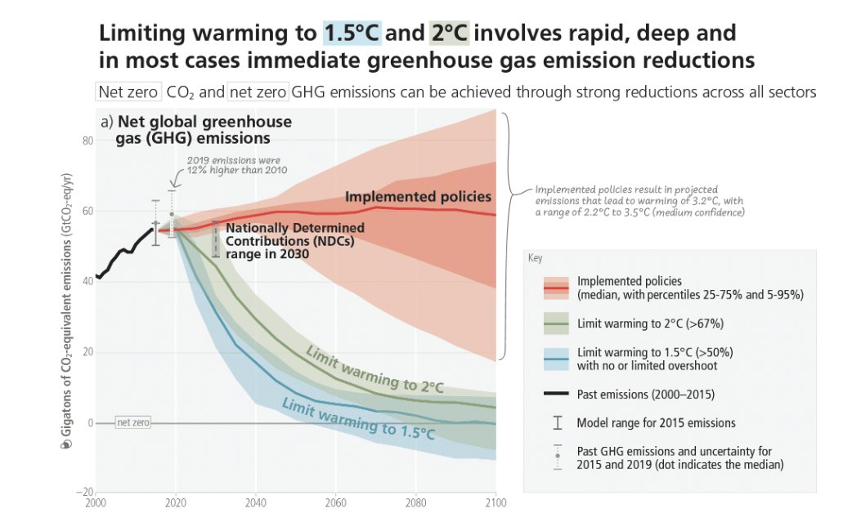
Notes:
Source: https://www.ipcc.ch/report/ar6/syr/
This graph from the newest IPPC (synthesis report) shows how implemented policies compares to the 1.5 and 2.0 degree goal, which is currently on track of 3.2 degrees.

Slide 12
1.5°C
2.0°C
3.0°C
Sea level rise 48 cm
Ocean acidity up 17%
Probability of sea ice-free arctic summer in any one year: 3%
Average drought length increase: 2 months
Proportion of vertebrates losing >50% of their habitat: 4%

Slide 13
1.5°C
2.0°C
3.0°C
Sea level rise 56 cm
Probability of ice-free arctic summer in any one year: 16%
Ocean acidity up 29%
Average drought length increase: 4 months
Proportion of vertebrates losing >50% of their habitat: 8%

Slide 14
1.5°C
2.0°C
3.0°C?
Probability of ice-free arctic summer in any one year: 63%
Average drought length increase: 10 months
Proportion of vertebrates losing >50% of their habitat: 44%
Notes:
There are much wider confidence intervals when estimating various consequences of reaching 3.0 degrees above pre-industrial levels. What we do know for sure is that the predicted outcomes are far more extreme and unpredictable the further the global average temperature rises.

Slide 15
1.5°C
2.0°C
3.0°C
Sea level rise 48 cm
Ocean acidity up 17%
Probability of sea ice-free arctic: 3%
Average drought length increase: 2 months
Proportion of vertebrates losing >50% of their habitat: 4%
Sea level rise 56 cm
Ocean acidity up 29%
Probability of sea ice-free arctic: 16%
Average drought length increase: 4 months
Proportion of vertebrates losing >50% of their habitat: 8%
Probability of sea ice-free arctic: 63%
Average drought length increase: 10 months
Proportion of vertebrates losing >50% of their habitat: 44%

Slide 16
Trade-off
Environmental protection / Consumption
  Cost of mitigating emissions/foregone consumption
Value judgements: economic concerns vs social/environmental
Neglects the effect of environment on consumption and the economy.
Cost of environmental degradation
  Earth
  Society
  Economy

Slide 17
2. What are the main drivers of environmental degradation?
Notes:
Wordcloud. Activate the students to think what is pushing our planetary boundaries.

Slide 18








Production Process
Extraction
Production
Retail
Consumption
Waste disposal

Slide 19
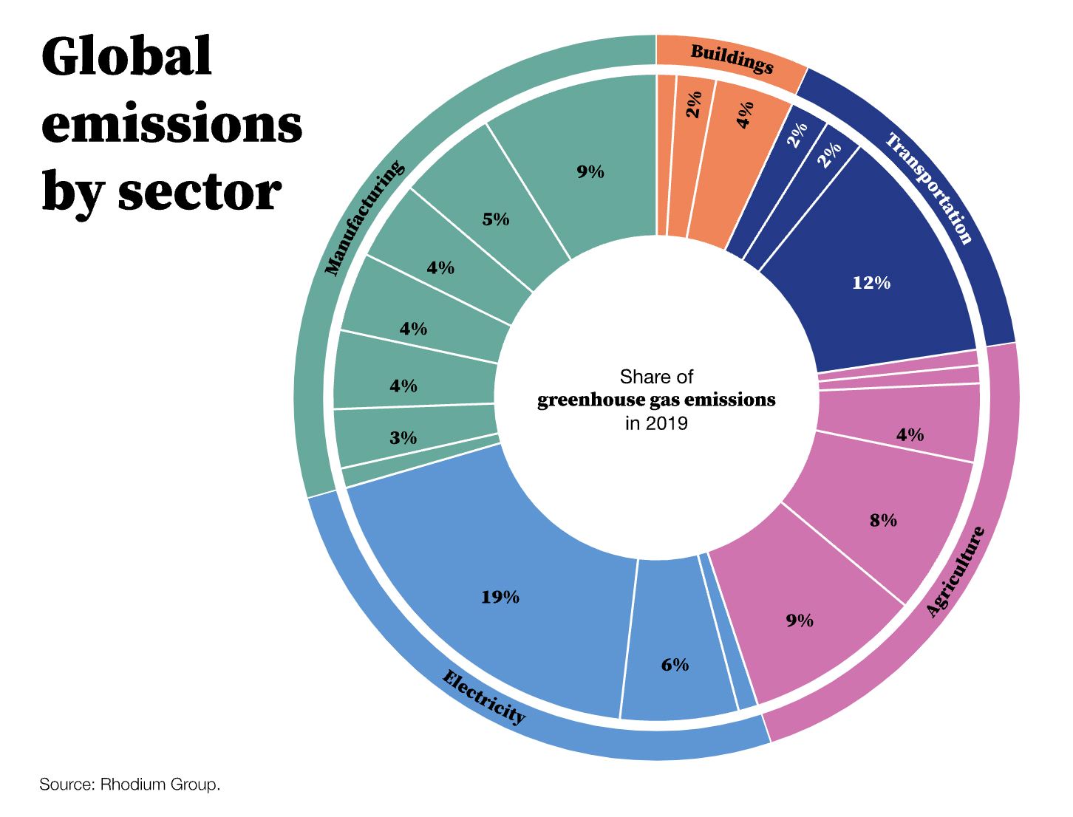
Notes:
Figure source: https://www.gatesnotes.com/The-Year-Ahead-2023?WT.mc_id=20221219210000_The-Year-Ahead_BG-TW_&WT.tsrc=BGTW#ALChapter8 with data retrieved from Rhodium Group

Slide 20
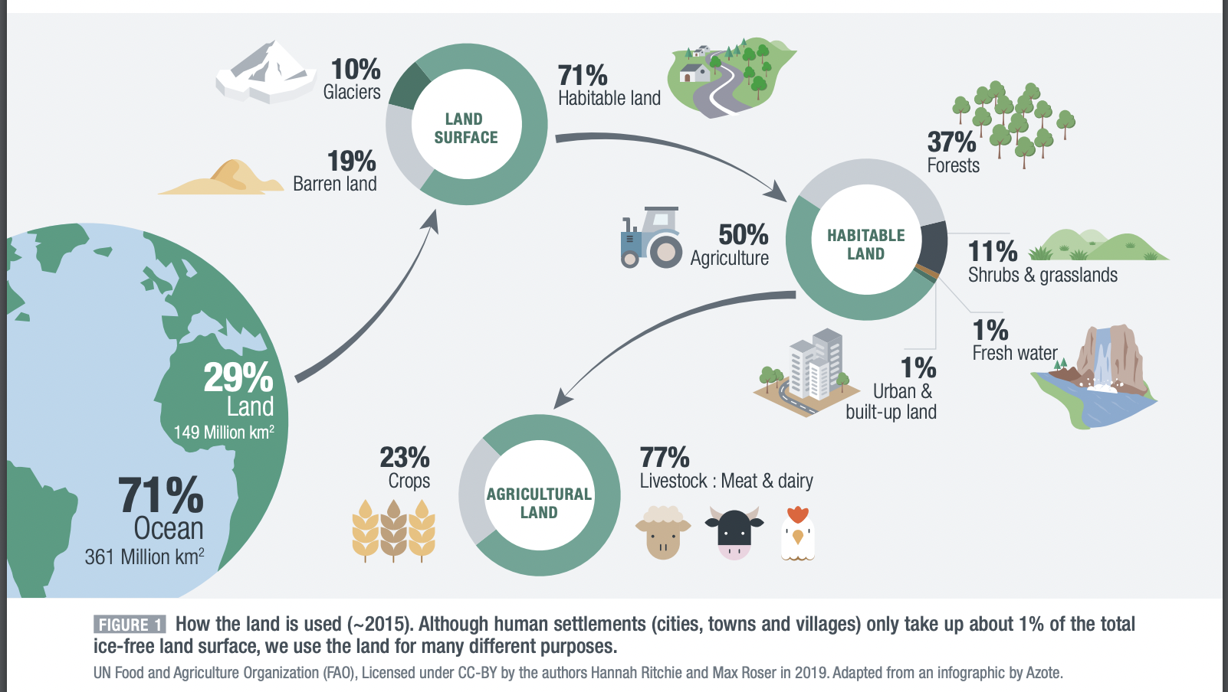
Notes:
Source: https://www.oce.global/en/resources/climate-science/ipcc-special-report-climate-change-and-land-summary-teachers

Slide 21
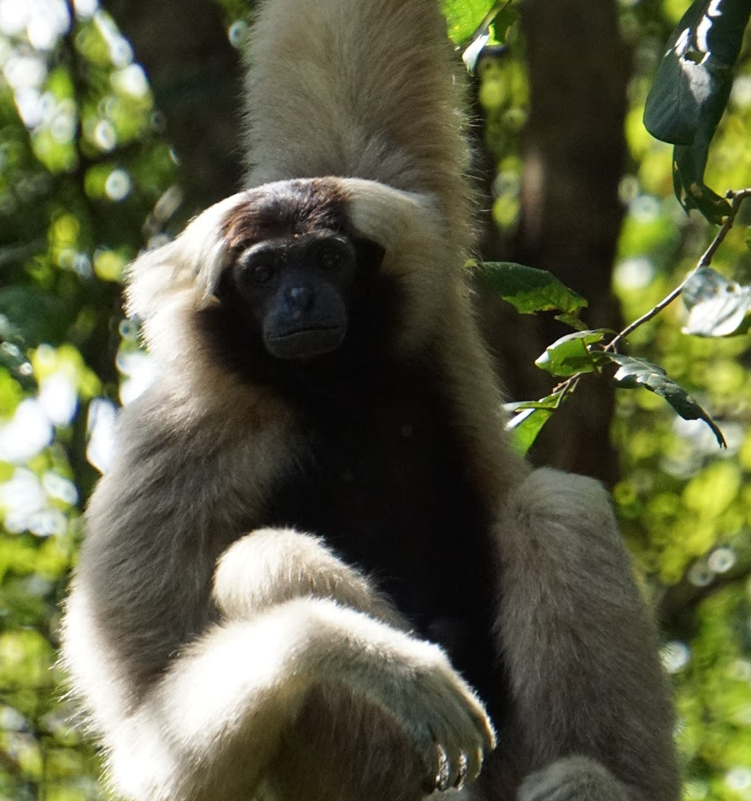
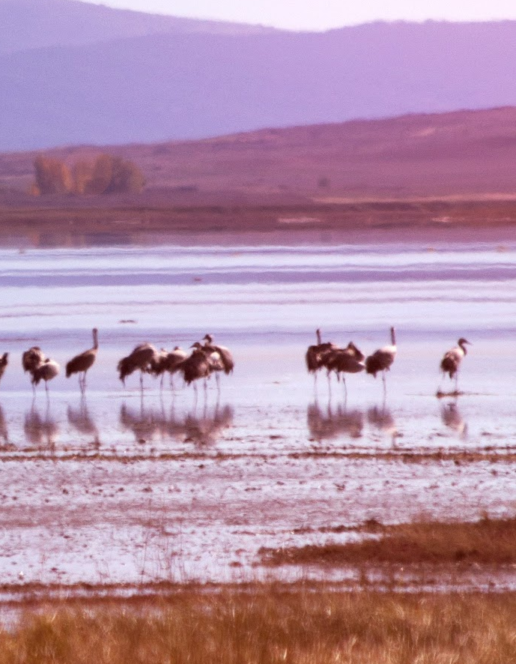
Biodiversity Loss
Land conversion 30%
  Large-scale food production
Overexploitation 20% (overfishing, overhunting and overharvesting)
Climate change + pollution 14%
Notes:
Land-use change is currently the largest driver of biodiversity loss, contributing to 30% of all the loss. However, many models predict that climate change will soon become the largest driver. All three point can be directly linked to the economy and the production cycle.

Slide 22
3. Who is responsible?
Notes:
Wordcloud. Who are responsible for the crisis, and who should be held responsible?

Slide 23
Production Process
Extraction
Production
Retail
Consumption
Waste disposal

Slide 24
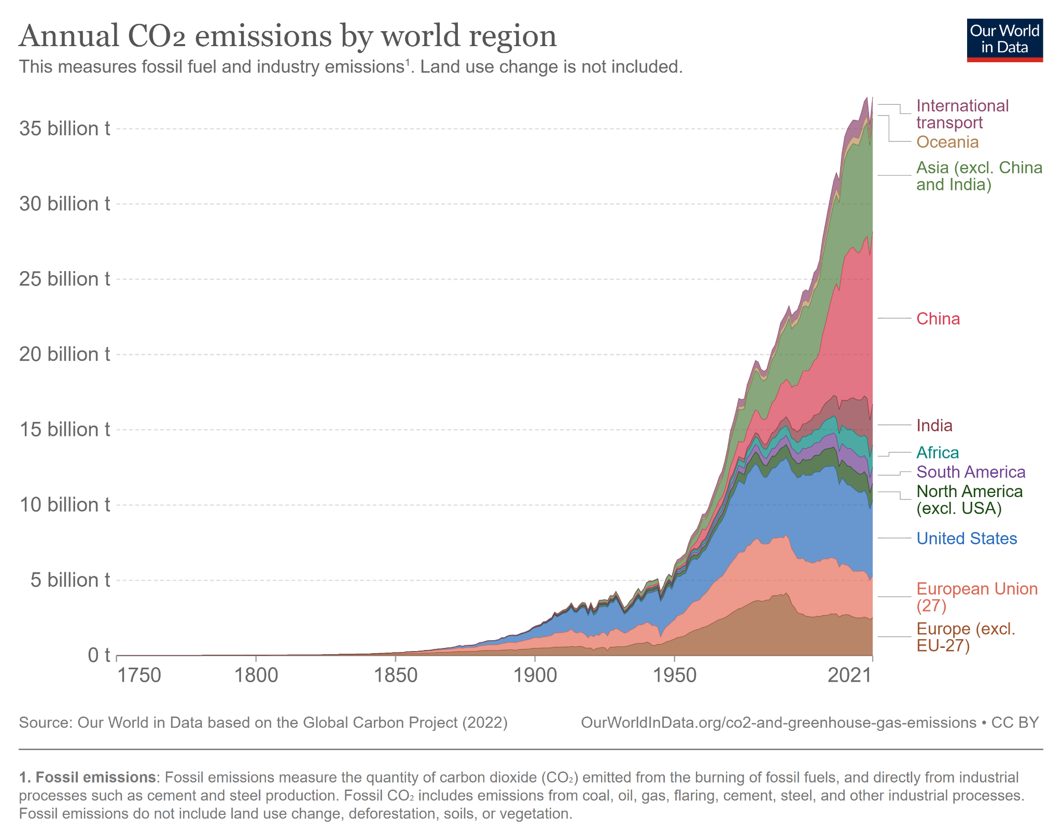
Notes:
Source: https://ourworldindata.org/co2-emissions

Slide 25
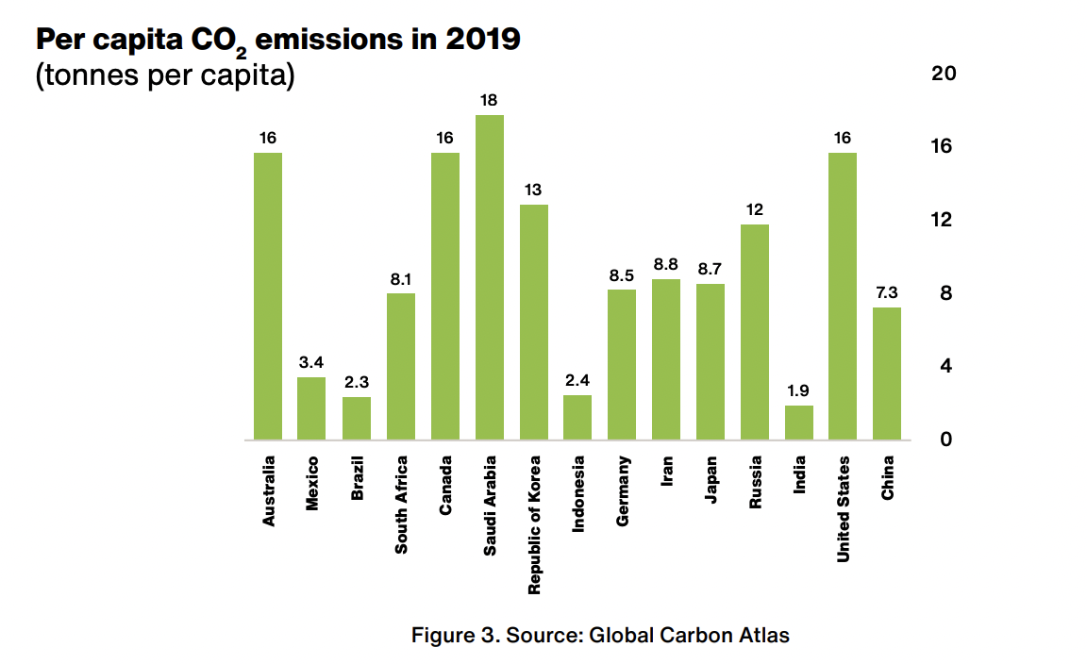
Notes:
https://www.clubofrome.org/wp-content/uploads/2022/07/Earth4All_Deep_Dive_Ghosh.pdf

Slide 26
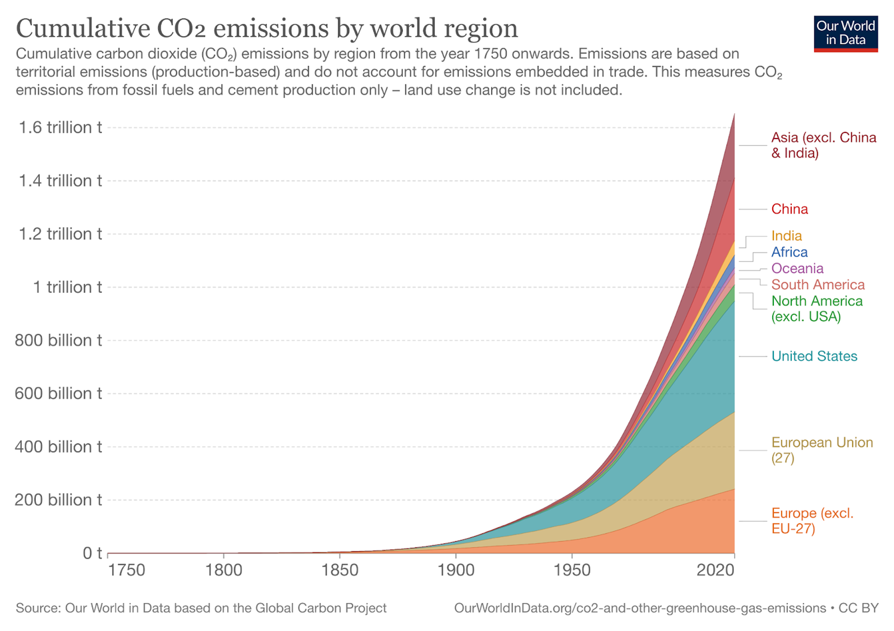
Notes:
Source: https://ourworldindata.org/contributed-most-global-co2

Slide 27
Welcome to the Anthropocene
Significance of human activity on the planet
Anthropocene: human beings are currently the main cause of changes in the Earth’s natural systems
Human activity responsible for: climate change, deforestation, pollution, and the (mass) extinction of species
  Consequences on earth ecosystem, e.g. sea level rise, loss of biodiversity, ocean acidification

Slide 28
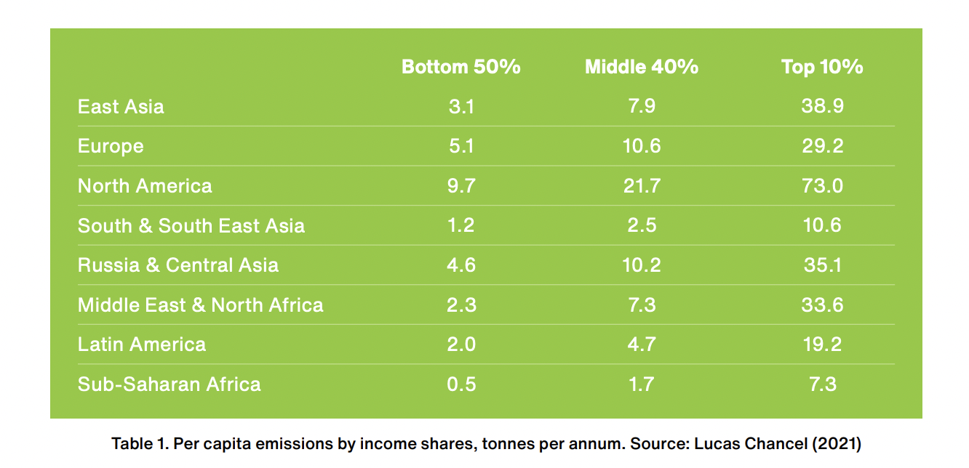
Notes:
https://www.clubofrome.org/wp-content/uploads/2022/07/Earth4All_Deep_Dive_Ghosh.pdf

Slide 29
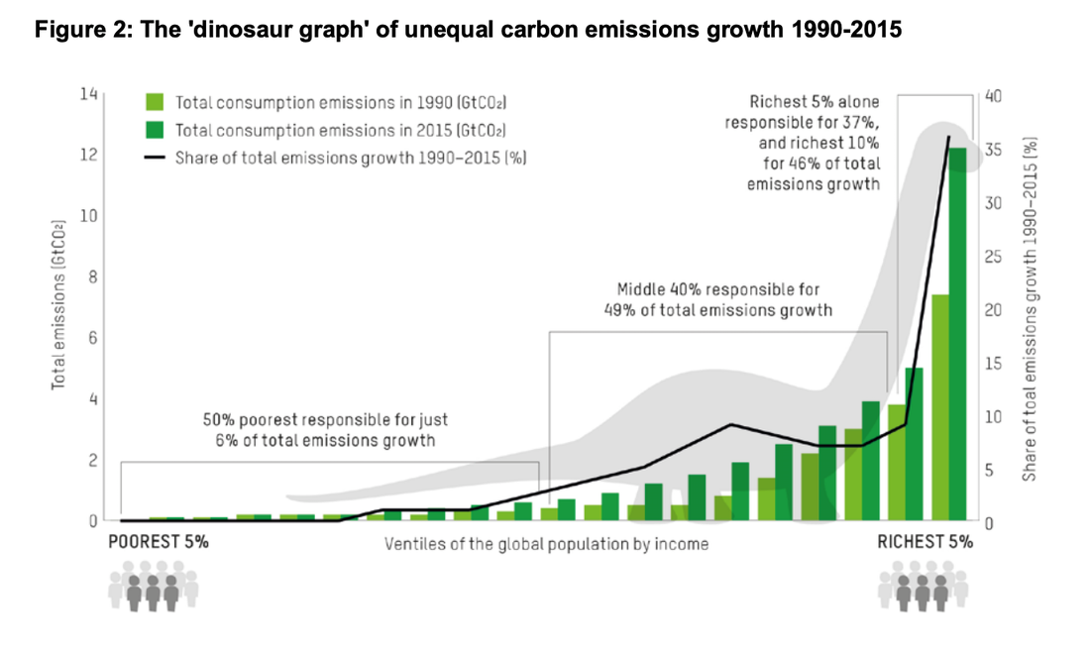
Notes:
https://wir2022.wid.world/chapter-6/
https://oxfamilibrary.openrepository.com/bitstream/handle/10546/621052/mb-confronting-carbon-inequality-210920-en.pdf

Slide 30
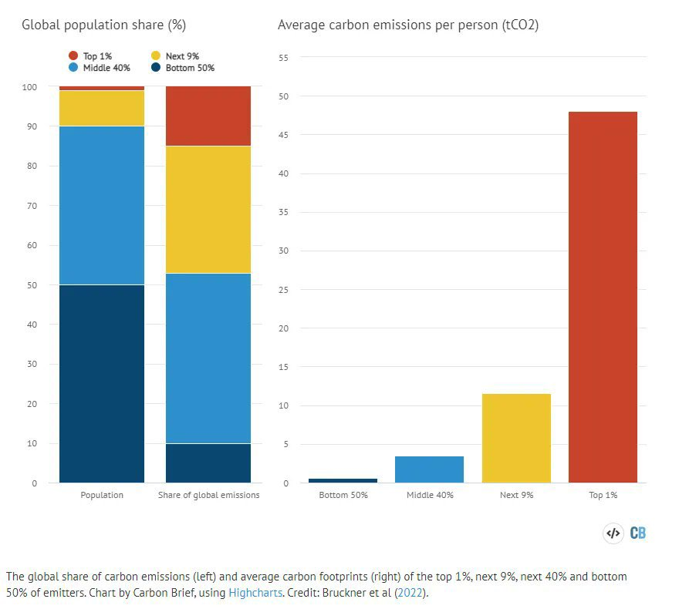

Slide 31
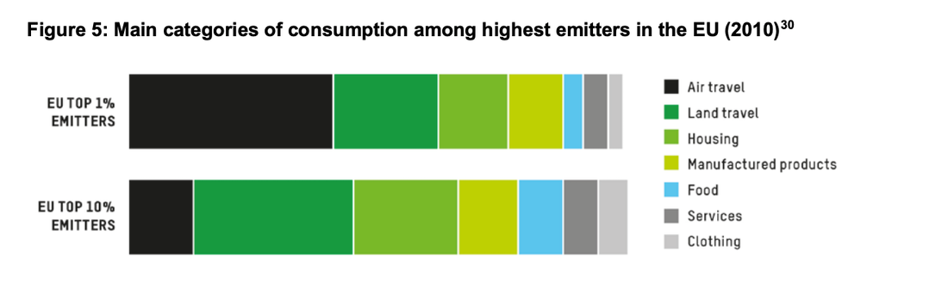
Notes:
Source: Oxfam

