Slide 1
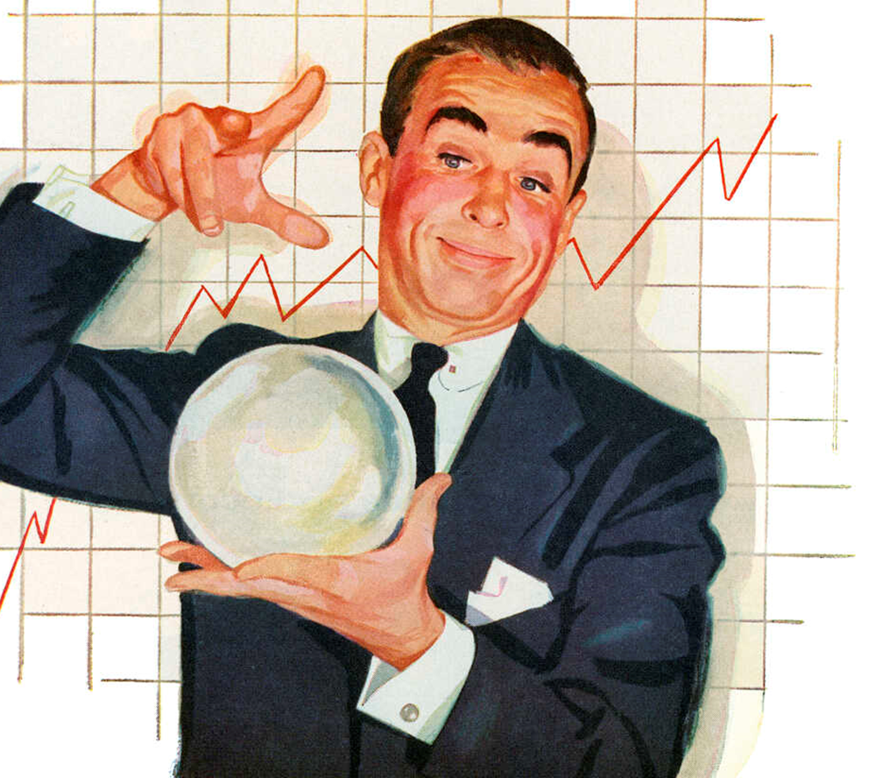
How to get away with a crisis?
Essential Lecture
Keynesianism and the economic crises of the 20th Century
Notes:
This title is a reference to the famous television series « How to get away with murder ». The title is meant to invoke the idea that economic policy can limit the impact of financial crises on the wider economy, allowing a country to “get away” with having a crisis.

Slide 2
Content
Introduction and Motivation
The Great Depression (1929 - 1941)
The (general) theory of Keynes (1936)
Expansion of the State (1940s - 1960s)
Stagflation and Energy Crises (1970s)
Crisis and you!? (21st Century)

Slide 3
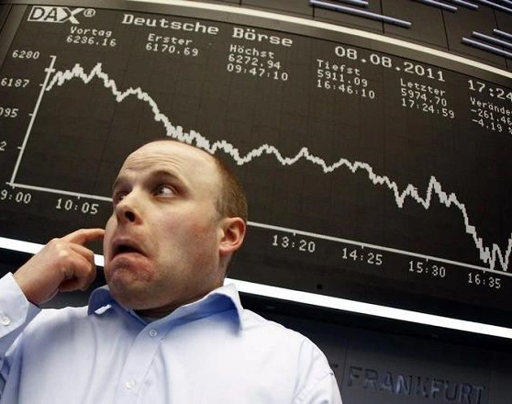
Motivation
Crises are a key part of the history of capitalism.
Economic theory can be used to minimize the impacts of a crisis.
Keynes provides key insights about how to manage crises.
How can we keep his bad day from becoming your country's bad decade?

Slide 4
The Great Depression
1929 - 1941

Slide 5
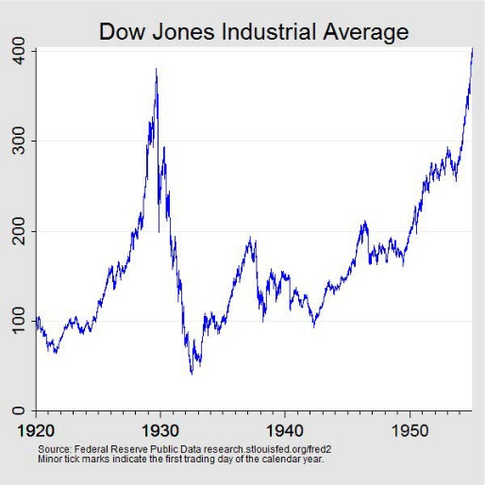
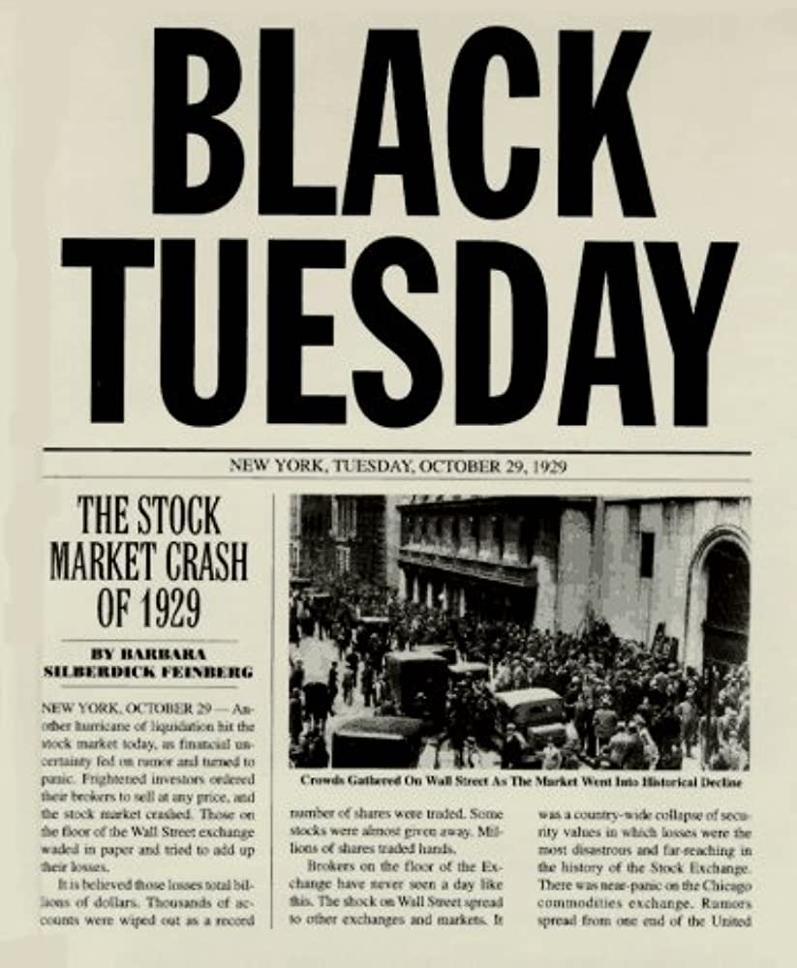
Stock Market Crash
In October 1929, panic took over on Wall Street.
During the Black Monday and Black Tuesday (28th and 29th of October), the stock market lost 25% of its value.
Notes:
Description of the Figure: Here the stock market can be expressed in terms of the Dow Jones Industrial Average. This indicator increases steadily until it crashes in October 1929.

Slide 6
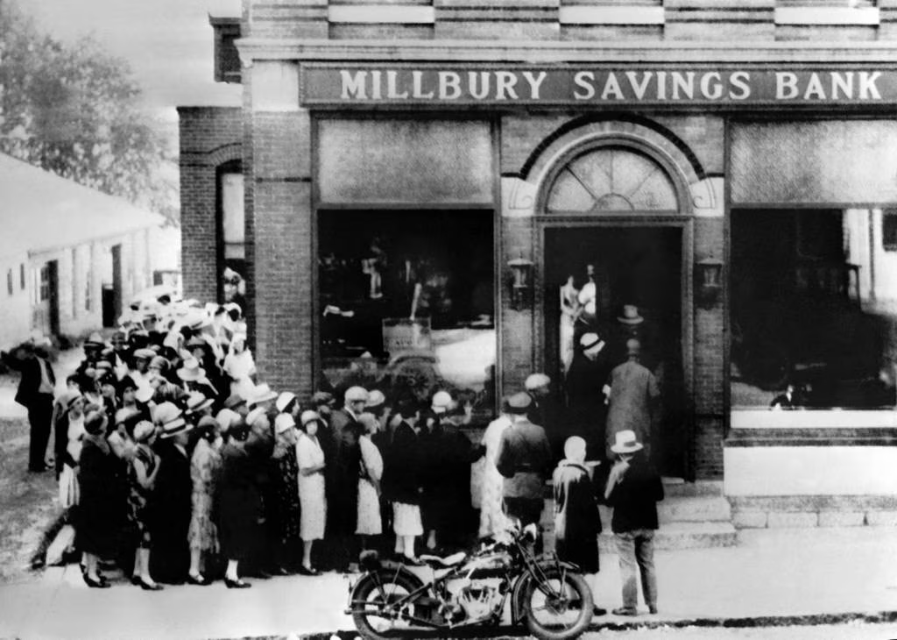
Banking Crisis
Notes:
The change in the price of stocks induced a major banking crisis.
The quantity of money at year-end 1933 was 33 percent less than that in 1929.
It induced bankruptcies and the disappearance of nearly half of American financial institutions.

Slide 7
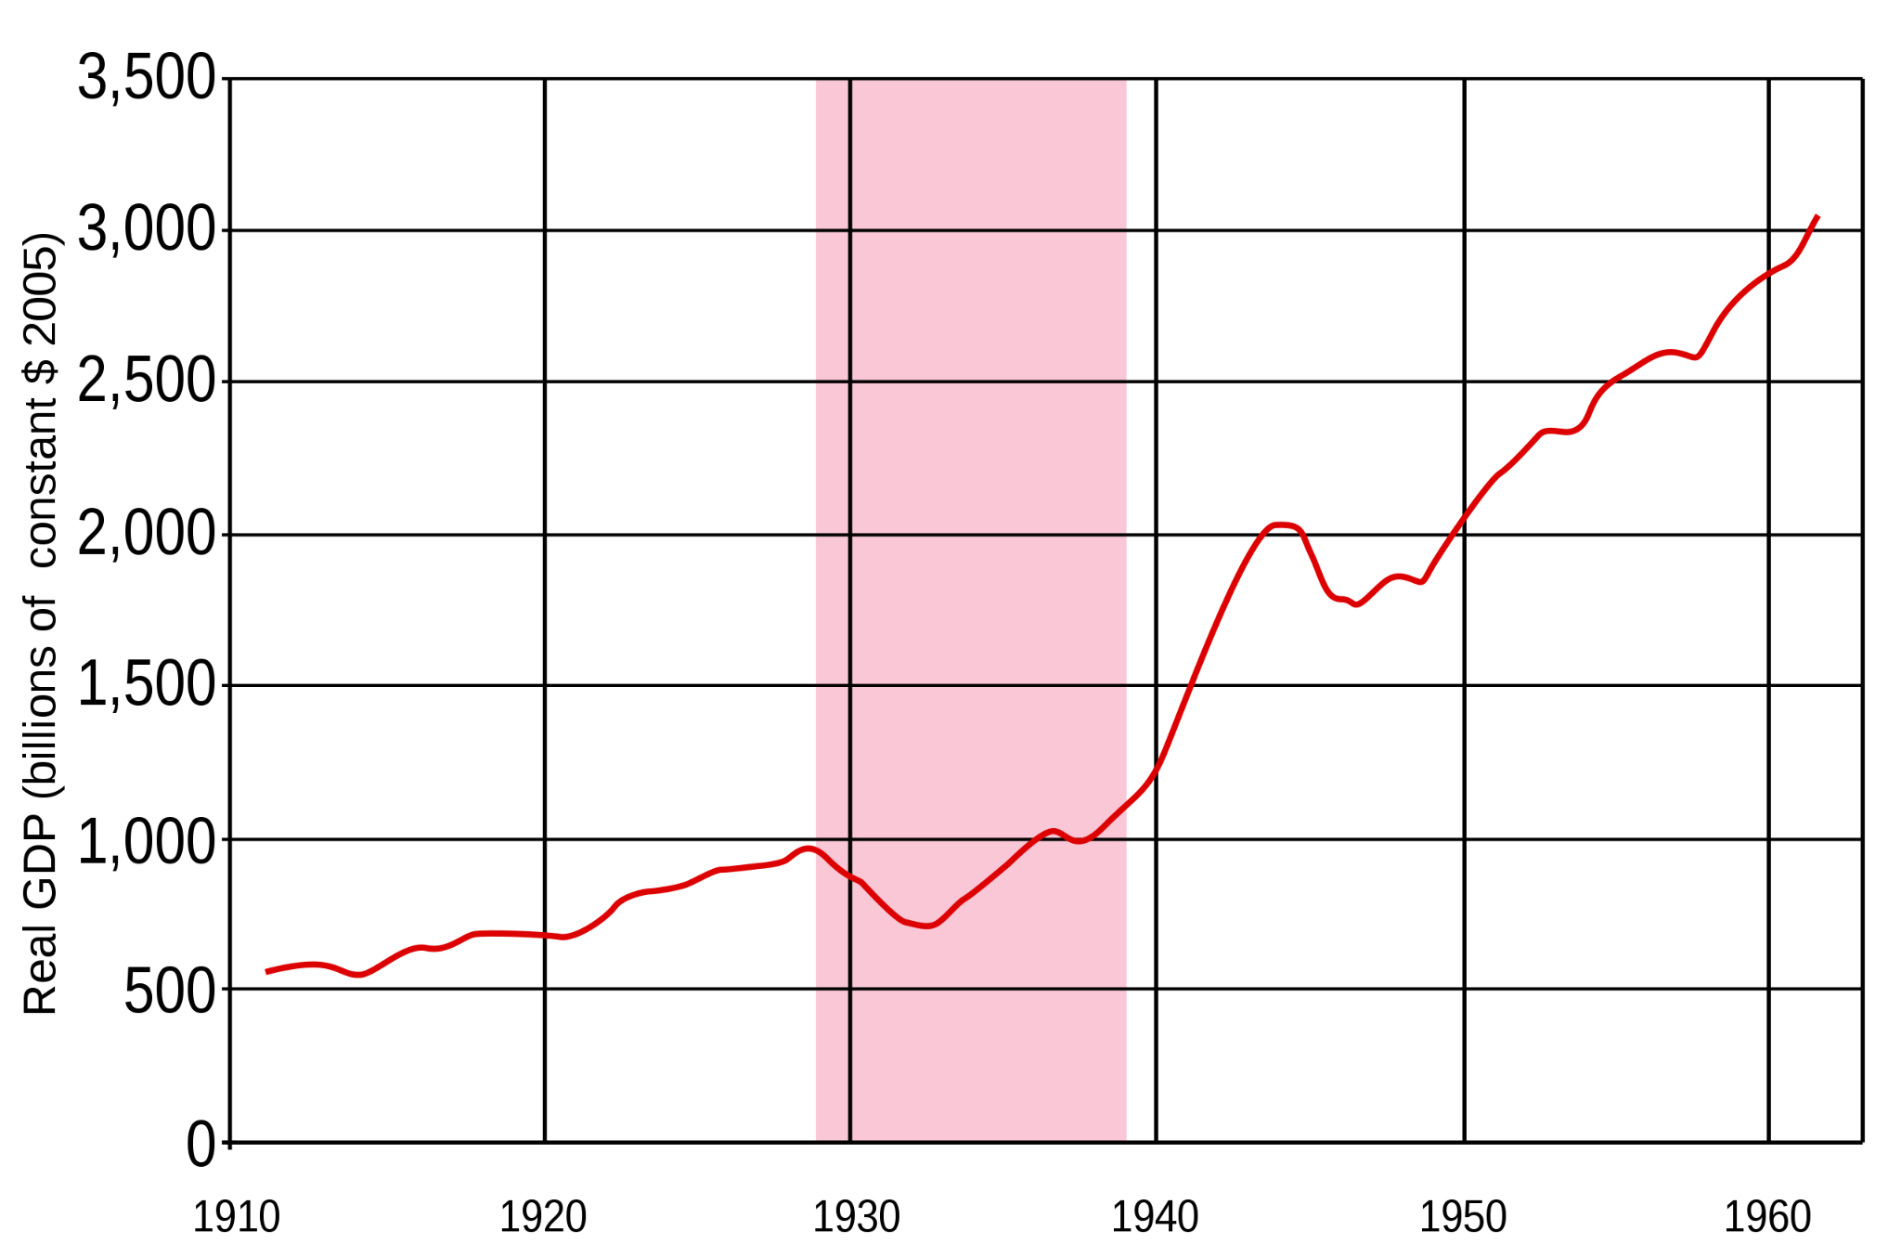
Production Stoppage
US Real GDP, annual, 1910-1960
Great Depression (1929–1939)
Notes:
Between 1929 and 1932, world GDP fell by an estimated 15%.

Slide 8
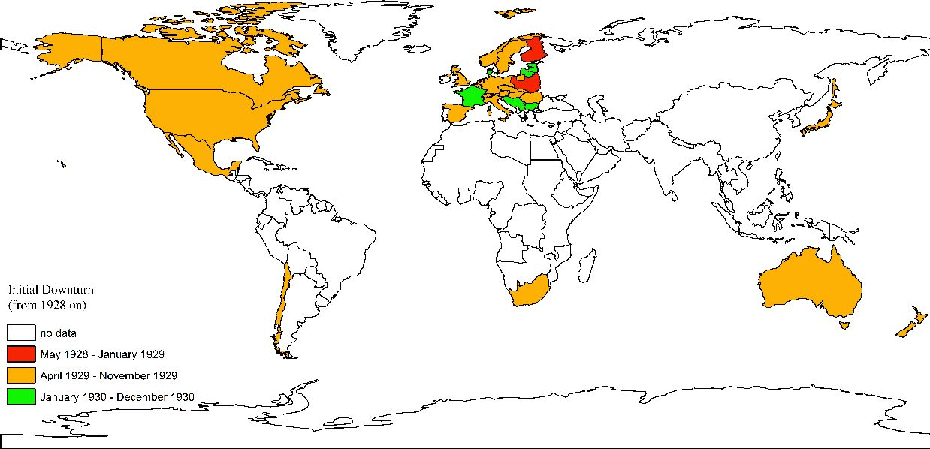
International Contagion
Notes:
A key feature of the Great Depression is that virtually every industrial country experienced a severe contraction in production and a terrible rise in unemployment.
It spreads fairly rapidly in the year 1928, 1929 and 1930.
Source for the figure: Albers, Thilo N. H. and Martin Uebele. “The global impact of the great depression.” LSE Research Online Documents on Economics (2015).
About the figure: It represents the international contagion at the Start of the Depression in 30 countries for which historical data were found by the authors Albers and Uebele (2015).

Slide 9
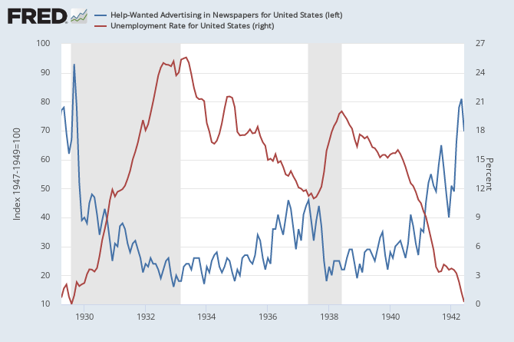
Prolonged Unemployment
Unemployment in the United States reached 25%.
Notes:
Businesses stopped hiring.

Slide 10
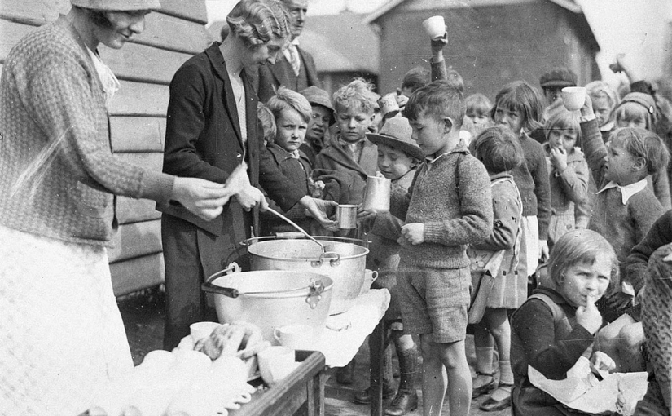
Mass Poverty
Notes:
African Americans were the first people to be laid off and they suffered an unemployment rate that was initially double that of white Americans. By 1932, the district of Harlem in New York had an unemployment rate of 50%.
Desperate, hungry and impoverished people had no option but to go to 'Soup Kitchens', established by charities where food, mostly soup and bread, was served to the hungry. Soup kitchens provided food as many as 3000 hungry people every day serving breakfast, lunch and dinner. The Soup kitchens were set up in churches or any places suitable as service centers.
Source photo: https://cmvtcivils.wordpress.com/2015/09/05/did-the-1930s-depression-cause-ww2/

Slide 11
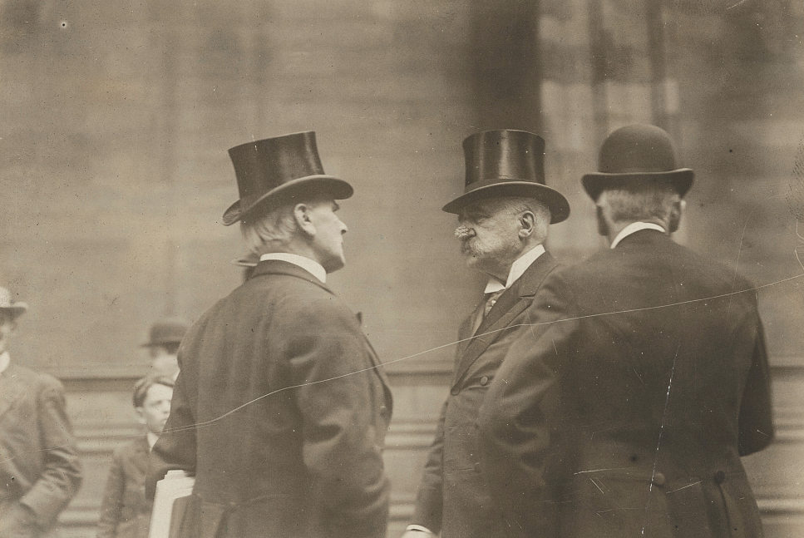
Responses to the Crisis
Free Market
Balanced Budget
Increase interest rates
Trade barriers
Notes:
Most of the governments decided to leave market mechanisms solve the crisis.
Source of the image: https://www.loc.gov/item/96508845/ The photography features JPMorgan

Slide 12


Discussion Time!
Were the responses to the covid crisis similar to the responses to the Great Depression?
Which policies were implemented? Did they reduce poverty and unemployment?
Notes:
Instruction: You can invite the students to participate and comment to the whole group or divide them in smaller groups.

Slide 13
The (general) theory of Keynes
1936

Slide 14
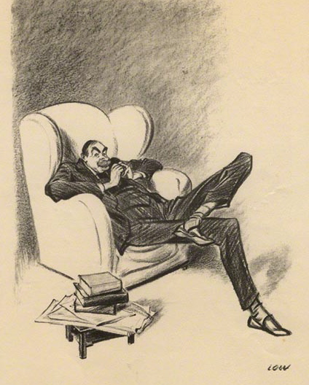
Fierce opponent of laissez-faire
Keynes argued in favor of administered markets. For him, active state interventions lead to better outcomes for society as a whole.
But, why?

Slide 15

Effective Demand
Keynes introduces the principle of effective demand, which is the assumption that the level of production depends on economic agents' decision to spend.

Slide 16
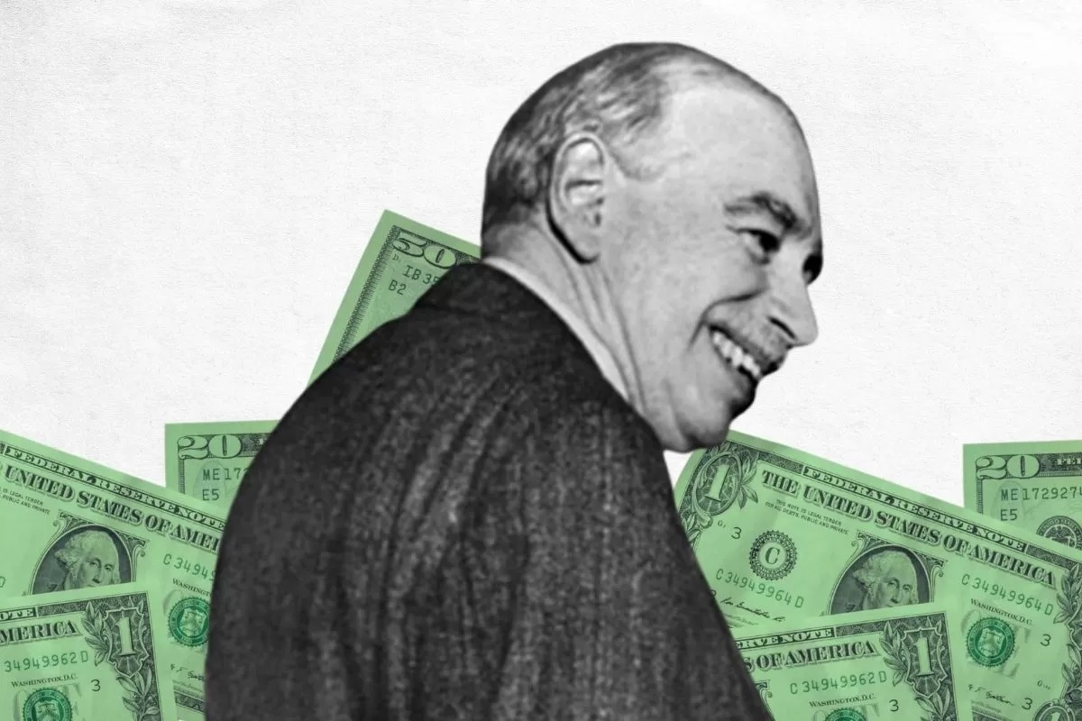
Paradox of Thrift
Traditionally, economists thought a country would get richer if it saved more.
Keynes argued that too much savings could actually be a problem.
If no one is willing to buy what an economy produces, the result is a Depression.

Slide 17
What drives growth?
Good Expectations
Entrepreneurs think business will be strong in the future
Demand and Growth
High Investment
Investments drive increased demand, boosting economic growth
Businesses invest heavily to be prepared to make big profits in the future
Notes:
According to Keynes, investment decisions depend on the expectations of entrepreneurs about the future. For example, if firms are confident about the future state of the economy, then they will invest as they expect their goods will be sold.
Investment will then raise the level of effective demand, and, in turn, increase employment.

Slide 18
What harms
growth?
Bad Expectations
Entrepreneurs think business will be weak in the future
Crisis and Depression
Low Investment
Total demand falls and the economy slows. Some businesses might fail.
Businesses stop investing to prepare for bad times

Slide 19
But the future is uncertain.
Good Expectations
Entrepreneurs think business will be strong in the future
Demand and Growth
High Investment
Investments drive increased demand, boosting economic growth
Businesses invest heavily to be prepared to make big profits in the future
Notes:
Entrepreneurs can’t know for sure if the economy will do well in the future, or if a big crisis is right around the corner.

Slide 20
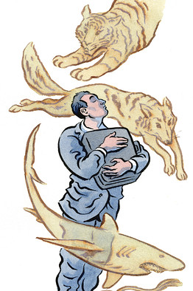
Expectations are unstable because they are based on psychological factors. Keynes called Animal Spirits this psychological aspect of investment decisions by firms.
On the Black Tuesday, expectations crumbled and resulted in a panic in the financial market, leading to the Great Depression.

Slide 21
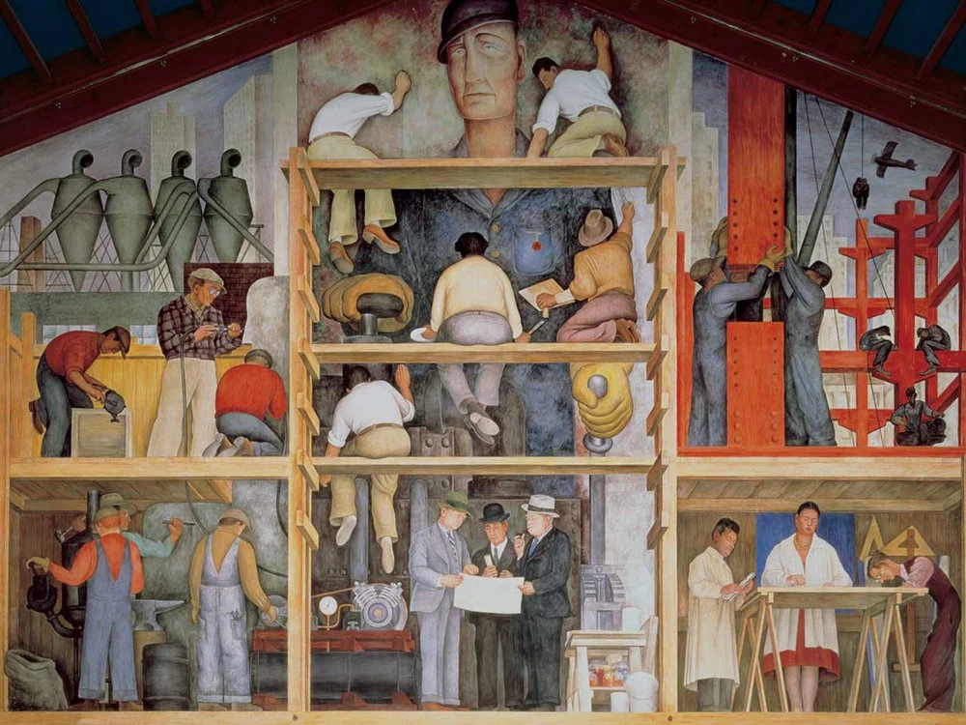
Government investment
If businesses don’t want to invest enough to keep the economy going, the government can step in to help.
Notes:
Image from Diego Rivera

Slide 22
Expansion of the State
1940s - 1960s

Slide 23
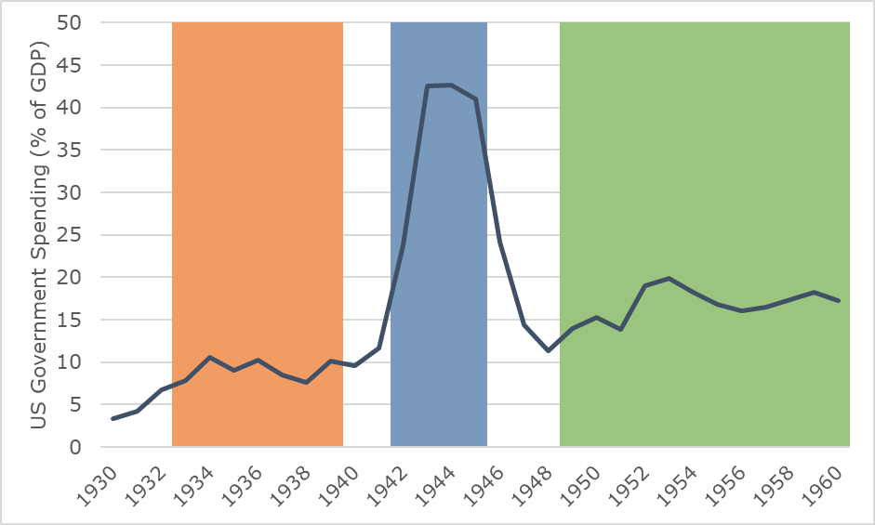
Growth of government spending
USA in World War II
Rise of
Welfare State
New Deal
Notes:
During the Great Depression, the size of the United States federal government increased substantially. This was followed by a massive increase during the American involvement in the Second World War. While spending dropped immediately after the war, it picked up quickly in the late 1940s and 1950s.
Data Source:
https://www.presidency.ucsb.edu/statistics/data/federal-budget-receipts-and-outlays

Slide 24
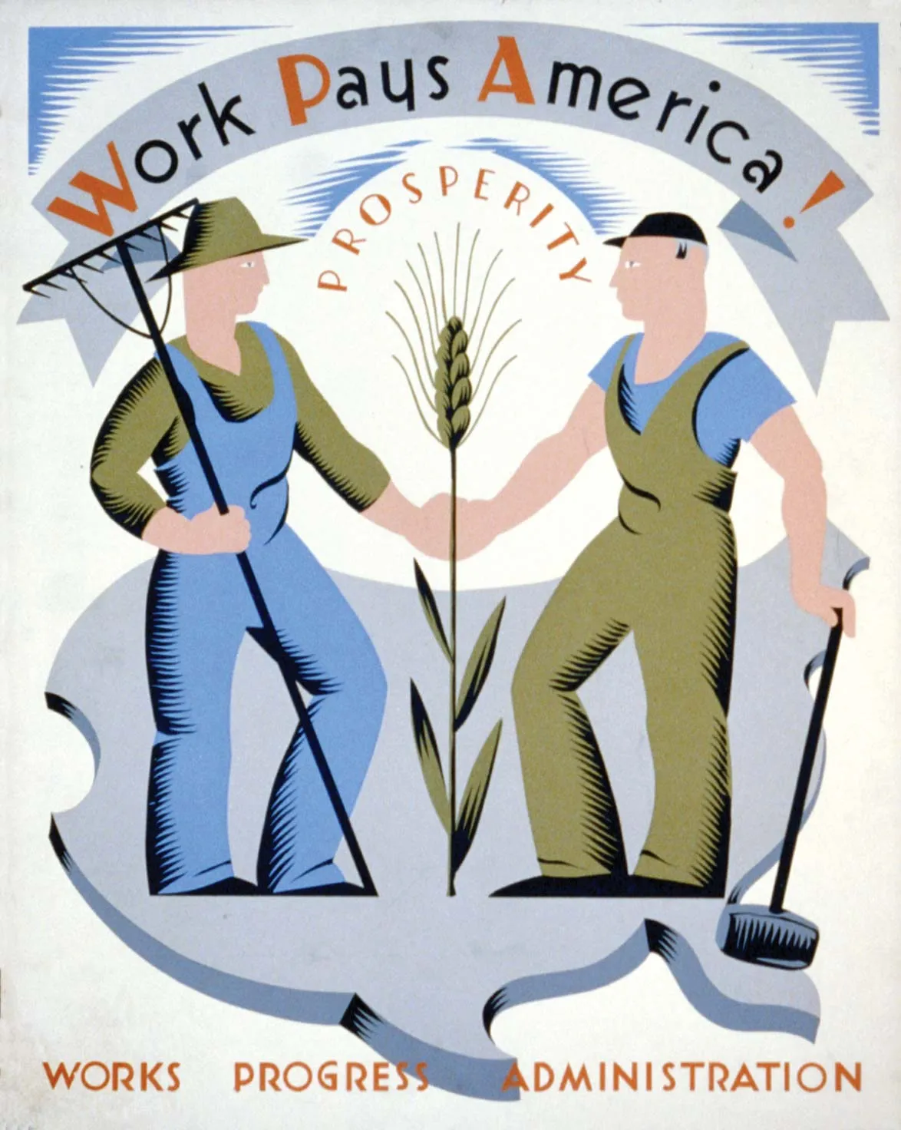
New Deal
The New Deal was a series of government programs designed to increase investment and put Americans back to work.

Slide 25
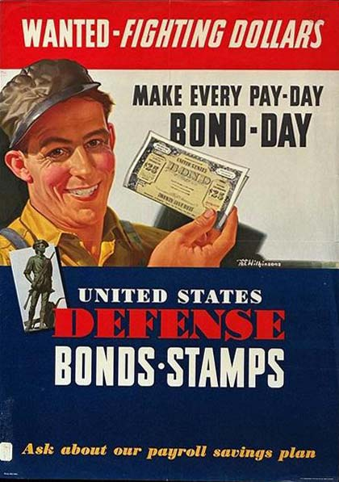
World War II
When the United States entered the World War, the government borrowed money and invested massively in the war effort.

Slide 26
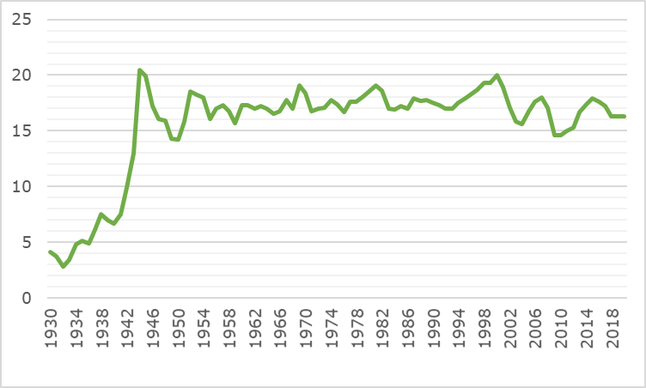
Rise of the Welfare State
The phenomenal expansion of state intervention was characterized by an increase in state spending, both on social programs and on support for the private sector.
Source: U.S. Federal Government Revenues 1930-2022 (% of GDP)
Notes:
There was a large fear that when the Second World War ended, the global economy would return to the Great Depression. This did not happen, as levels of government spending stayed very high compared to their levels before the war.
Data Source:
https://www.presidency.ucsb.edu/statistics/data/federal-budget-receipts-and-outlays

Slide 27
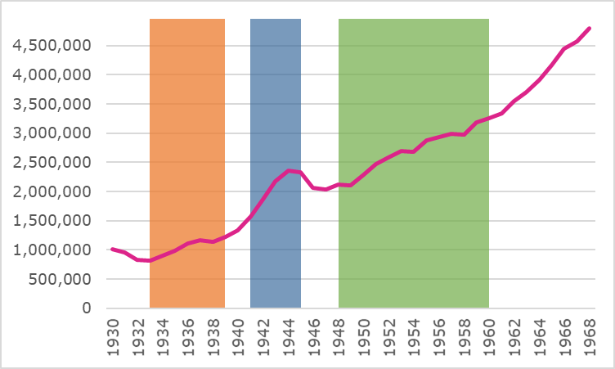
Recovery of economic growth
New Deal
USA in World War II
Rise of Welfare State
US Government Spending, 1930-1960
US Real GDP, 1930-1970
(millions of 2012 dollars)
Notes:
Throughout the War and in the years after, Gross Domestic Product in the USA increased steadily. There was no return to a second Great Depression after war mobilization ended.
Data Sources:
https://www.presidency.ucsb.edu/statistics/data/federal-budget-receipts-and-outlays
https://www.measuringworth.com/datasets/usgdp/result.php

Slide 28
Stagflation and Energy Crises
1970s

Slide 29
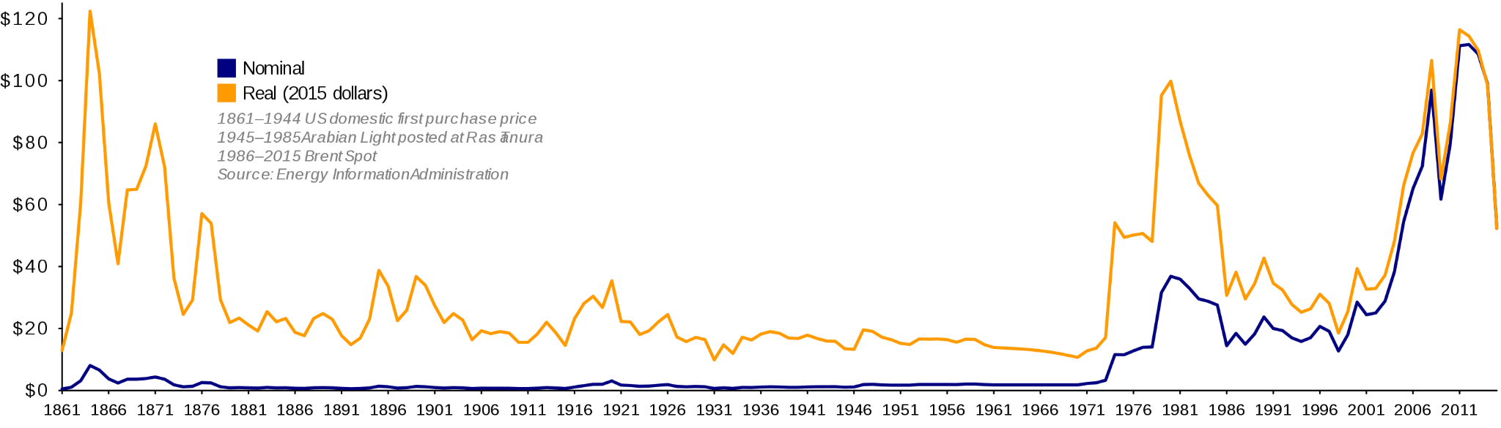
Oil prices spike in 1970s
Iranian Revolution
Arab-Israeli conflict
Notes:
Oil prices spike in 1970s was caused by two specific events, the 1973 Arab-Israeli war and the 1979 Iranian revolution. Both events sent global oil prices soaring, and disrupted global markets which had come to rely on a cheap and stable supply of oil from the Middle East.
https://en.wikipedia.org/wiki/1970s_energy_crisis#/media/File:Oil_Prices_Since_1861.svg

Slide 30
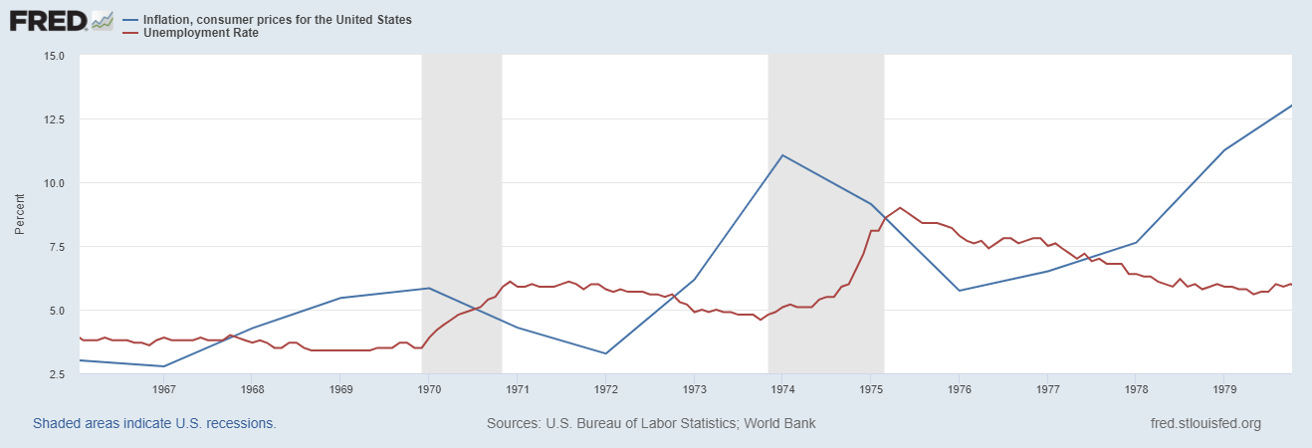
Stagnation+Inflation =
Stagflation
High Inflation
High unemployment
Inflation
Unemployment
Notes:
Throughout the 1970s, inflation became a problem in the United States and Europe. This was combined with a number of recessions which led to both high unemployment and high inflation at the same time, a situation called stagflation.

Slide 31
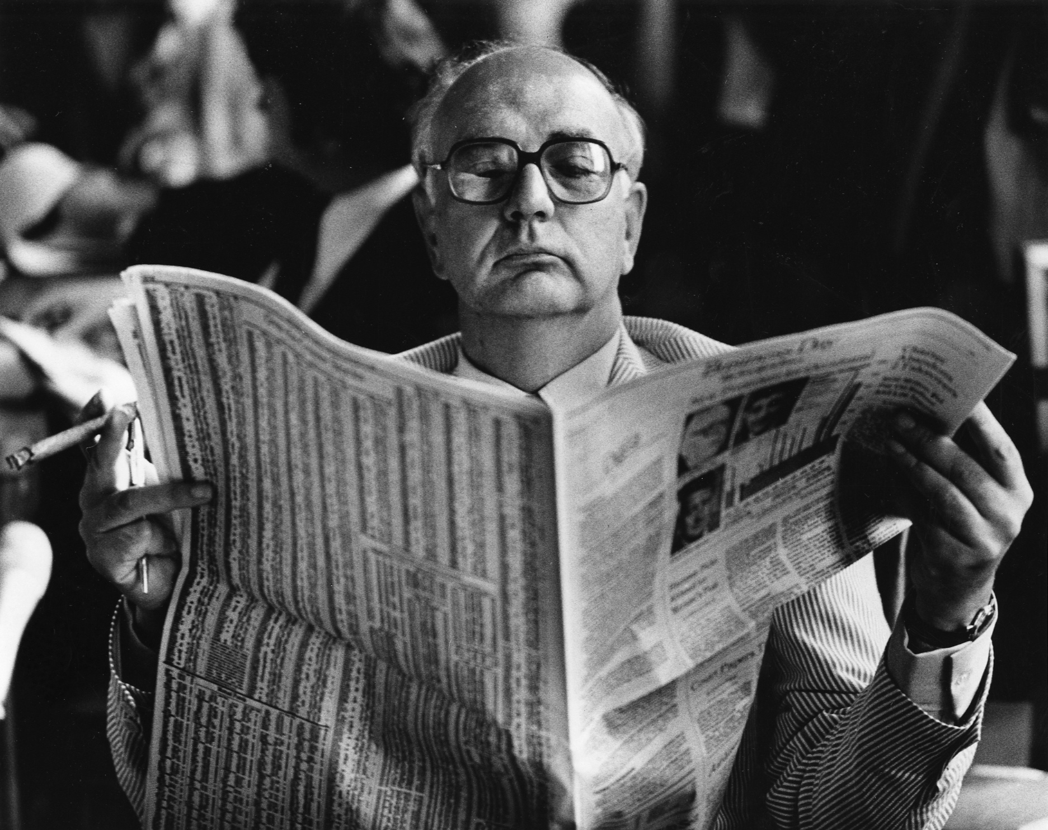
How to fight stagflation?
Increasing cost of oil drove up prices and caused recessions in the 1970s.
This was different from the crisis of the 1930s when there was not enough investment and demand.
Chairman of the US Federal Reserve Paul Volcker studies his options
Notes:
During the Great Depression and Post-War period, governments could manage the unemployment rate by increasing or decreasing their amount of spending. This wasn’t an exact science, but it worked well enough that by the 1960s even conservatives like Milton Friedman and Richard Nixon could say that "We are all Keynesians now".
However, this formula broke down in the 1970s with the energy crisis and spike in inflation. It was no longer clear that governments could control unemployment without driving prices even higher. This led to a new policy response (the Volcker shock) and a shift in economic theory away from traditional Keynesianism.

Slide 32
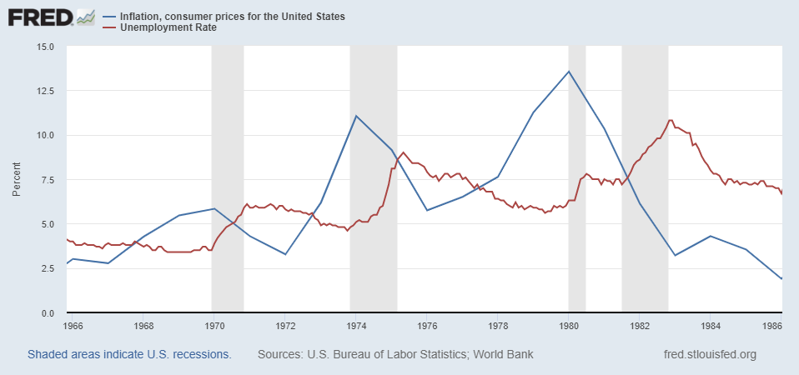
Solution:
Stop inflation
A massive spike in interest rates in the United States controlled inflation but worsen unemployment.
Inflation
Unemployment
Notes:
The response to stagflation in the USA was the so called Volcker Shock, where the Federal Reserve dramatically increased interest rates to stop inflation. This caused a large spike in unemployment, but did succeed in lowering inflation. The tradeoff is still controversial.

Slide 33
Crisis and you!?
21st Century

Slide 34
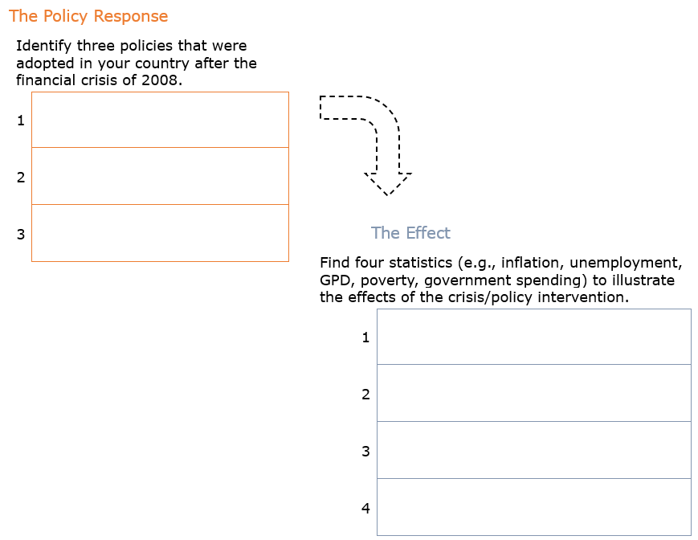
Activity.
Policy response to the Great Financial Crisis

Slide 35
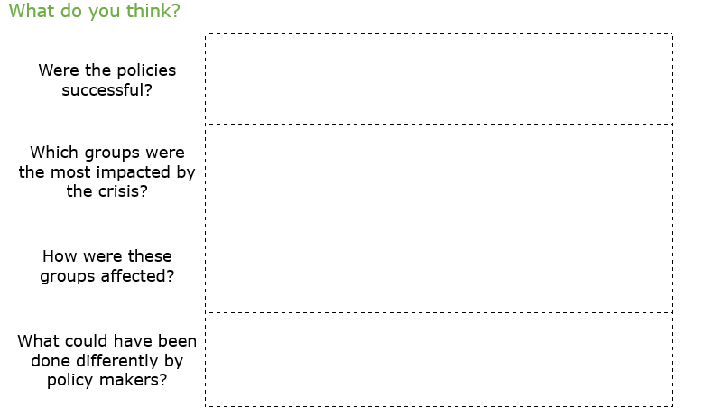
Activity. Policy response to the 2008 Global Financial Crisis

Slide 36
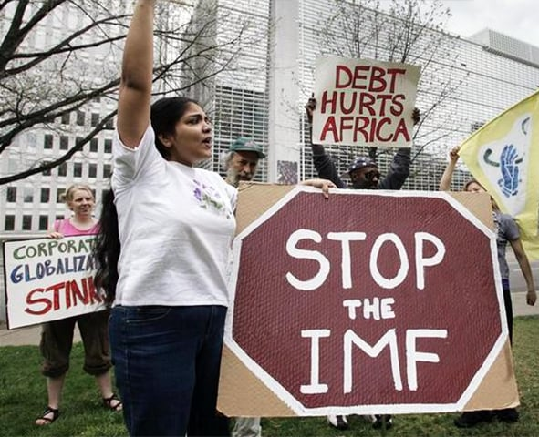
Optional: Homework
Repeat this activity for a different economic crisis that happened after 1980 in a country other than your own.
Write your results in an approximately 500-word essay.

