Slide 1
World Cup in
This month in the Economy

Slide 2
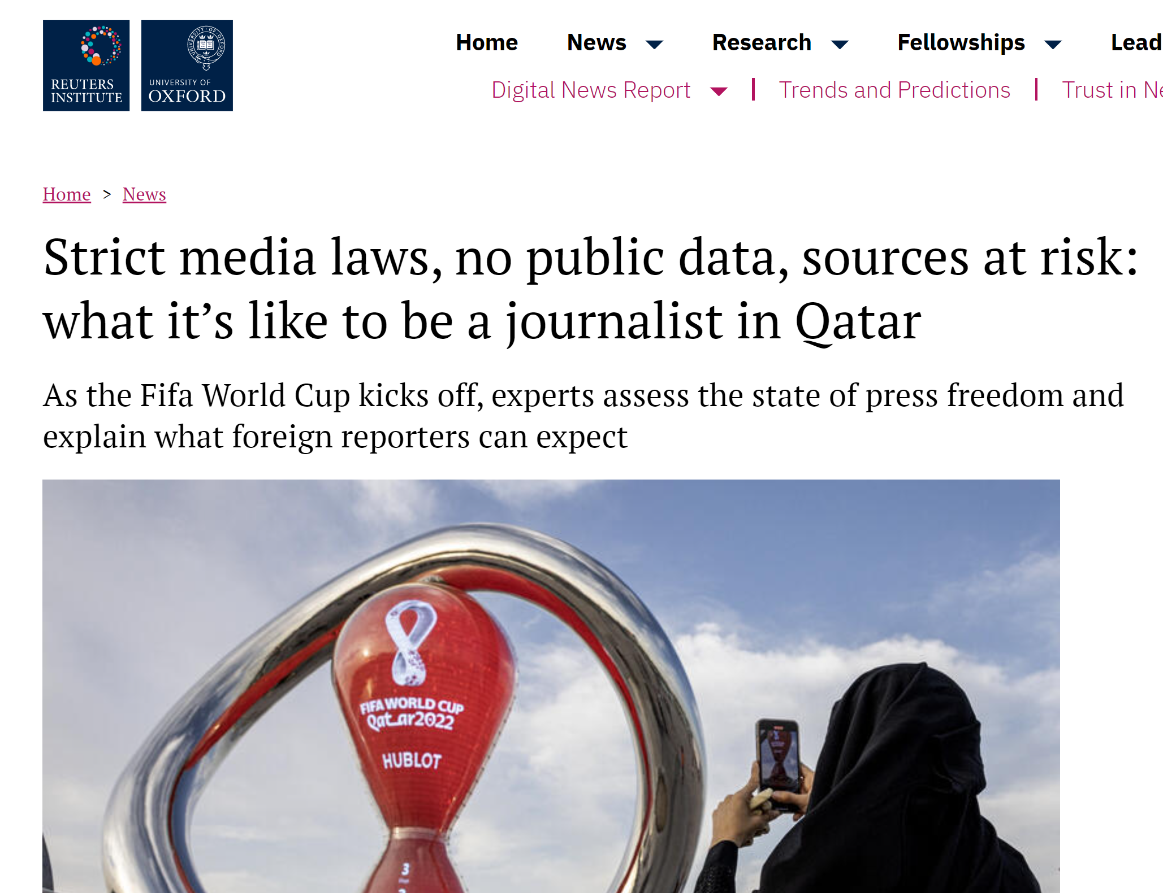
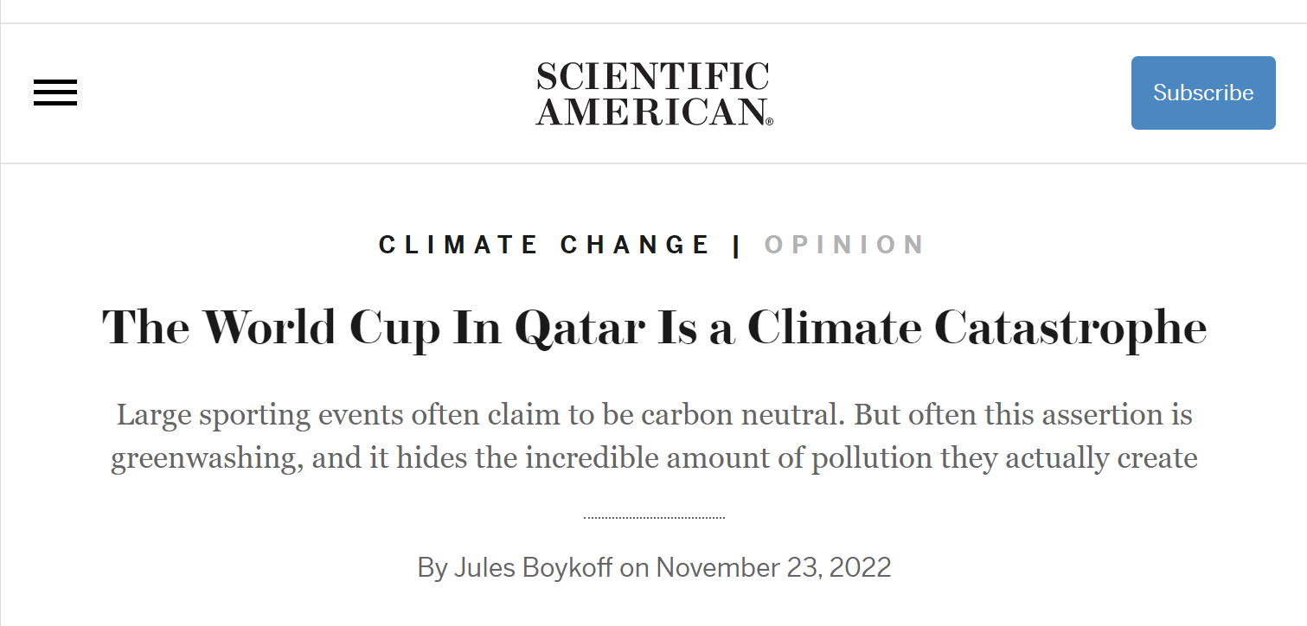
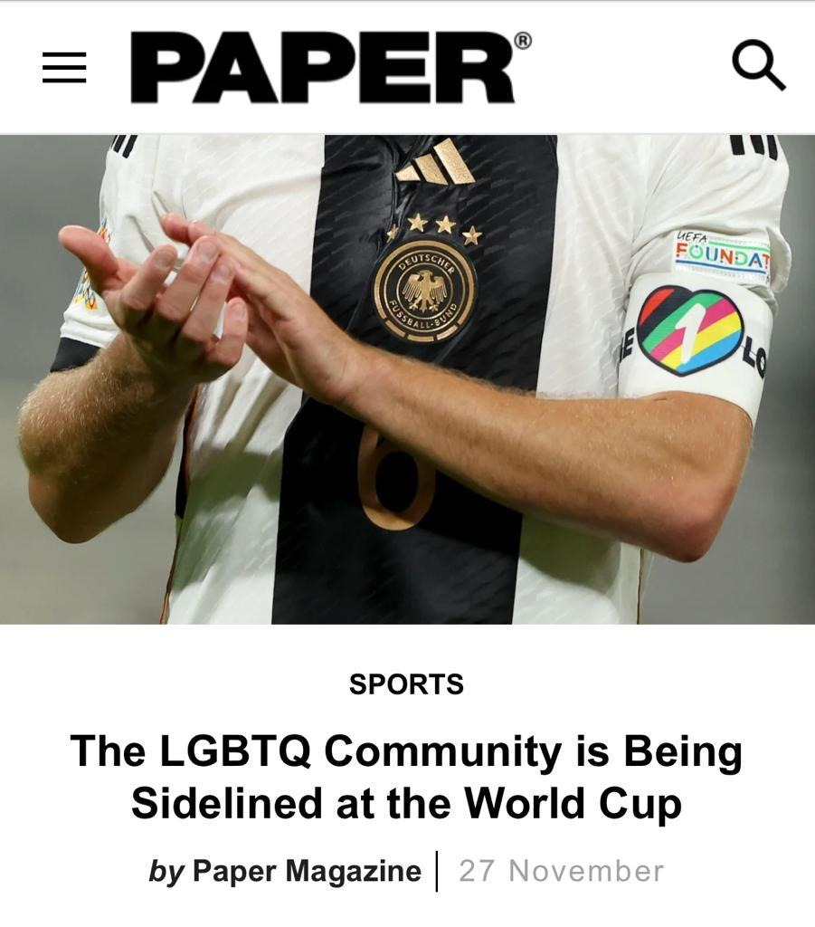
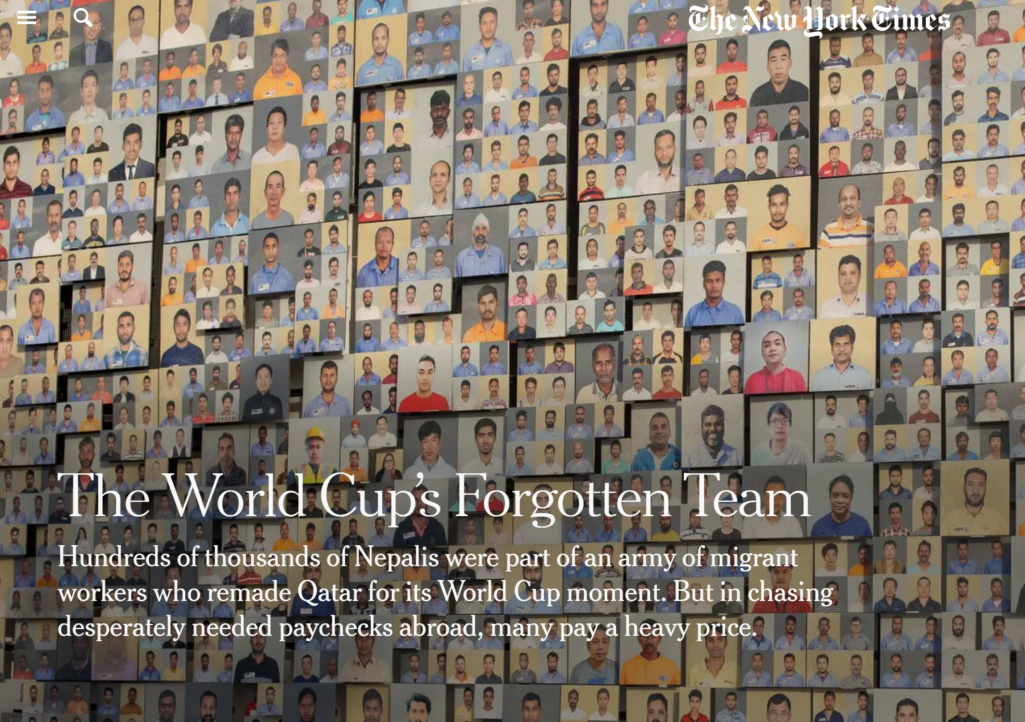
Environment
Free Press
The controversies
Workers’
Human Rights
LGBTQ+
Notes:
Environment : https://www.scientificamerican.com/article/the-world-cup-in-qatar-is-a-climate-catastrophe/?amp=true
LGBTQ+: https://www.papermag.com/fifa-world-cup-lgbtq-qatar-2658787626.html?rebelltitem=5#rebelltitem5
Work : https://www.nytimes.com/2022/11/16/sports/soccer/world-cup-migrant-workers.html?smid=nytcore-ios-share&referringSource=articleShare
Journalist: https://reutersinstitute.politics.ox.ac.uk/news/strict-media-laws-no-public-data-sources-risk-what-its-be-journalist-qatar

Slide 3
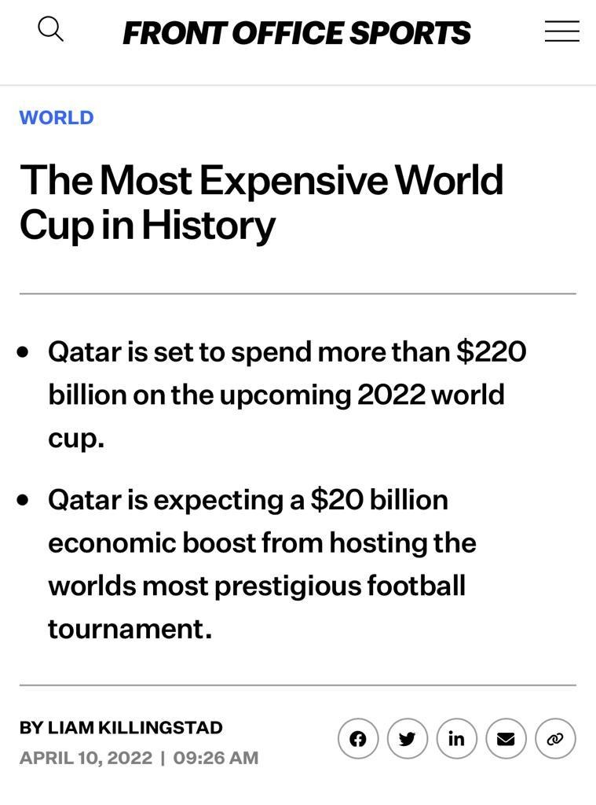
Why did Qatar do it?

Slide 4
Discuss why Qatar hosted the World Cup:
What are the costs of hosting the World Cup? Identify at least 3 types of cost.
What are the benefits of hosting the World Cup?
Identify at least 3 types of benefit.

Slide 5
Who wins and who loses?
For each cost, write who will pay.
For each benefit, write who will gain.
How do you think the decision was made? Do you think some groups worked together for Qatar to host the Cup? To resist it?
Notes:
Some groups might consider the decision of Qatar to bid to host. Other might look at the decision of FIFA to host in Qatar. Both are fine!

Slide 6
Highlights of the match:
You can’t always put a dollar amount on every cost or every benefit.
The sum of cost and benefit does not always predict the outcome.
Different groups will benefit (or suffer) from any activity: these groups shape who wins and who loses!

