Slide 1
Space & Agriculture
This Month in the Economy Exercise

Slide 2
Learning objectives
Understanding the basic workings of satellite crop monitoring and commodity futures.
Understanding what financialization is and reflecting upon it.

Slide 3
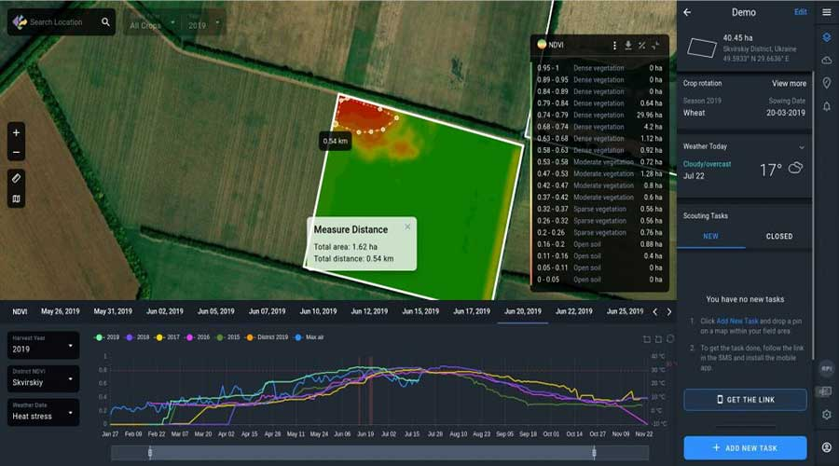
Modern technologies used by farmers
Autonomous
self-driving tractors
Drones
Satellites
Notes:
Source image: https://itechiteasy.com/satellite-crop-monitoring/

Slide 4
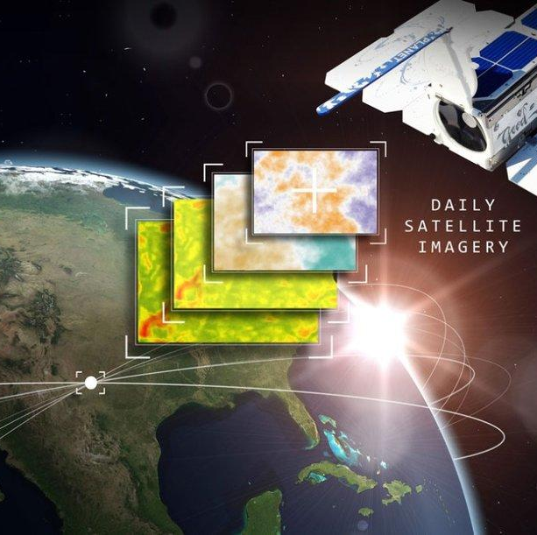
Satellite crop monitoring: What is it?
Real-time digital crop monitoring based on the observations of fields by satellites.
This is a quicker and less labour-intensive way of monitoring when compared to normal assessment methods, where people visit the fields physically to make observations.
Notes:
Source image: https://www.agcanada.com/daily/farmers-edge-expands-satellite-imagery-offering

Slide 5
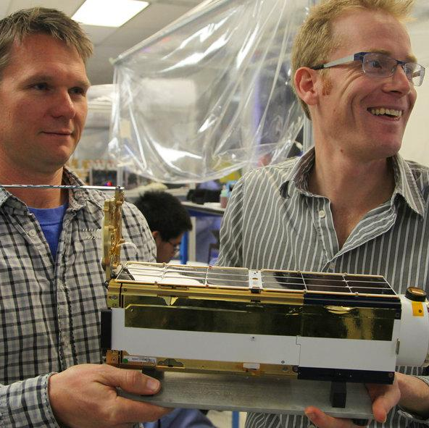
A key provider: Planet Labs
Headquarters in Silicon Valley (US California)
Founded in 2010 by former NASA scientists
Initially financed by venture capital
Since 2021 publicly traded on the New York Stock Exchange (Wall Street) with a total equity value of $1.3 billion as of Oct 2022.
As of 2021 roughly:
  200 satellites
  500 employees
  700 customers
  $130 million revenue
  $50 million gross profit
Notes:
Source image: https://www.eoportal.org/satellite-missions/planet#spacecraft

Slide 6


Satellite crop monitoring: What is it used for?
Real economy: Helping farmers and machinery producers to manage crops and predict harvest times and yields.
Financial economy: Helping business owners, investors, insurance companies, and financial traders and brokers to predict revenues, capital requirements, risk assessments, and market trends.
Notes:
Sources images:
https://toppng.com/free-image/farmer-icon-PNG-free-PNG-Images_125717
https://www.iconfinder.com/icons/7451746/financial_analyst_analise_money_analysis_icon

Slide 7
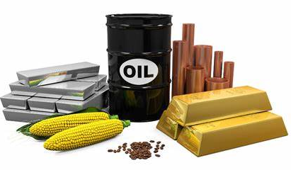
Commodity Futures
Contract to buy, or sell, an agricultural product or raw material at a set price and date in the future.
Trading is rarely done by farmers as the minimum trades are too large for them. Trading is instead done by financial actors and large corporations.
Only 2% of futures contracts end in physical delivery. In the other 98% only money changes hands (FAO US, 2018).
Notes:
Source image: https://www.queensway-academy.com/learn/articles/learn-trade-commodities/

Slide 8
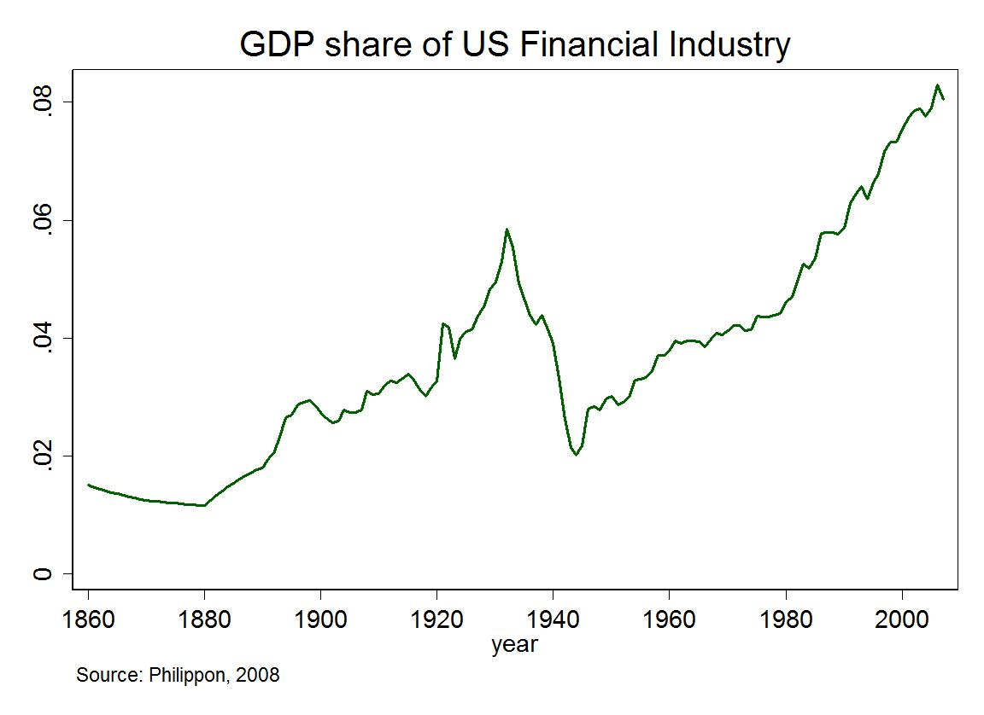
Financialization
Financialization: Increased size and importance of financial activities and entities in an economy in relation to its real economic activities and production.
Example: A house becomes more of a financial investment compared to a home to live in.

Slide 9
Discuss in groups of 3 (or 4)
What is the likely societal impact of using satellites for commodity futures trading?
Think about financialization more broadly, for what financial speculation and trading purposes might other new technologies be used?
  Artificial intelligence
  Biotech
  Digital art
  Internet of things
  Other new technologies: …

