Slide 1
Production and Waste: Plastic Pollution
This Month in the Economy: June 2023

Slide 2
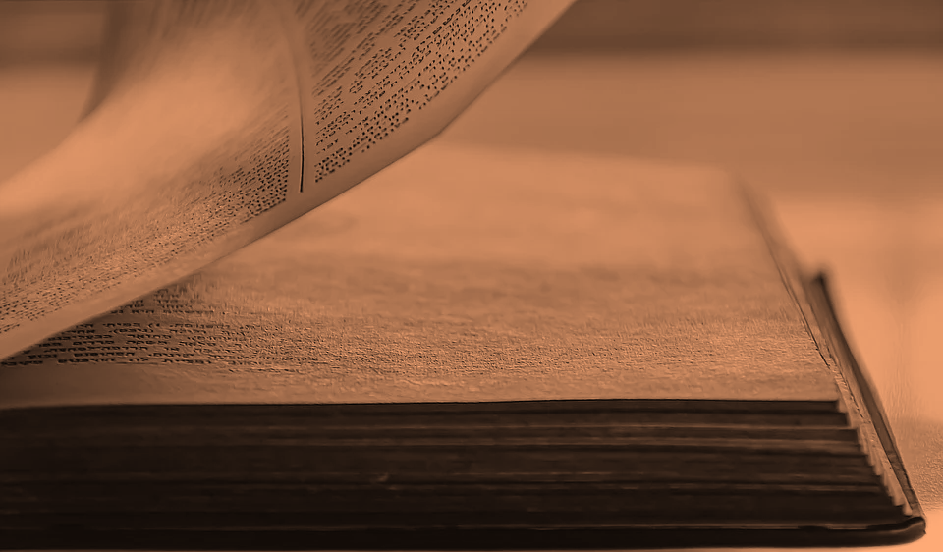
Overview of today’s class
What is a production process?
How are plastic bottle produced?
What alternatives are available?
How can we organise our production differently?

Slide 3

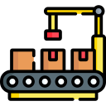
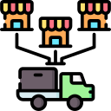

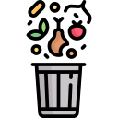

The production process
Extraction
Manufacturing
Distribution
Consumption
Waste disposal

Slide 4



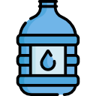
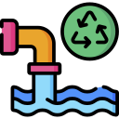
Production of plastic bottles
Extraction
Manufacturing
Distribution
Consumption
Waste disposal

Slide 5
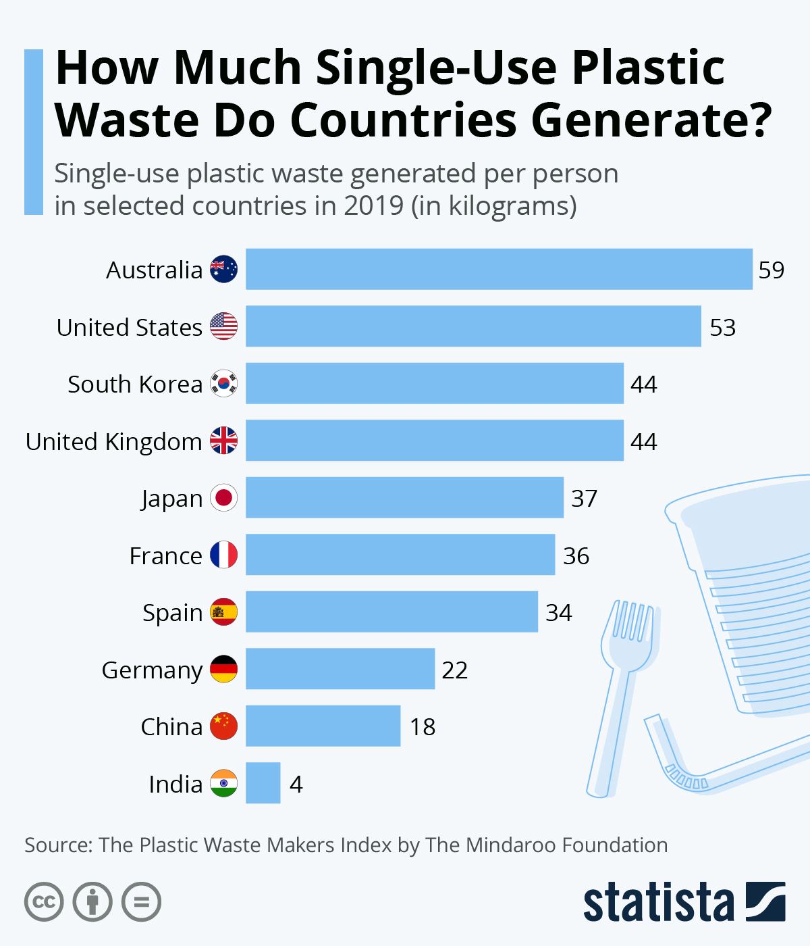
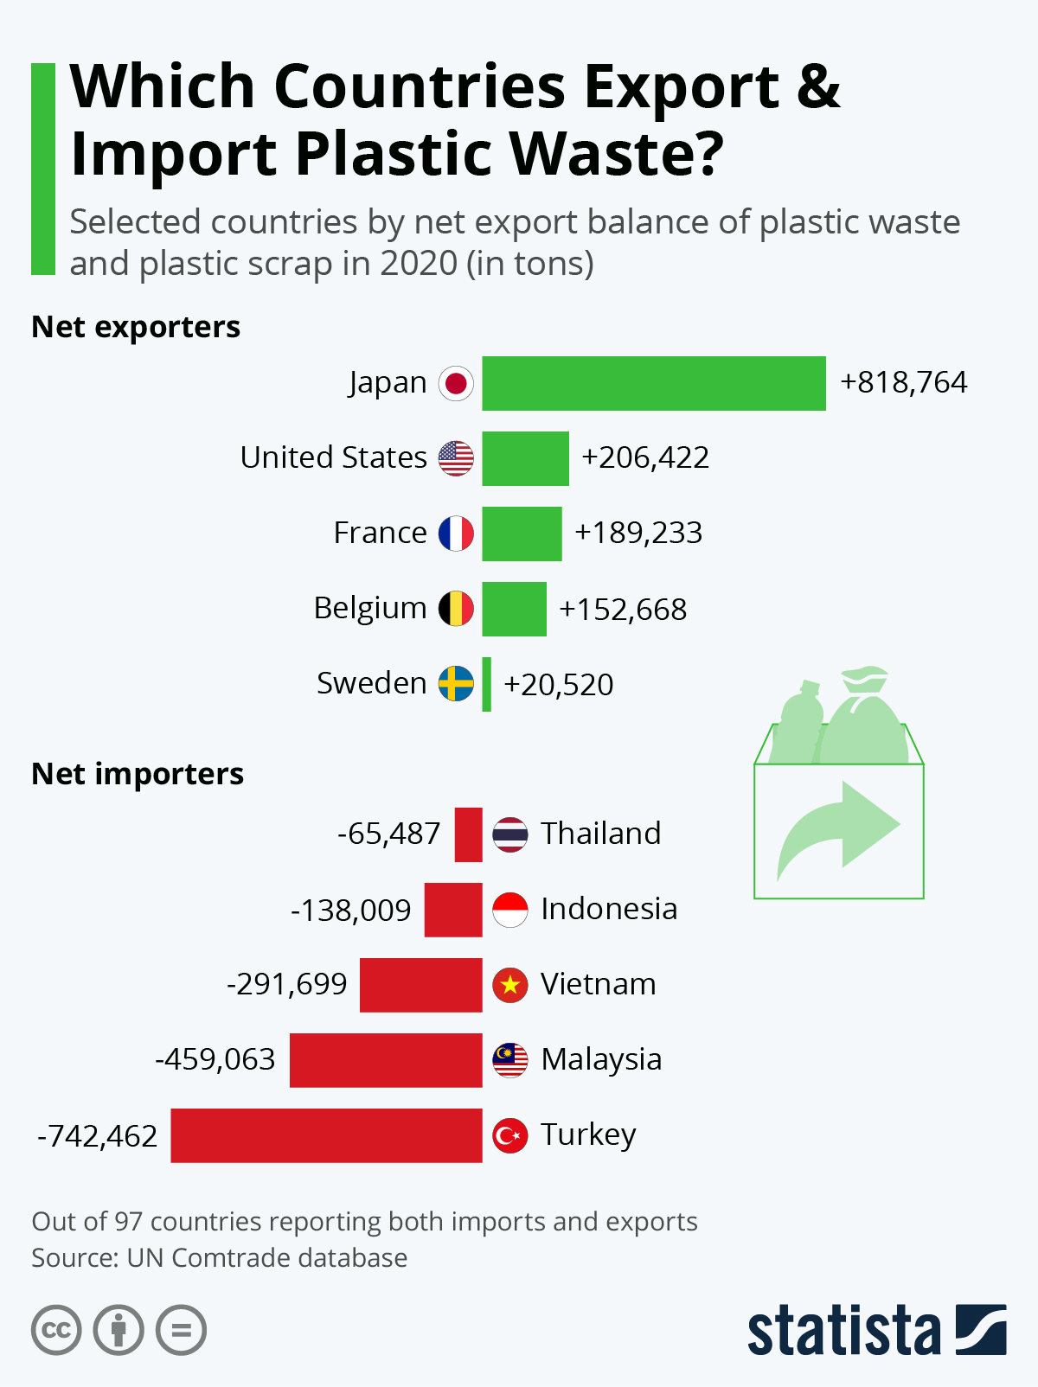

Slide 6
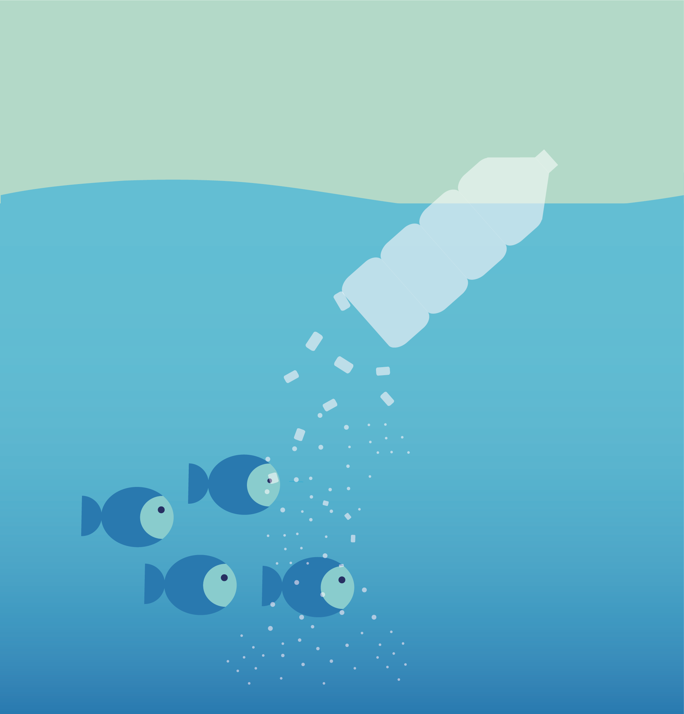
If plastic is not carefully disposed of then it is often washed into the ocean, harming marine wildlife.
Plastic does not decompose like organic materials. Instead it breaks into smaller and smaller pieces, known as microplastics and nanoplastics.
Microplastics and nanoplastics are now found in our food, our drinking water and even the air we breathe – but it is not yet clear if or how they harm us.
Notes:
Image source: https://www.eea.europa.eu/media/infographics/the-breakdown-of-a-plastic/view

Slide 7

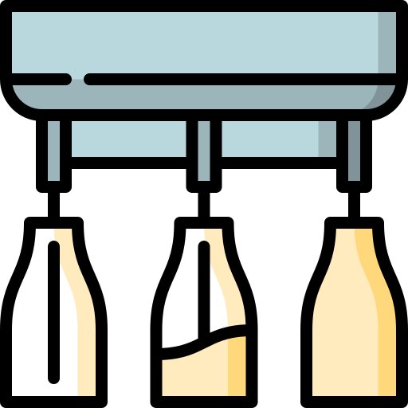
So how do we do better?

Slide 8
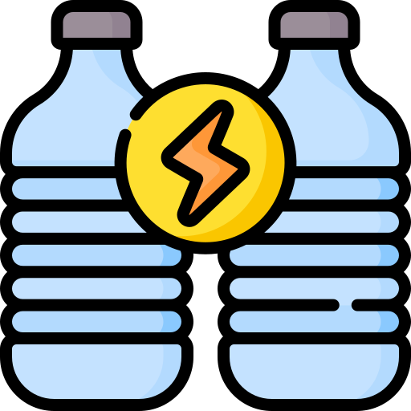

The first task
The Bioplastics Packaging Company approach you with a proposal. In preparation for your meeting with them, make a list of questions covering:
Physical properties
Environmental impact
Financial cost
It may help to think about their production process:

Slide 9
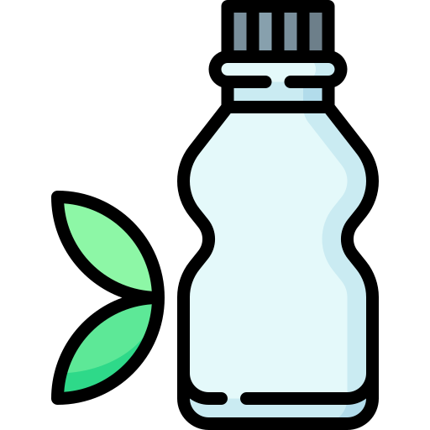
Bioplastics and biodegradability
Bioplastics generally include at least some hydrocarbon-based inputs.
Biodegradable plastics will biodegrade only under certain conditions.
Alternatives still require the extraction of materials and energy use in manufacturing.
Notes:
https://environment.ec.europa.eu/publications/communication-eu-policy-framework-biobased-biodegradable-and-compostable-plastics_en

Slide 10

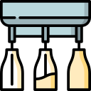
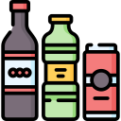
The second task
Bioplastics don’t yet seem to be the solution. So how else can you change your production process?
Extraction
Manufacturing
Distribution
Consumption
Waste disposal

