Slide 1
Meeting Basic Needs
This Month in the Economy Exercise

Slide 2
Learning objectives
Understanding what basic needs are.
Understanding that goods and services can be provided by a range of economic mechanisms.

Slide 3
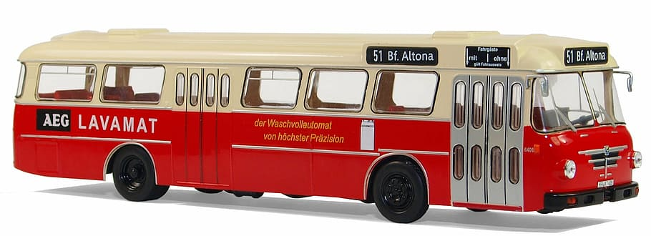
What are basic needs?
The minimum resources necessary for long-term wellbeing.
Notes:
Source images: https://www.clipartmax.com/middle/m2H7d3b1b1G6i8H7_clothes-clipart-green-sweater-clipart/
https://vector.me/browse/122138/my_house_clip_art
https://www.stockio.com/free-clipart/lunch-box
https://www.wallpaperflare.com/red-and-white-bus-clip-art-model-buses-bussing-type-senator-12-d-wallpaper-zulid
https://publicdomainvectors.org/en/free-clipart/Stack-of-books-vector-clip-art/75624.html

Slide 4
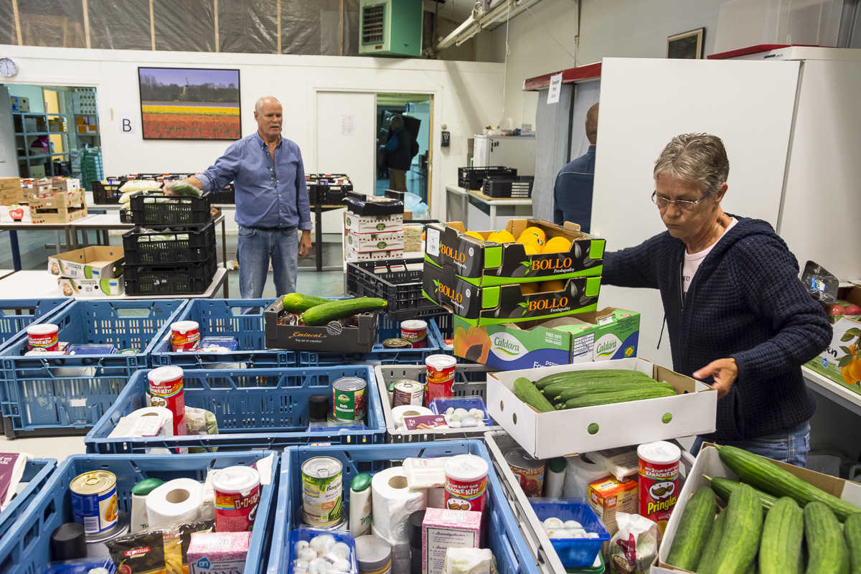
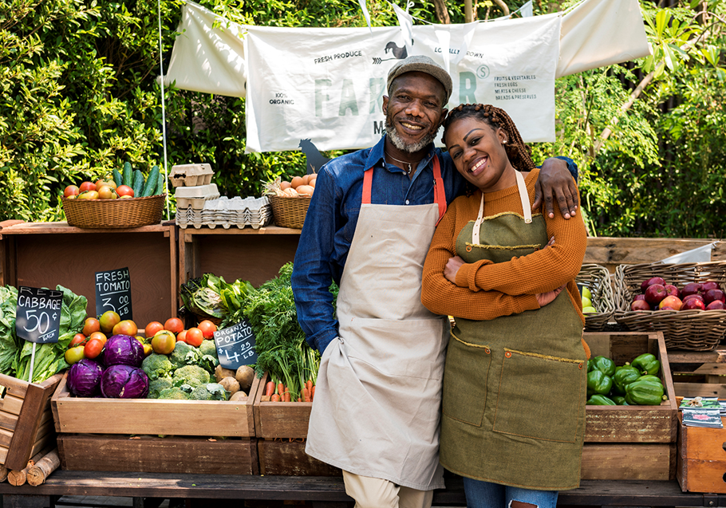
How do we provide for our basic needs?
?

Slide 5
State
Market
How do we provide for our basic needs?
There are different ways, which fit for different circumstances.
Community
Householding

Slide 6
State
Market
This includes different welfare policies like the food stamps or food banks provided by the State.
This includes grocery stores, supermarkets and restaurants. They are often organised as subsidiaries of large companies.
This includes communal food banks, where households with spare food share it with households that don’t have enough.
Some families aim to produce the food themselves. Being self-sufficient takes knowledge and skills.
Community
Householding

Slide 7
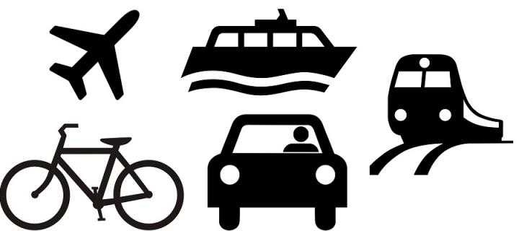
Healthcare
Childcare
Housing
Heating
Transport

Slide 8
Group exercise
Ways to provide for the basic need | What are the constraints to implementing it in practice? | Which social groups are more likely to benefit?
Householding
Community
Market
State

