Slide 1
Market Design: Cannabis in Germany
This Month in the Economy: May 2023

Slide 2
Overview of today’s class
Setting the scene
A very short introduction to market design
How other drug markets are designed
Exploring the options for the cannabis market
Reflecting on our design choices

Slide 3
Germany’s path to legalisation
10th January 2022
26th October 2022
12th April 2023
1st May 2023
The justice minister states that legalisation guidelines are being drafted.
The health minister publishes the framework for legalisation, including the sale of cannabis to over 18s at licensed establishments.
The health minister announces a change to the government’s legalisation plans, with “social clubs” replacing licensed shops.
Legalisation of cannabis has not yet been implemented, with the possibility of further changes to the design of the cannabis market.

Slide 4
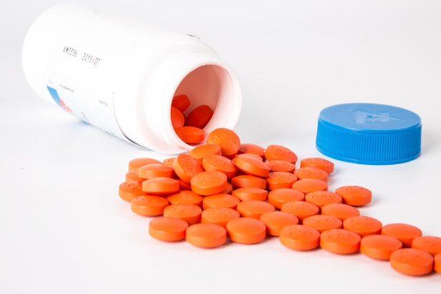
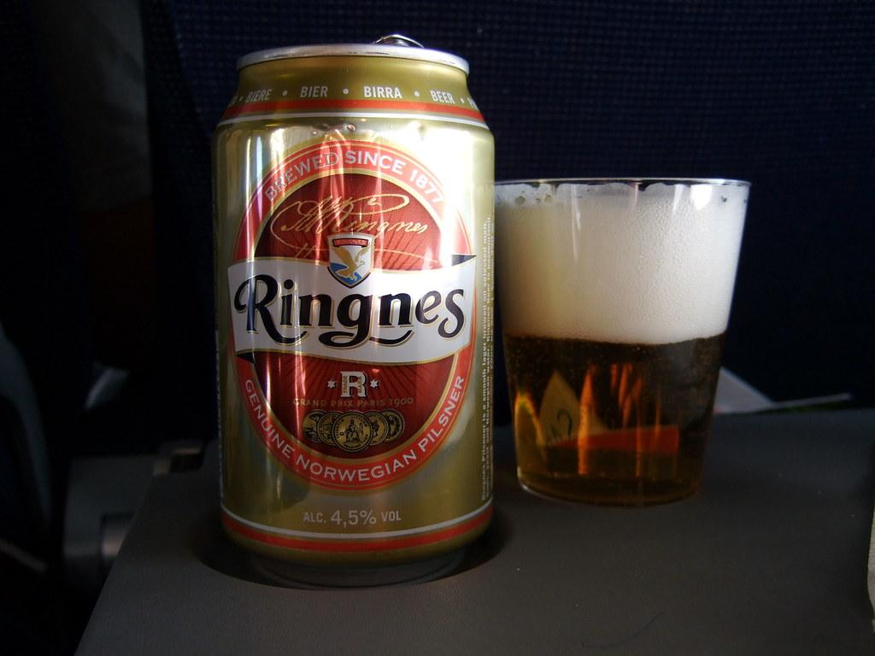
What does it mean to design a market?
Who is allowed to buy?
Who is allowed to sell?
Where can they interact?
When can they interact?
Notes:
Image sources:
Prague Morning (fireworks)
Pexels (psychotherapy)
Public Domain Pictures (pill bottle)
Flickr (Ringnes beer)
PxHere (fast food)

Slide 5
Product standards
Conduct requirements
Safety standards
Information disclosure
Environmental regulation
Anti-trust legislation
Intellectual property laws
Labour regulations
Advertising standards

Slide 6
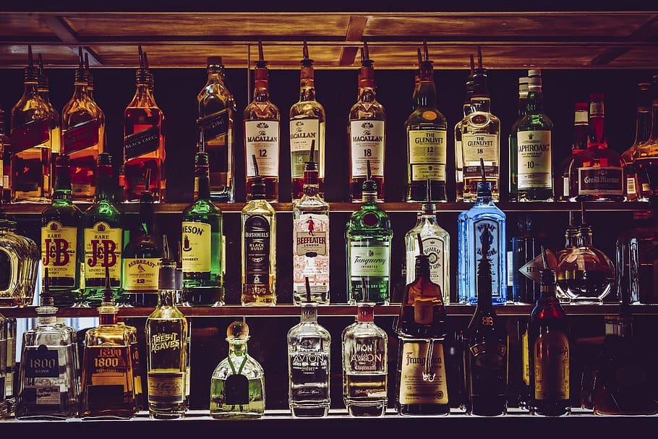
How are other legalised drugs regulated?
Notes:
Image sources:
Pexels (coffee beans)
Wallpaper Flare (alcoholic drinks bottles)
Flickr (paracetamol)
Picryl (IV bag)

Slide 7
Sellers | Buyers | Where and when | Other restrictions
Anyone | Anyone | No restrictions | None
Regulated firms | Over 18s | Licensed shops | No advertising
Government-owned stores | Over 18s | Day only | 25g quantity limit
Social clubs | Members | Private/communal | No sale for profit

