Slide 1

The Gender
Pay Gap
This Month in the Economy
Notes:
Image source: https://www.sfu.ca/wwest/WWEST_blog/female-passiveness-is-not-to-blame-for-pay-disparity.html

Slide 2
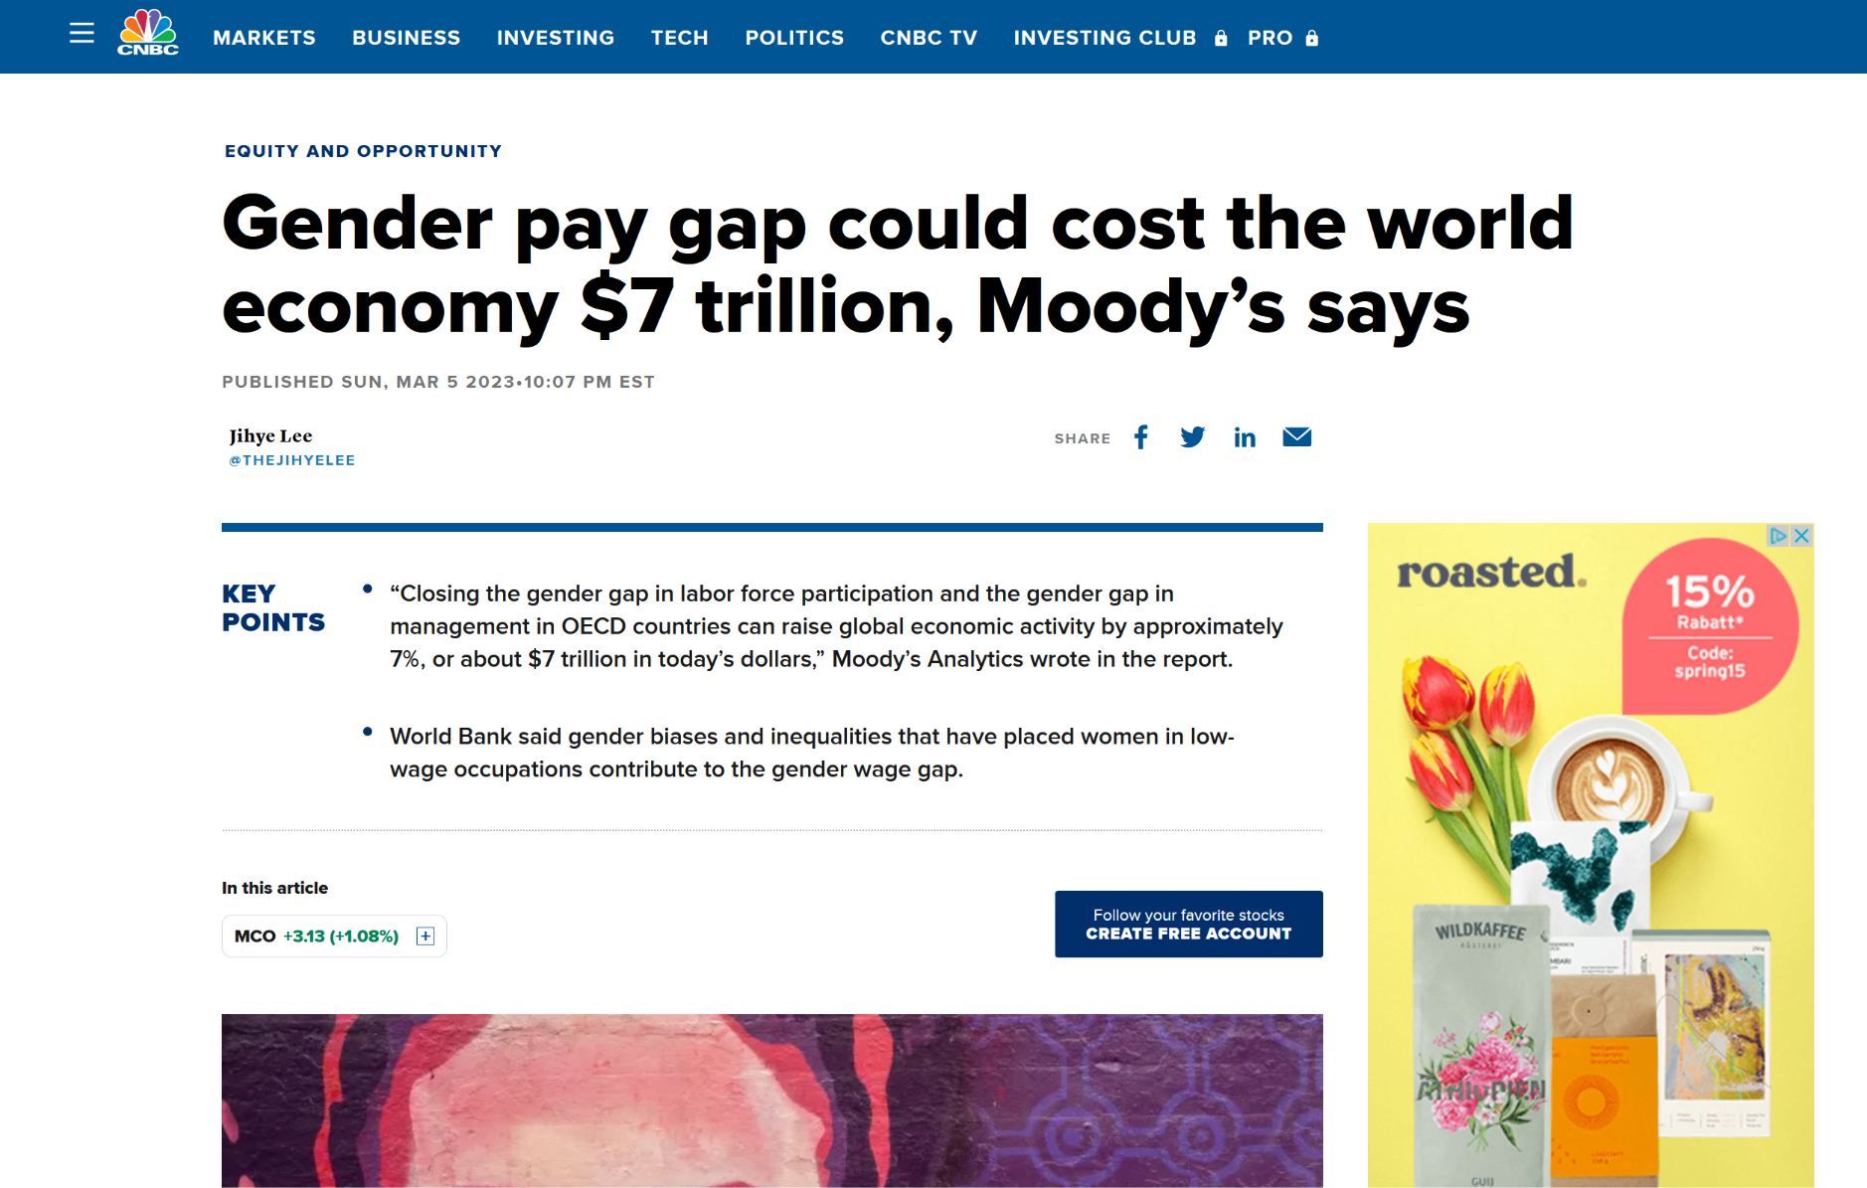
Notes:
Source article: https://www.cnbc.com/2023/03/06/gender-pay-gap-could-cost-the-world-economy-7-trillion-moodys-says.html
Thank you for joining us for today’s class, part of which we’ll use for looking at what’s going on in the economy this month. At home, you’ve all read the CNBC article that you can see on the screen. A recent study by Moody's Analytics found that eliminating the gender gap in management roles and labor force participation in OECD nations may boost the world economy by almost $7 trillion, or 7% of current global economic activity. At the current rate, the gender gap may not be closed in the world for another 132 years. The report also identifies network linkages, discrimination, and family obligations as contributing contributors to the female pay gap. In the next 30 minutes, we'll look deeper into the economic and sociological factors that contribute to the gender pay gap and why it is a problem.

Slide 3

Overview and learning objectives
I Introduction
II Class discussion
III Connecting the dots
-> Understand…
…the concept of the gender pay gap and why it is an important issue
…the various factors that contribute to the gender pay gap
…the limitations of neoclassical economics in explaining the gender pay gap
…the value of a pluralistic approach to understand the gender pay gap and potential solutions
Notes:
Image source:
https://eu.usatoday.com/story/money/personalfinance/2012/10/24/gender-pay-gap/1652511/

Slide 4
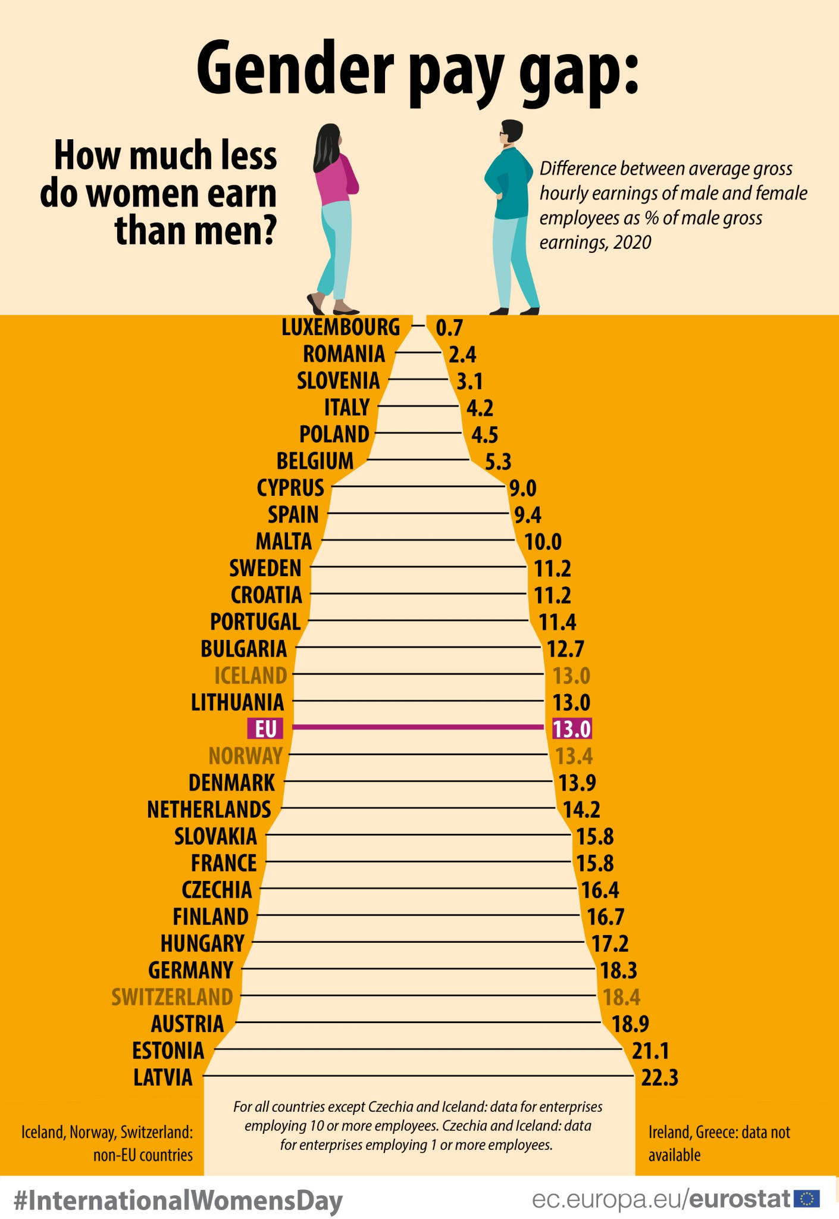
The concept of the gender pay gap
Notes:
Image source: https://commission.europa.eu/strategy-and-policy/policies/justice-and-fundamental-rights/gender-equality/equal-pay/gender-pay-gap-situation-eu_en
The gender pay gap refers to the difference in earnings between men and women in the workforce. It is a persistent issue in many countries around the world. On the slide you can see that women in the EU in 2020, on average, earned 13% less than men. (https://commission.europa.eu/strategy-and-policy/policies/justice-and-fundamental-rights/gender-equality/equal-pay/gender-pay-gap-situation-eu_en). In around half of the EU Member States, the gap is even larger, including in the Netherlands and Germany.

Slide 5
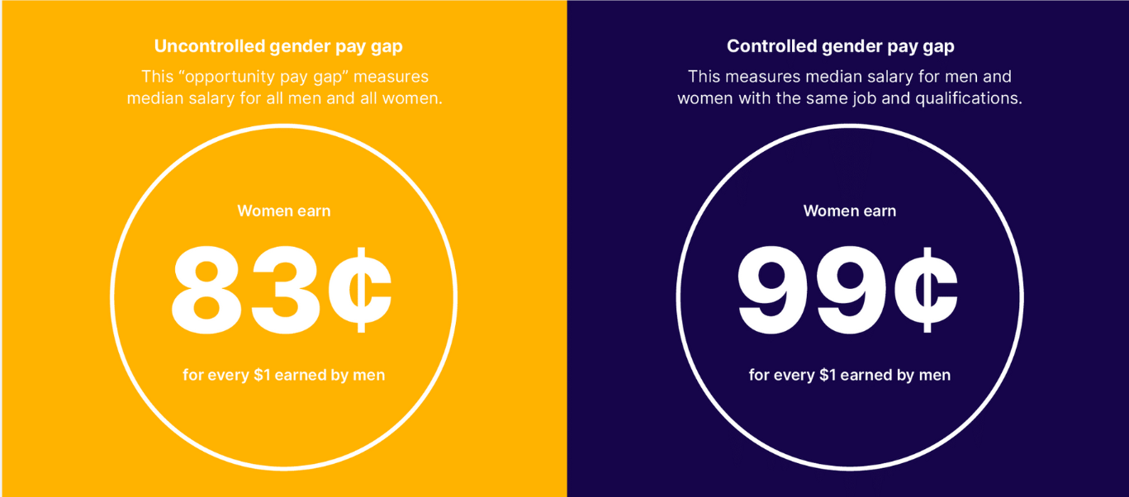
The concept of the gender pay gap
Notes:
Image source: https://www.payscale.com/research-and-insights/gender-pay-gap/
The gender pay gap can be measured in two ways, the unadjusted and adjusted gap. The unadjusted gap, also known as the "opportunity gap," represents the raw difference in median earnings between men and women. This gap reflects the disparities in opportunities and access to resources that exist between men and women, and can be attributed to several factors, including discrimination, societal norms and biases, and systemic factors that disadvantage women and other marginalized groups.
The adjusted gap, on the other hand, controls for factors such as education, roles, and experience, which can help to isolate the portion of the gap that cannot be explained by these factors. This portion may be attributable to direct discrimination in hiring and promotion.
In the United States, for example, the current unadjusted gender pay gap is around 17%, meaning that women earn 83 cents for every dollar earned by men (https://www.payscale.com/research-and-insights/gender-pay-gap/). When adjusted for factors such as occupation, education, and experience, the gap is around 1%, meaning that there is still a gap, even if men and women have the exact same qualifications and experience, and work in the exact same role, industry, etc.

Slide 6
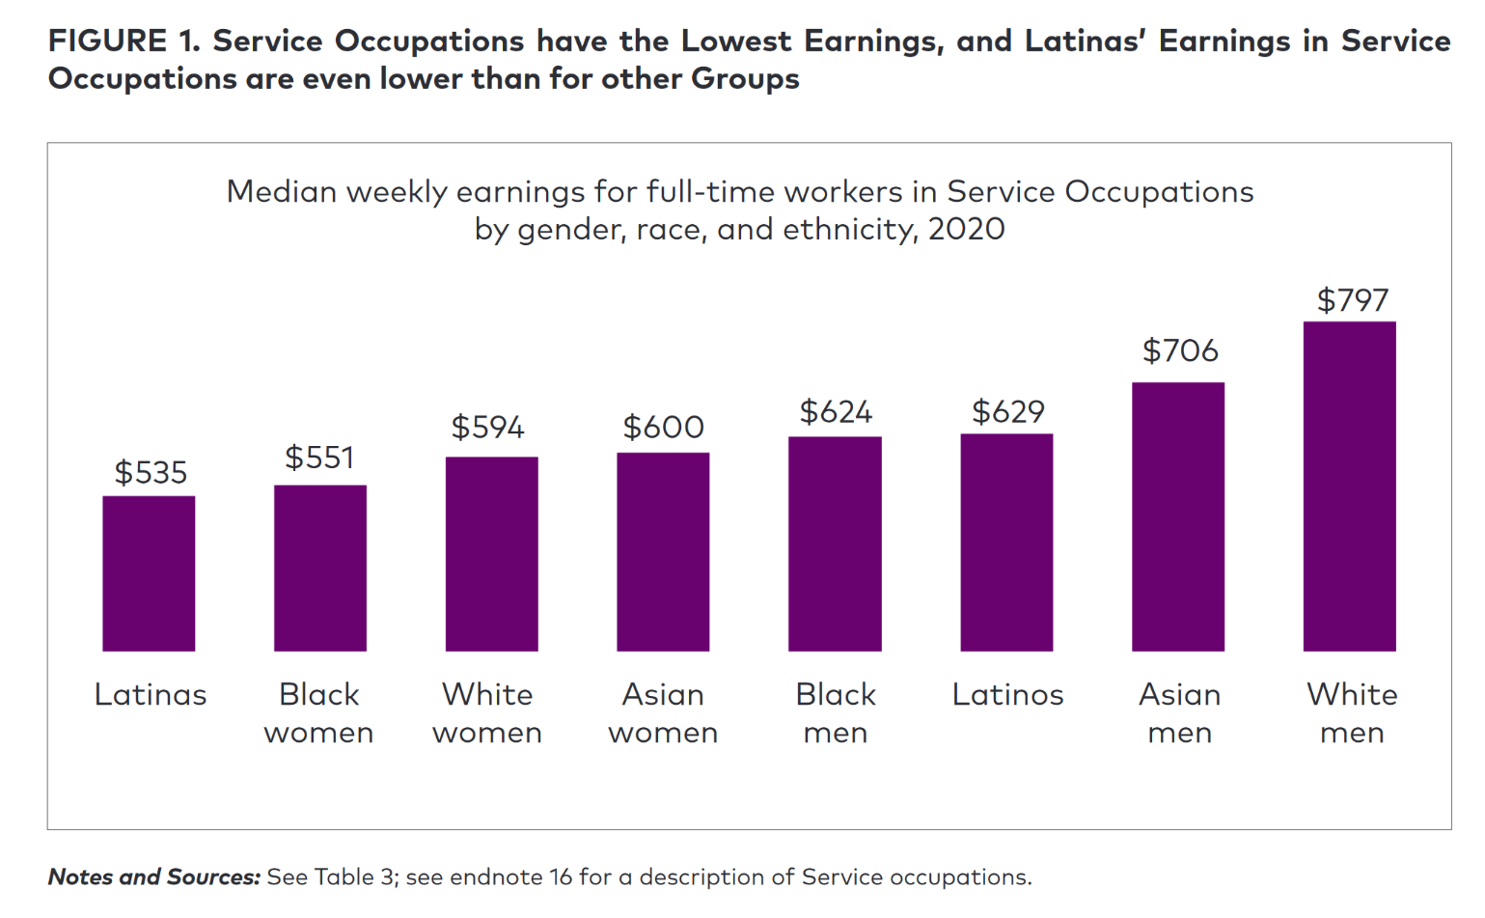
Intersectionality and the gender pay gap
Notes:
Imagesource: https://iwpr.org/wp-content/uploads/2021/03/2021-Occupational-Wage-Gap-Brief-v2.pdf
When examining gender wage gaps, we also want to underline the significance of intersectionality. It’s critical to understand that intersectionality significantly contributes to wage gaps. Even after adjusting for variables like education and experience, women from marginalised groups may still endure prejudice and additional restrictions. So, even the adjusted gap may still significantly underestimate how unequal these women's lives really are.
Wage gaps are not just about gender, but also about the ways in which gender intersects with other social identities to create a complex web of discrimination and inequality. Women of color, for example,may face unique barriers in the workplace that other women don't face. For example, research has shown that Latinas in service occupations in the United States earn only 67 cents for every dollar earned by White men, and face both gender and race discrimination in hiring, promotion, and pay (https://iwpr.org/wp-content/uploads/2021/03/2021-Occupational-Wage-Gap-Brief-v2.pdf).
Similarly, women with disabilities may face discrimination and barriers in the workplace that can affect their earning potential. For instance, they may not have access to certain jobs or face challenges in getting to work due to lack of accommodations. Women who are LGBTQ+ may also experience discrimination and harassment in the workplace based on their sexual orientation or gender identity, which can impact their career opportunities and earnings.

Slide 7
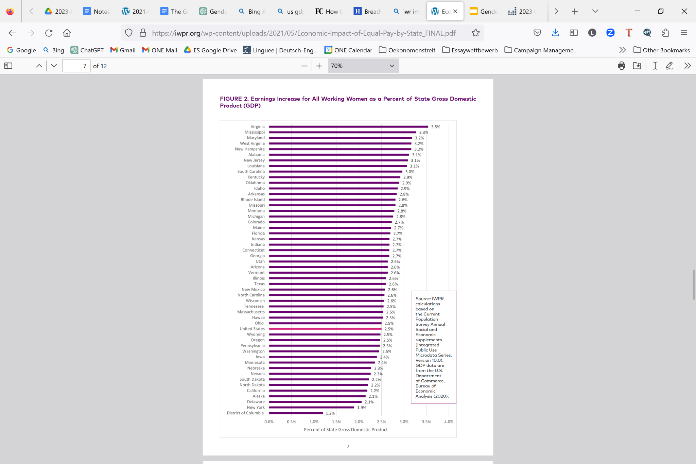
Social and economic consequences of the gender pay gap
Notes:
The gender pay gap has numerous social and economic consequences, such as lower GDP and reduced economic efficiency. In fact, closing the gender pay gap alone could increase earnings by women in the US by $512 billion, which was equal to 2.5% of US-GDP in 2019 (https://iwpr.org/wp-content/uploads/2021/05/Economic-Impact-of-Equal-Pay-by-State_FINAL.pdf).
The gender pay gap also has a significant impact on women's financial stability, leading to several consequences such as higher student loan debt. Women are more likely to have higher student loan debt than men due to the gender pay gap. The pay gap makes it harder for them to pay off their student loans. In fact, according to the American Association of University Women (AAUW), women hold about two-thirds of the outstanding student loan debt in the United States (https://www.fastcompany.com/90449297/how-the-gender-pay-gap-cuts-through-the-u-s-economy). Closing the gender pay gap would reduce the financial burden on women, enabling them to pay off their student loans faster and with less difficulty. This would, in turn, allow them to invest more in their future and contribute more to the economy.
Secondly, the gender pay gap also affects retirement savings, as women typically have lower lifetime earnings and therefore lower retirement savings than men. This can lead to financial insecurity in retirement, with women more likely to live in poverty and rely on government assistance. Closing the gender pay gap would help to address this issue by ensuring that women have equal access to financial resources and opportunities to save for retirement.

Slide 8

Class activity
This Month in the Economy
Notes:
Image source: https://ppe.brown.edu/courses

Slide 9







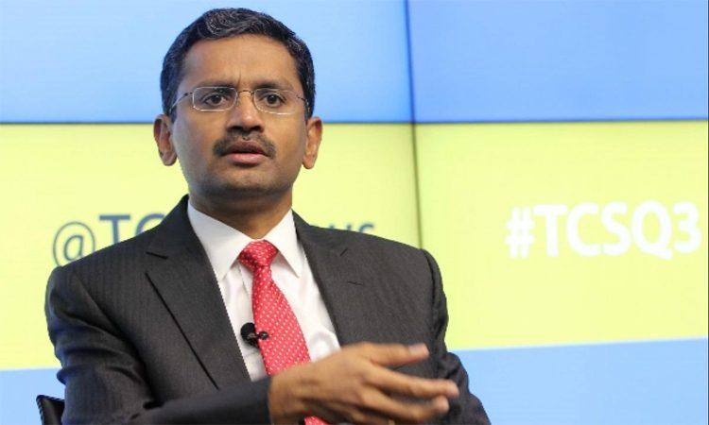
What is a fair salary?
Secretary/administrative assistant
Sales representative
Software developer
Chief executive
Notes:
Images sources:
Upper left: https://laort.edu/course/administrative-assistant/; https://educationsn.com/2020/01/23/recrutement-dun-assistant-administratif-a-world-vision/
Upper right: https://stonewaterroofing.com/professional-sales-representative-roofing-tyler/; https://thriftyintrovert.com/worst-jobs-for-introverts/
Lower left: https://elu.nl/best-tech-careers-to-pursue-as-an-engineer-or-it-professional/; https://www.womenintech.co.uk/become-software-developer
Lower right:

Slide 10
What are the real salaries?
Secretary/administrative assistant
Sales representative
$40,949
$66,870
Software developer
Chief executive
$101,552
$135,240
Notes:
Data source: https://iwpr.org/wp-content/uploads/2021/03/2021-Occupational-Wage-Gap-Brief-v2.pdf

Slide 11
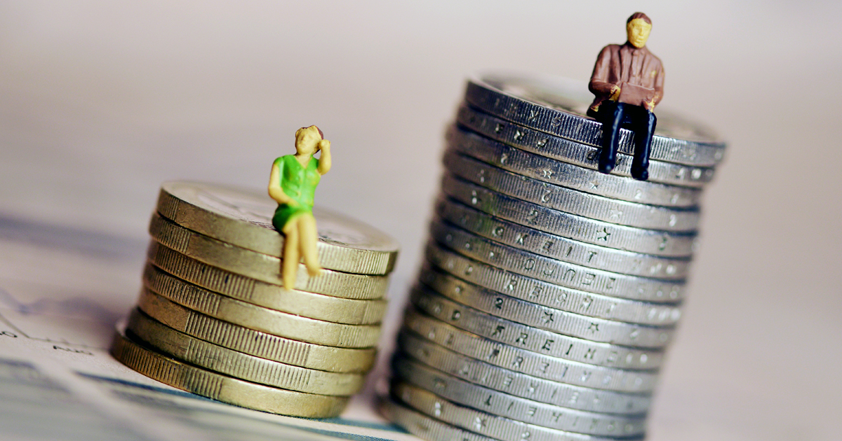
What are the causes of unequal pay?
?
Notes:
Image source: https://www.asyousow.org/blog/gender-equality-workplace-issues

Slide 12
Conclusion
This Month in the Economy
Notes:
Image source: https://ppe.brown.edu/courses
In the class activity just now, we assessed the fair salary range for different positions, taking into account intersectionality and systemic factors contributing to discrimination in the workplace.

Slide 13






Causes of the gender pay gap
Systemic
Motherhood penalty
Unemployment penalty
Intersectionality
Discriminatory hiring practices
Toxic corporate culture
Notes:
Image sources: https://nutritionrx.ca/to-grow-to-great-heights-you-must-plant-deep-roots/; https://www.gettyimages.de/detail/foto/mother-with-two-young-children-uses-a-laptop-lizenzfreies-bild/1344330627?adppopup=true; https://madamenoire.com/710796/year-later-getting-fired-lessons/; https://www.nytimes.com/2021/07/29/business/economy/hiring-racial-discrimination.html; https://www.bbc.com/worklife/article/20211201-why-some-work-environments-breed-toxic-cultures;
Now, let's recap some of the causes of the gender pay gap from the pre-class readings.
The gender pay gap is systemic, stemming from perceptions about the value of women's work versus men's work and the types of work women are suited for. This leads to women being funneled into lower-paying positions.
The motherhood penalty is another factor, where working mothers face biases and reduced working hours to balance childcaring responsibilities, leading to a larger pay gap.
The unemployment penalty also contributes to the gap, with unemployed women struggling to secure higher-paying jobs compared to unemployed men.
Hiring practices that involve discrimination in recruitment and selection processes, gender-coded language and imagery in job advertisements, and conscious and unconscious bias in processing candidates' information are also factors.
Lastly, women are 41% more likely than men to experience toxic corporate culture, with women chefs exhibiting the largest gender gap in toxic culture.
It's important to remember that intersectionality and systemic factors are crucial to understanding and analyzing the gender pay gap.

Slide 14

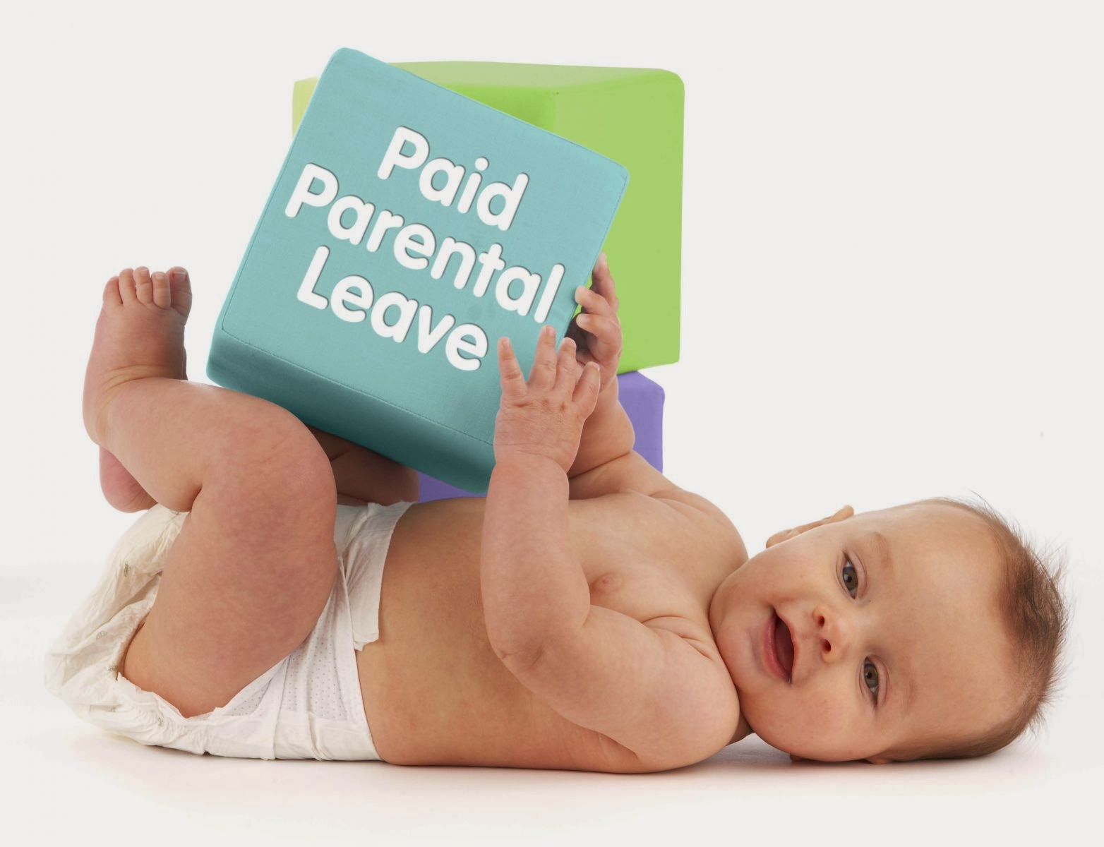

Potential solutions
Pay transparency
Parental leave policies
Representation in leadership
Notes:
Image sources: https://www.i4cp.com/productivity-blog/2015/09/11/will-pay-transparency-be-the-next-new-thing-in-the-war-for-talent; https://maternitypicturesideas.blogspot.com/2013/12/paid-maternity-leave.html; https://www.propelhr.com/blog/how-to-cultivate-female-leadership
As we conclude our class on the gender pay gap, it's important to consider potential solutions to address this systemic issue.
One solution is the implementation of policies promoting pay transparency, which can help to eliminate gender-based pay disparities.
Another solution is the implementation of parental leave policies that support working parents, particularly mothers, in balancing work and family responsibilities.
Additionally, representation in leadership positions is crucial for creating more equitable and inclusive workplaces. Increasing the representation of women and other underrepresented groups in leadership positions can help to break down the systemic barriers that contribute to the gender pay gap.
By implementing these solutions and continuing to address the systemic factors that perpetuate the gender pay gap, we can create more equitable and inclusive workplaces for all

