Slide 1
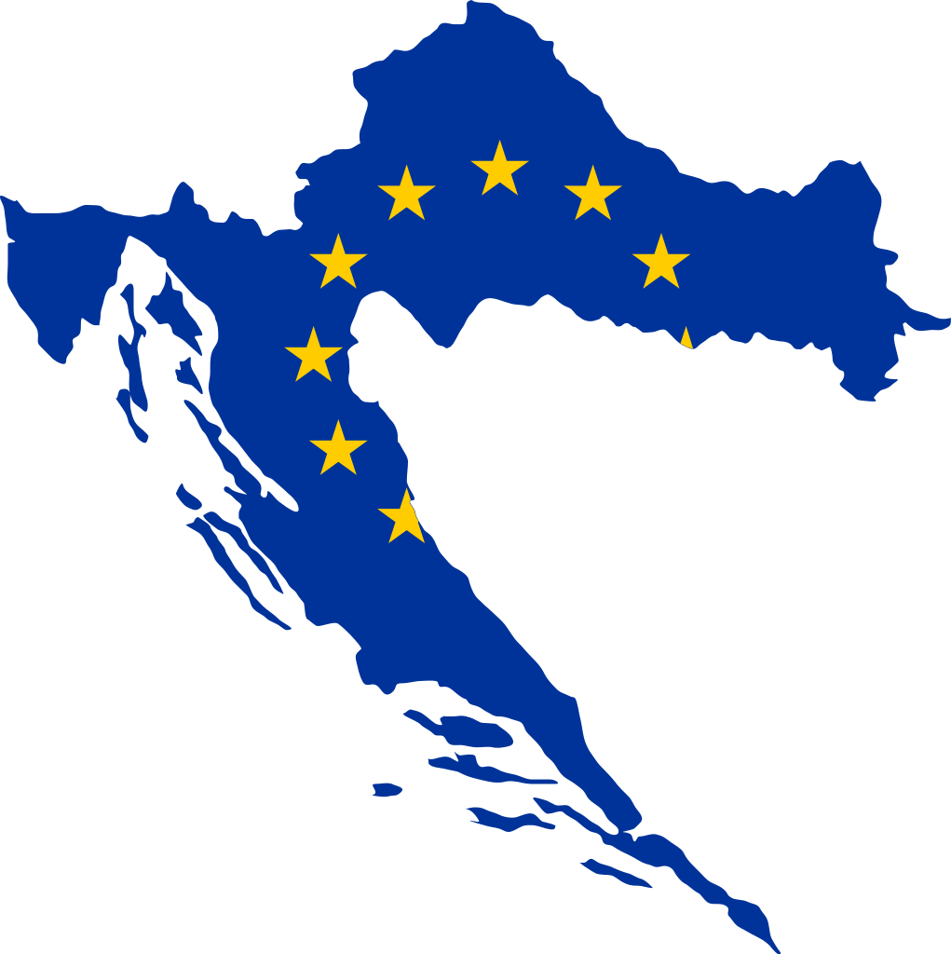
Croatia adopts the euro
This Month in the Economy
Notes:
Source image: https://commons.wikimedia.org/wiki/File:Croatia_EU.svg

Slide 2
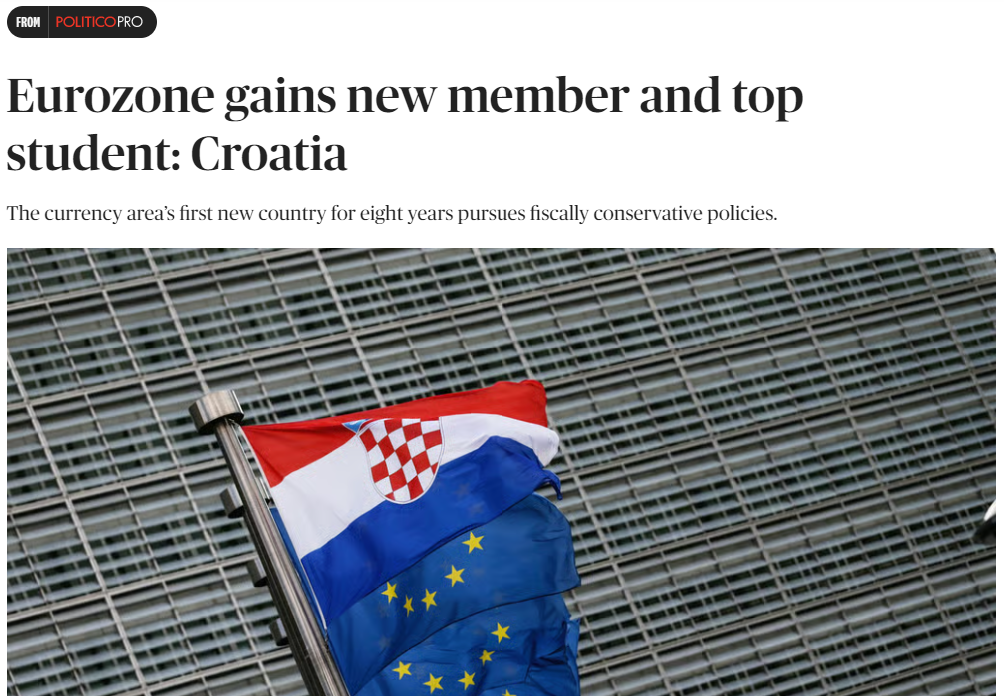
Notes:
Source article: https://www.politico.eu/article/eurozone-gains-new-member-and-top-student-croatia/
Source image: https://www.total-croatia-news.com/lifestyle/60000-stolen-croatian-euro-coin-design

Slide 3
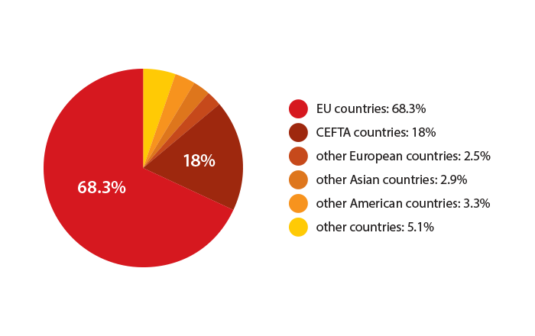
Croatian economy in a nutshell
Importance of tourism
20 million tourists per year
20% of GDP
Main trading partners:
Germany, Italy, Bosnia and Herzegovina, Slovenia, and Austria
Mostly services-based economy
Low median income (EU-standard)
Croatian Kuna previously pegged to the euro
Notes:
Source figure: https://croatia.eu/index.php?view=article&lang=2&id=32

Slide 4
How to join the eurozone: Convergence criteria
Inflation not much higher than EU benchmark countries with low inflation
Maximum budget deficit of 3% of GDP
Maximum public debt of 60% of GDP
Stable exchange rate
Having the currency pegged to the euro for 2 years minimum (ERM II)
Long-term interest rates not much higher than EU benchmark countries with low inflation
Having a ban on monetary financing (Compatibility of legislation)

Slide 5
Exercise: How did Croatia meet the convergence criteria?
10 minutes in groups of 2 or 3 - Find out how Croatia fulfilled these criteria:
Inflation not much higher than EU benchmark countries with low inflation
Maximum budget deficit of 3% of GDP
Maximum public debt of 60% of GDP
Stable exchange rate
Having the currency pegged to the euro for 2 years minimum (ERM II)
Long-term interest rates not much higher than EU benchmark countries with low inflation
Having a ban on monetary financing (Compatibility of legislation)

Slide 6
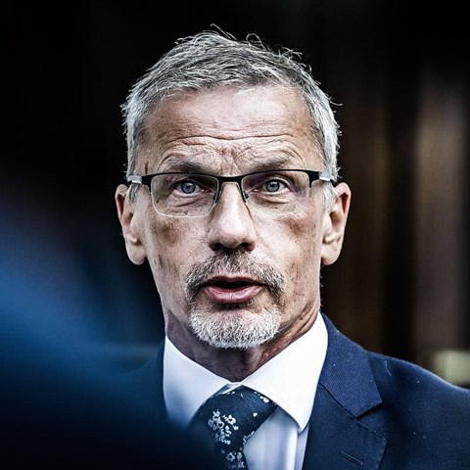
Arguments for and against joining the eurozone
Monetary policy
Exchange rate
Fiscal policy
“I always quote the Bob Dylan song 'When you ain't got nothing, you got nothing to lose'. If you don't have independent monetary policy what are you going to lose by entering into the monetary union?” Boris Vujčić in 2013, Governor of the Croatian National Bank from 2012 to the present
Notes:
Source image: https://www.index.hr/vijesti/clanak/tko-je-boris-vujcic-zlatni-zagrebacki-decko-koji-voli-skupa-vina-i-putovanja/2331607.aspx

Slide 7
Application process
2013: Croatia joined the EU
2015/2016: Original goal to adopt the euro
2019: Official application started
2020: Croatia joined the ERM II
2022: Croatian and EU governments supported the plan
2023: Adoption of the euro

Slide 8
How does the adoption of the euro influence tourism, trade and fiscal policy?
10 minutes in groups of 2 or 3 - Discuss how tourism, trade and fiscal policy change because of the adoption of the Euro:
Tourism
Within Eurozone
Outside Eurozone
Trade
Within Eurozone
Outside Eurozone
Fiscal Policy
Before the adoption during the application
After the adoption as an Euro area member state

