Slide 1
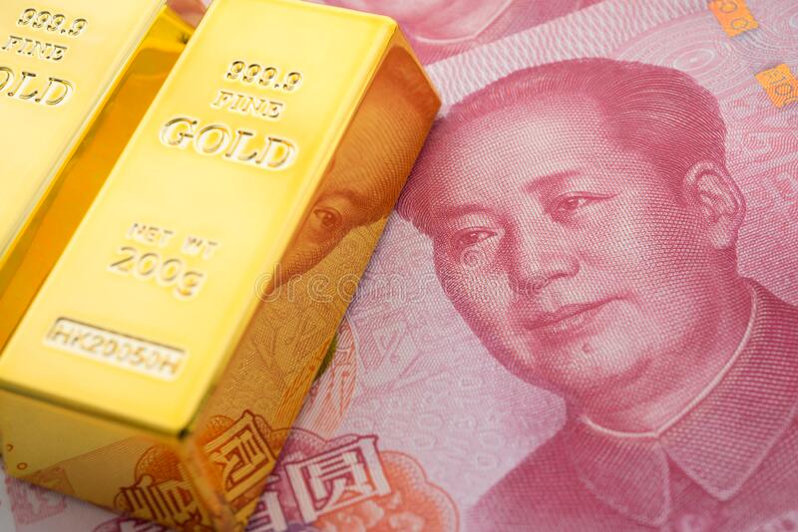
Russia sells foreign reserves
This Month in the Economy

Slide 2
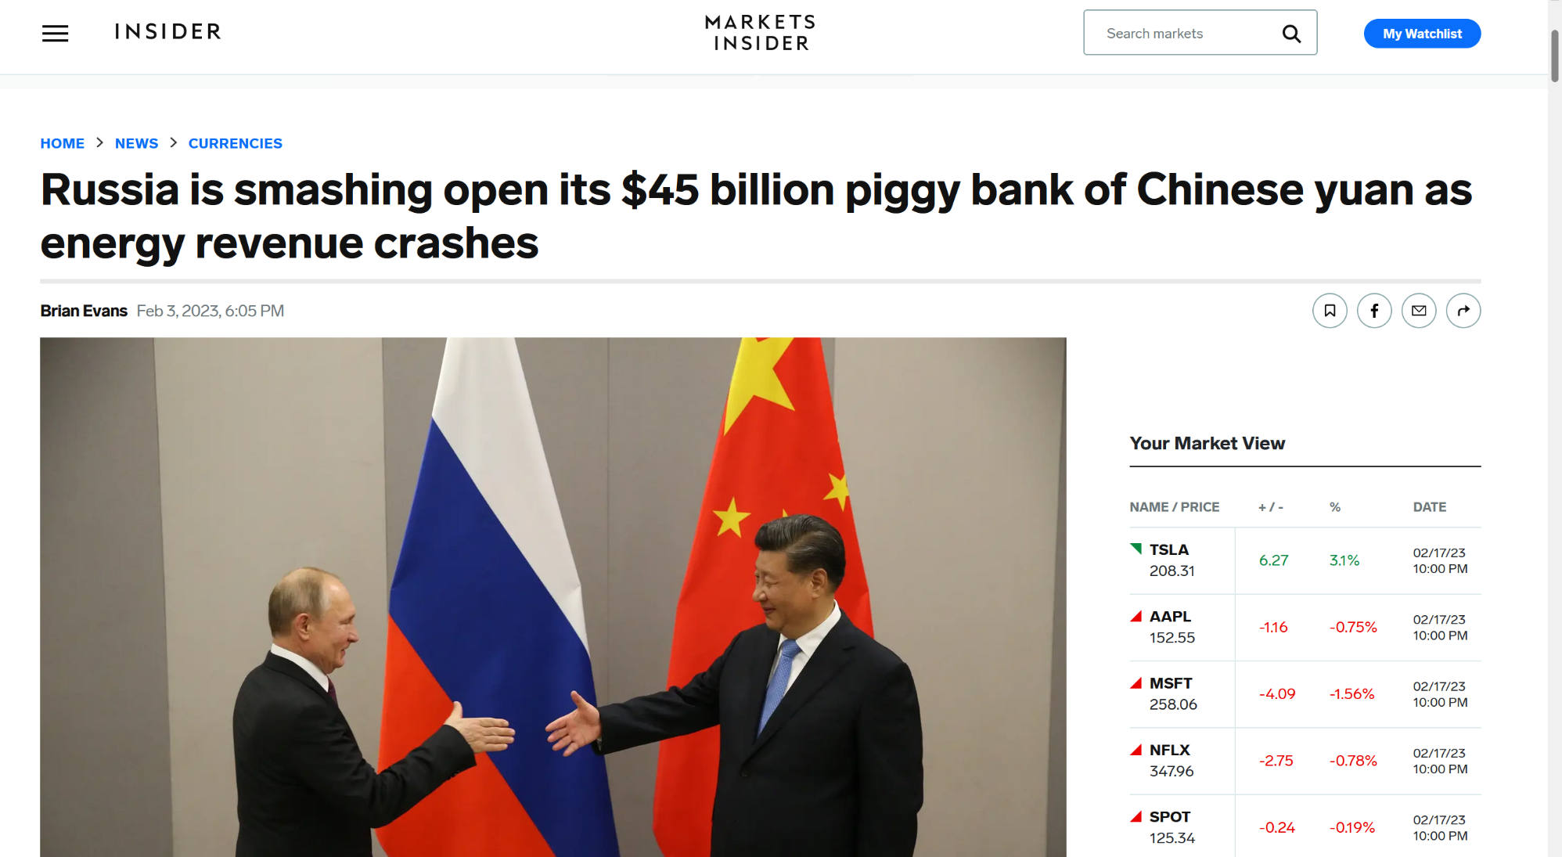
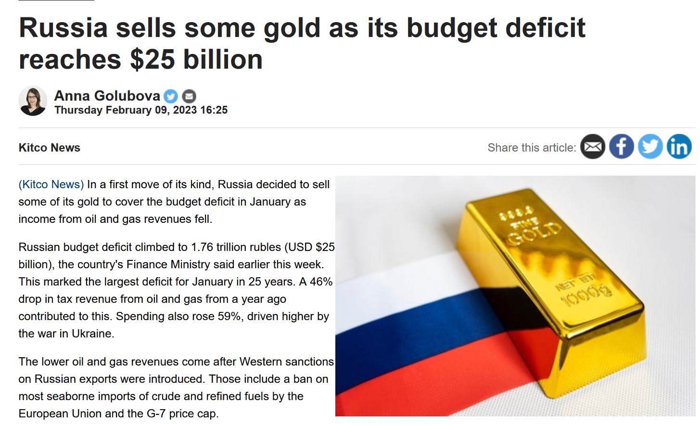
Russian Yuan sales 2023
Jan 13 - Feb 6
54.5 bn. roubles ($0.78 bn.)
Feb 7 - Mar 6
160.2 bn. roubles ($2.3 bn.)
Russian gold sales 2023
January
3.6 t ($0.245 bn.)
Notes:
Source article 1: https://markets.businessinsider.com/news/currencies/russia-china-yuan-renminbi-reserves-ruble-forex-sales-energy-revenue-2023-2
Source article 2: https://www.kitco.com/news/2023-02-09/Russia-sells-some-gold-as-its-budget-deficit-reaches-25-billion.html

Slide 3
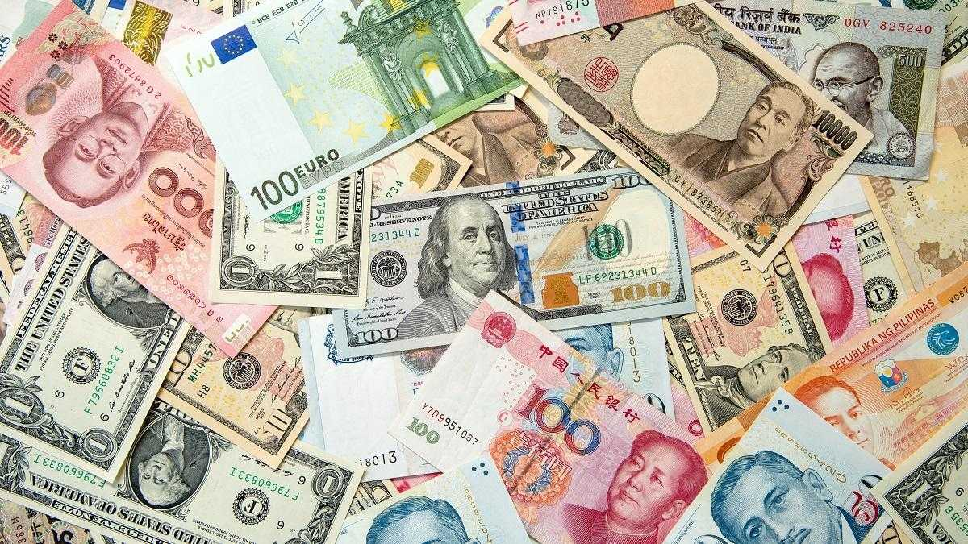
Overview and learning objectives
I Introduction
II Class discussion
III Connecting the dots
-> Understand…
…why countries hold foreign exchange reserves and how they use them
…why Russia is selling Yuan and gold reserves
…what goals other than economic efficiency can drive economic decision making by governments
Notes:
Image source: https://www.foreignexchangelive.com/wp-content/uploads/2019/03/operating-globally-invoicing-in-a-foreign-currency-explained-2.jpg

Slide 4
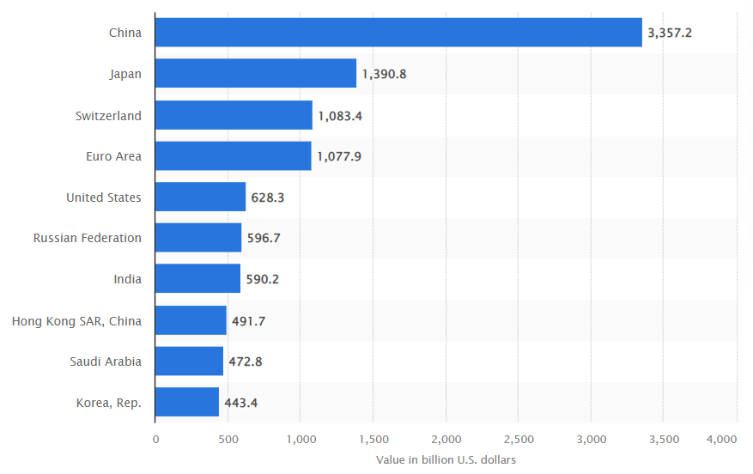
Let’s discuss!
Why do countries hold foreign exchange reserves and what do they usually use them for?
The countries with the largest foreign currency reserves in 2020.
Notes:
Figure source: https://www.weforum.org/agenda/2022/08/foreign-currency-reserves-global-economic-crisis/

Slide 5
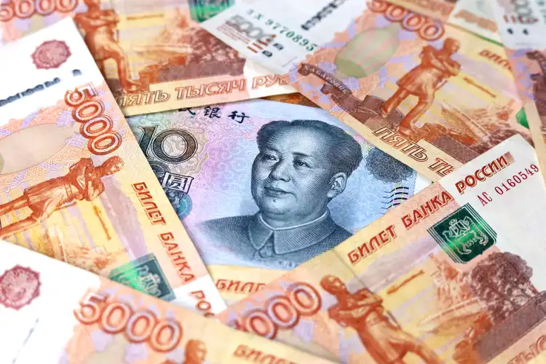
Let’s discuss!
To which extent do the common purposes and usages of foreign exchange reserves explain Russia’s actions?
What is motivating Russia’s reserve sales?
Notes:
Image source: https://static.seekingalpha.com/cdn/s3/uploads/getty_images/1400810645/image_1400810645.jpg?io=getty-c-w750

Slide 6
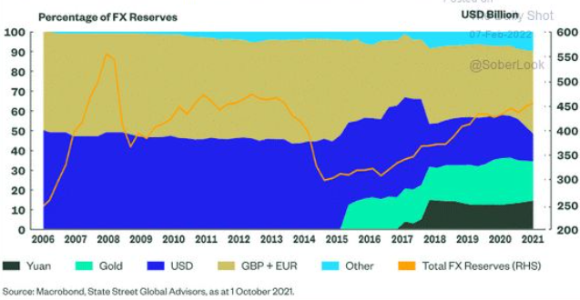
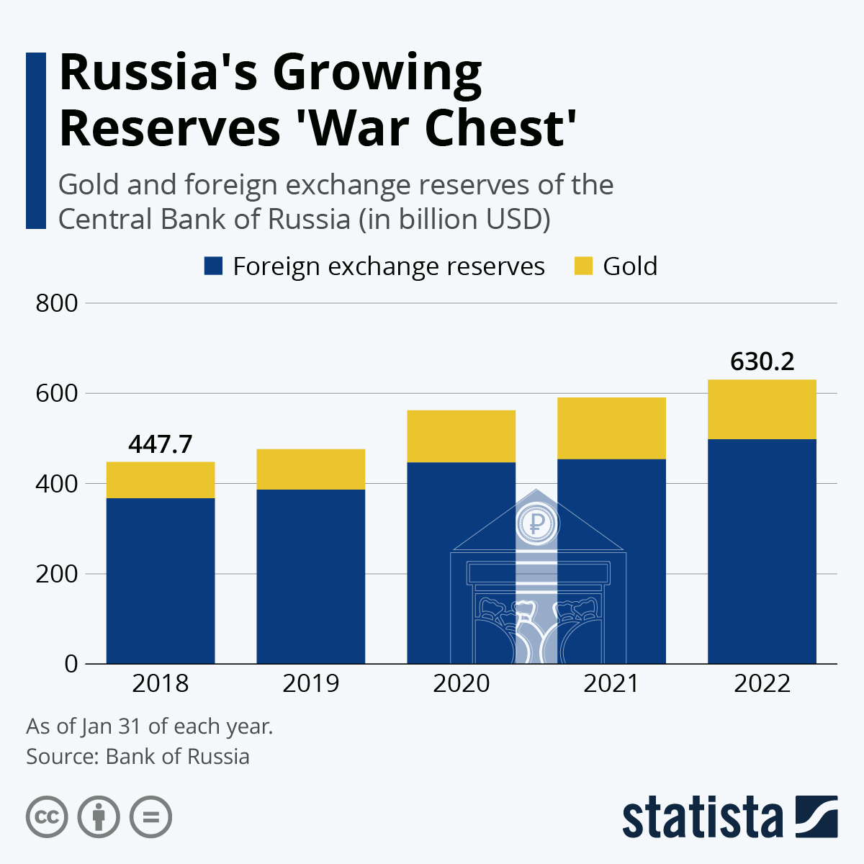
Let’s discuss!
Which goals has Russia been pursuing internationally and how are they linked to the composition and handling of its reserves?
Notes:
Figure source 1:https://twitter.com/MacroAlf/status/1490784934885089283/photo/1
Figure source 2: https://www.statista.com/chart/26942/gold-foreign-exchange-reserves-of-central-bank-of-russia/

Slide 7
Foreign exchange reserves in the (international) economy
Foreign exchange reserves
= assets, such as foreign currencies, foreign government bonds or gold, held by a country’s central bank or national wealth fund
7 reasons for having/using foreign exchange reserves
(according to mainstream economic theory)
1 Keep fixed exchange rate
2 Keep domestic currency lower
3 Ensure liquidity in times of crisis
4 Meet international financial obligations
5 Fund domestic economic sectors/industries
6 Maintain investor confidence
7 Diversify risk
Notes:
Sources:
https://www.investopedia.com/terms/f/foreign-exchange-reserves.asp
https://www.thebalancemoney.com/foreign-exchange-reserves-3306258
https://www.cityindex.com/en-uk/news-and-analysis/what-are-currency-reserves/

Slide 8
Russia’s use of foreign reserves
Immediate motivations
frozen dollar, pound, euro and yen reserves (Western sanction)
Revenue shortfalls,due to price limit on Russian oil and gas (G7 sanction)
Yuan and gold sales to make up for budget deficit
Underlying geopolitical motivations
Keep financing war against Ukraine
Since 2014-annexation of Crimea, strategic increase in share of Yuan and gold reserves -> hedge against international sanctions
Promote de-dollarization of international finance -> undermine US hegemony
Notes:
Sources:
https://www.bloomberg.com/news/articles/2023-01-24/sanctions-proof-yuan-to-putin-s-rescue-after-oil-cap-hits-budget
https://www.omfif.org/2023/01/central-banks-are-reassessing-foreign-exchange-reserves/
https://www.grid.news/story/global/2022/07/15/russias-bright-shiny-anti-sanctions-weapon-inside-the-billion-dollar-business-of-blood-gold/

Slide 9
The role of values in the economy
Values regarding outcomes of economic processes
Economic efficiency is not by default the valued outcome a society, government or other actors might pursue through their economic decisions
Russia’s foreign reserve composition and recent sales are not motivated by economic efficiency considerations (see below), but by Russia’s (Putin’s) imperial ambitions and geopolitical goals
7 reasons for having/using foreign exchange reserves
(according to mainstream economic theory)
1 Keep fixed exchange rate
2 Keep domestic currency lower
3 Ensure liquidity in times of crisis
4 Meet international financial obligations
5 Fund domestic economic sectors/industries
6 Maintain investor confidence
7 Diversify risk
Notes:
Source:
https://www.economystudies.com/book/values/

