Slide 1
The Practice of Central Banking

Slide 2
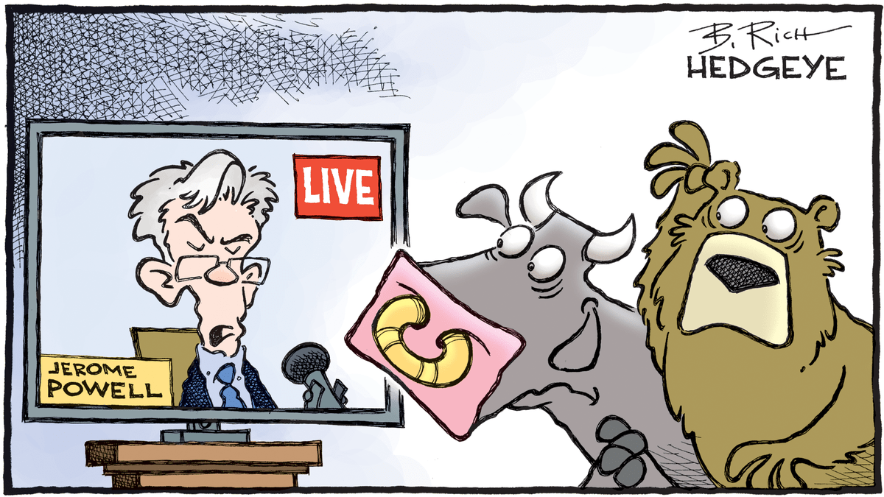
Central banks
Institutions that oversee the monetary and financial systems of a country
One of the most important ways in which economists and economics have an impact on the world
Notes:
Source image: What If Chairman Powell is Wrong About Neutral Interest Rates (R*)? (hedgeye.com)

Slide 3
Learning objectives
Understanding that central banking is multifaceted, uncertain and complex in the real-world.
Basic understanding of the different central bank policy types and instruments.
Being able to relate monetary and macroeconomic theories to real-world policy making
Being able to reason and argue about central bank decision making.

Slide 4
Discuss in groups of 2-3
What have you learned before about central banks?
Have you heard, read, or talked about central banks outside of your classes, and if so what was it?

Slide 5
Types of central bank policies
Conventional monetary policy:
Setting a target for the overnight interest rate to pursue economic objectives
Unconventional monetary policy:
When conventional monetary policy is not sufficient due to the zero lower bound and is characterised by instruments such as quantitative easing asset purchase programmes
Lender of last resort policies:
Providing liquidity to financial institutions and markets when they otherwise are unable to meet their obligations and can cause financial instability
Central bank policies
Monetary policy
Lender of last resort policies
Conventional
Unconventional

Slide 6
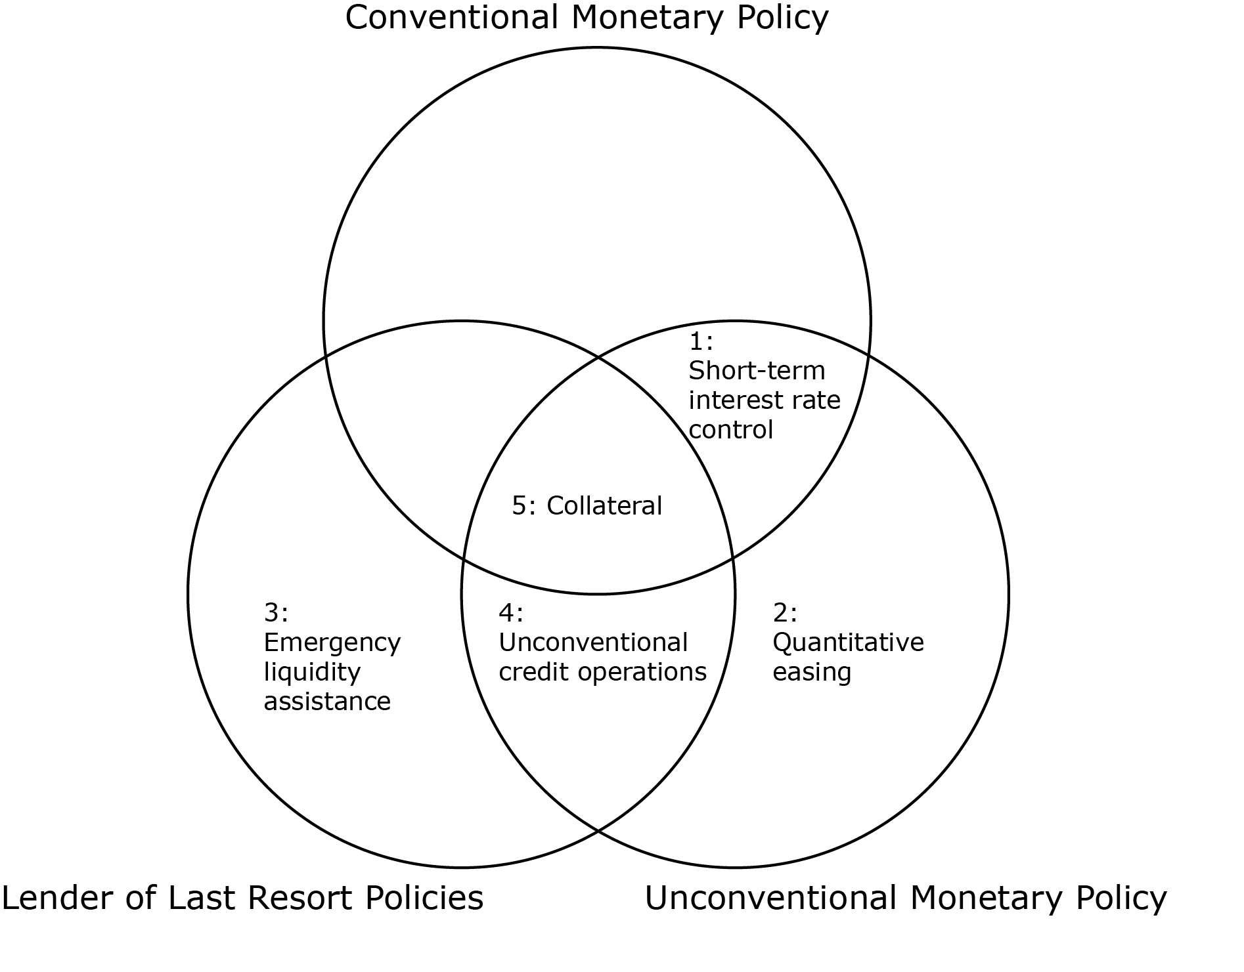
Central bank policy instruments
Control of short-term interest rate to influence growth, inflation and employment. Negative interest rate policies are considered unconventional and more controversial.
In quantitative easing (QE) types of asset purchase programs central banks buy bonds from financial actors and private investors in secondary markets.
With emergency liquidity assistance (ELA) central banks support commercial banks by lending freely against good collateral to solvent institutions at a penalty rate to prevent financial instability.
With unconventional credit operations central banks provide more credit to commercial banks to keep them stable and operating.
With their collateral frameworks central banks decide which assets can underwrite credit loans.

Slide 7


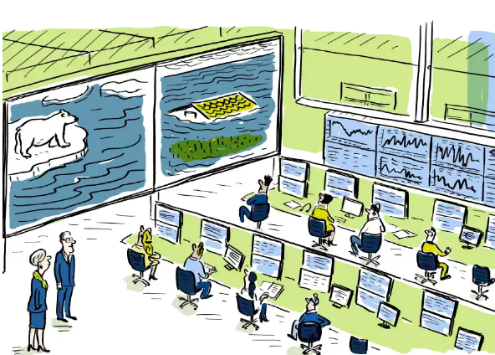
The Targets of Monetary Policy:
What central banks try to achieve
Traditionally
  Price stability
  Maximum employment and economic growth
  Financial stability
Recently debated
  Ecological sustainability
  Geopolitical interests
  Social equity
Notes:
Sources images:
Stable Coins: The Next Wave of Adoption? | by Richard Knight | Good Audience
Unemployment, a festering wound | Deccan Herald

Slide 8

Hawks and doves
In general, “hawks” tend to want tighter monetary policy to lower inflation whilst “doves” tend to want looser monetary policy to support growth and employment.
During times of high inflation, hawks tend to advocate for higher interest rate hikes, while doves caution against excessively hurting growth and employment.
During times of low growth and employment, doves tend to advocate for more monetary stimulus, while hawks caution against causing excessive inflation.
Notes:
Source image: Hawkish vs Dovish: Differences Between Monetary Policies - BabyPips.com

Slide 9

Decision making at central banks
Decision making at most central banks is done through voting in policy committees and boards. Departments and teams do research and prepare documents helping gain insight into recent economic and financial developments.
Real-world complexities and different ways of understanding them give rise to arguments over what policy options are best. But while central bankers are debating and voting behind closed doors, they are generally unanimous to the outside world.

Slide 10
Real-world exercises:
Know your own central bank
What is the mandate of your central bank?
What is the current short-term interest rate target?
What is the total value of the assets on the central bank balance sheet?
Who sits on the board of the central bank and who are they?
  Demographics: Age, gender, ethnicity/race, and the place or region she/he grew up in
  Trained as: …
  Worked before at: …
  Known as hawk or dove

Slide 11
Conventional monetary policy
Setting a target for the overnight interest rate to pursue objectives, such as price stability and maximum GDP growth and employment.
Next slides
  How central banks set the interest rate
  How the interest rate can influence growth, inflation and employment
  How to determine the desired level of the interest rate

Slide 12
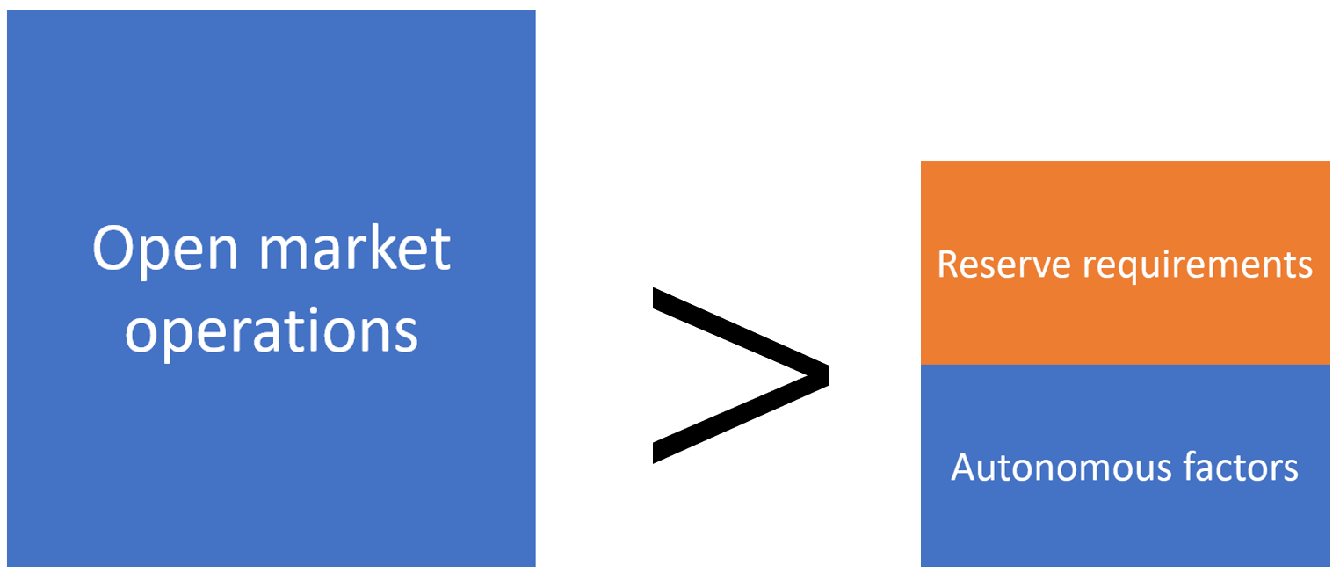
The Floor Approach: How central banks set the interest rate
Central banks set the interest rate with the deposit facility which functions as minimum interest rate in the market.

Slide 13
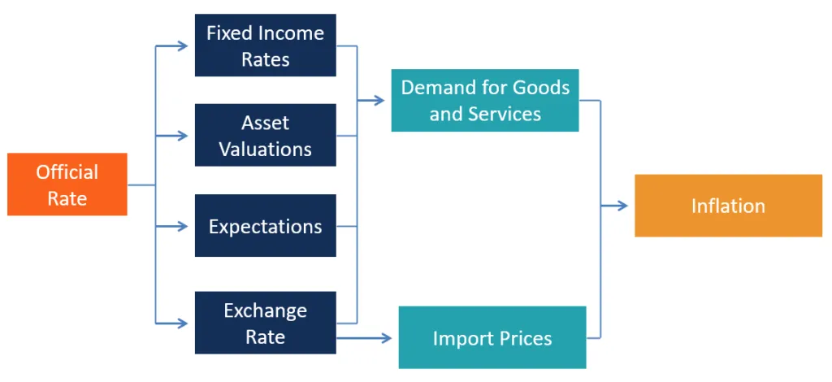
The Monetary Transmission Mechanism:
How the interest rate can influence growth, inflation and employment

Slide 14
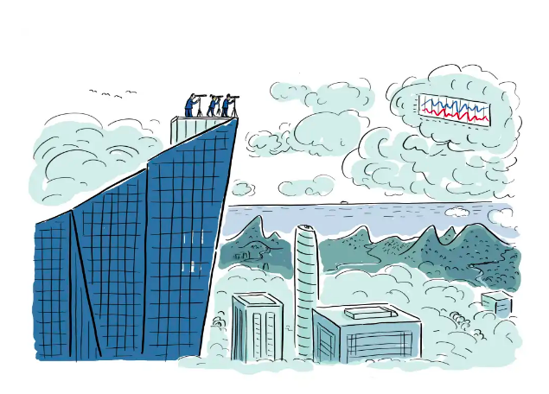
The Idea of a Natural Rate of Interest and its Critiques: How to determine the desired level of the interest rate
Idea: Interest rates will tend towards a ‘natural’ equilibrium.
Critique: Fiscal and monetary policy can influence potential growth and the neutral rate of interest.

Slide 15
Unconventional Monetary Policy
When conventional monetary policy is not sufficient due to the zero lower bound, central banks might adopt policies other then positive short-term interest rate policies to achieve their goals.
Next slides
  Negative Interest Rate Policy (NIRP): Setting the interest rate below zero
  Quantitative Easing: Buying bonds to influence interest rates and liquidity
  Unconventional Credit Operations: Providing more credit to banks to keep them stable and operating

Slide 16
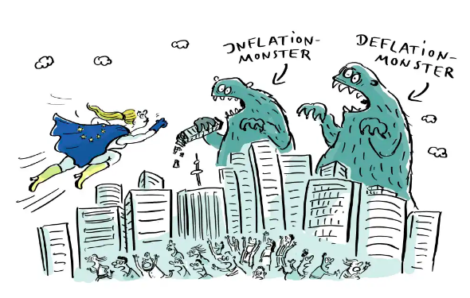
Negative Interest Rate Policy (NIRP): Setting the interest rate below zero
Pursued the Bank of Japan and the European Central Bank following a combination of low growth, low inflation, and financial instability.
There is debate over whether nominal interest rates substantially below zero are possible and can be a desirable policy option.

Slide 17
Quantitative Easing: Buying bonds to influence interest rates and liquidity
Outright purchases are transactions in which the central bank buys bonds from financial actors and private investors in secondary markets without any contractual obligations to resell them at a later date.
Objectives:
Reducing long-term interest rates
Compress credit and liquidity spreads
Threat to “buy all the assets in the world”
Strengthen banks’ liquidity buffers
Increase the money supply
Absorbing risks from banks
Substituting banks’ illiquid with liquid assets
Directly support through buying bonds

Slide 18
Unconventional Credit Operations:
Providing more credit to banks to keep them stable and operating
By strengthening the lender-of-last-resort the funding stress of commercial banks is reduced, which contributes to maintaining the readiness of banks to provide credit to the economy at a moderate mark up to short-term risk-free rates.
Types of unconventional credit operations:
Let to more financial actors lend
Fixed rate full allotment (FRFA) operations
Favourable lending if banks behave desirably
Provide credit in foreign currency (US $)
Accept a wider collateral set
Longer lending operations to banks

Slide 19
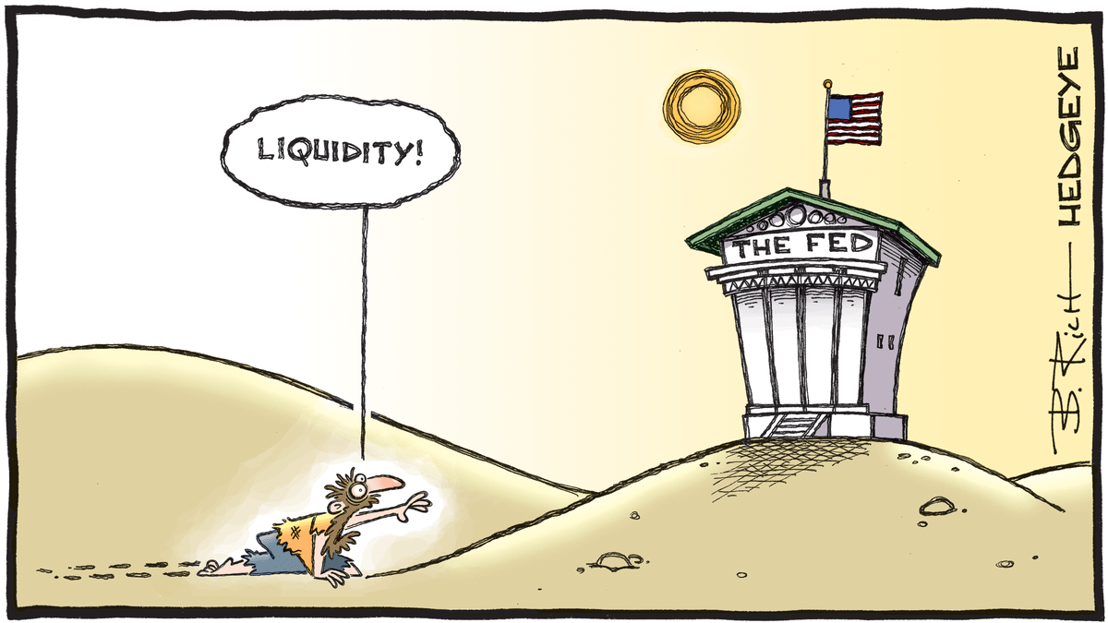
The Central Bank as Lender of Last Resort
Providing liquidity to financial institutions and markets when they otherwise are unable to meet their obligations and can cause financial instability.
Bagehot's dictum: Unlimited lending against good collateral to solvent institutions at a high interest rate.
Next slides
  Why the central bank acts as lender of last resort
  How the central banks acts as lender of last resort

Slide 20
Why the central bank acts as lender of last resort in financial crises
Negative externalities of funding liquidity stress
To keep banks functioning to prevent deflation
Only central banks have unlimited liquidity
Central banks have better information
Haircuts are an effective tool
Notes:
Source image: What Is The Fed’s New FIMA? The Potential For A SHADOW Shadow Run Is V (hedgeye.com)

Slide 21

How the central banks acts as lender of last resort
Collateral availability, accessibility of central bank credit, and (de-)stigmatisation of its use in:
  The regular operational framework of the central bank
  Changes of the framework and additional lending operations in crisis times
  Emergency liquidity assistance to individual banks or actors

Slide 22

Collateral: How to decide which assets can underwrite credit loans
For credit operations central banks require collateral, i.e. the pledging of certain eligible securities, to protect its credit exposures to commercial banks.
Government bonds often serve as collateral in credit operations as they have:
  High liquidity
  Ease of pricing
  Legal certainty
While your collateral, when you get a mortgage is the house, the typical collateral in financial markets and of a commercial bank when it lends from the central bank is government debt.
Notes:
Source image: Wat is Zekerheid: Definitie en betekenis | Capital.com

Slide 23
Types of central bank policies
Conventional monetary policy:
Setting a target for the overnight interest rate to pursue economic objectives
Unconventional monetary policy:
When conventional monetary policy is not sufficient due to the zero lower bound and is characterised by instruments such as quantitative easing asset purchase programmes
Lender of last resort policies:
Providing liquidity to financial institutions and markets when they otherwise are unable to meet their obligations and can cause financial instability
Central bank policies
Monetary policy
Lender of last resort policies
Conventional
Unconventional

Slide 24
Central bank policy instruments
Control of short-term interest rate to influence growth, inflation and employment. Negative interest rate policies are considered unconventional and more controversial.
In quantitative easing (QE) types of asset purchase programs central banks buy bonds from financial actors and private investors in secondary markets.
With emergency liquidity assistance (ELA) central banks support commercial banks by lending freely against good collateral to solvent institutions at a penalty rate to prevent financial instability.
With unconventional credit operations central banks provide more credit to commercial banks to keep them stable and operating.
With their collateral frameworks central banks decide which assets can underwrite credit loans.

Slide 25
Quiz
  First 5 questions:
  Under which central bank policy types do the following policy instruments fall?
  Choose the policy types that apply for each policy instrument, multiple answers can be correct.

Slide 26
Question 1: Short-term interest rate
Conventional monetary policy
Unconventional monetary policy
Lender of last resort policy

Slide 27
Question 2: Quantitative easing
Conventional monetary policy
Unconventional monetary policy
Lender of last resort policy

Slide 28
Question 3: Unconventional credit operations
Conventional monetary policy
Unconventional monetary policy
Lender of last resort policy

Slide 29
Question 4: Emergency liquidity assistance
Conventional monetary policy
Unconventional monetary policy
Lender of last resort policy

Slide 30
Question 5: Collateral
Conventional monetary policy
Unconventional monetary policy
Lender of last resort policy

Slide 31
Question 6: What position do “hawks” and “doves” typically take?
“Hawks” tend to want tighter monetary policy to lower inflation whilst “doves” tend to want looser monetary policy to support growth and employment.
“Hawks” tend to want tighter monetary policy to support growth and employment whilst “doves” tend to want looser monetary policy to lower inflation.
“Doves” tend to want tighter monetary policy to lower inflation whilst “hawks” tend to want looser monetary policy to support growth and employment.
“Doves” tend to want tighter monetary policy to support growth and employment whilst “hawks” tend to want looser monetary policy to lower inflation.

Slide 32
Question 7: From whom do central banks buy bonds (directly) in asset purchase programmes?
Financial actors and private investors in secondary markets
Governments and public sector bodies
Non-financial companies

Slide 33
Question 8: How have central banks provided credit in an unconventional way during recent crises?
Multiple answers are correct.
Lengthened the duration of their lending operations to banks.
Widened the access of counterparties to their credit operations.
Made favourable lending terms (or access in general) conditional on some desirable behaviour of banks, such as providing more lending to the real economy.
Provided credit in foreign currency, notably in USD (based on swap lines).

Slide 34
Question 9: When do central banks as lender of last resort provide liquidity to support financial institutions?
Multiple answers are correct.
When the financial system as a whole is threatened
When critical private financial institutions are unable to provide liquidity
When economic growth is weak
When inflation is expected to be above target

Slide 35
Match the situation with the accompanying policy response from the central bank.
Situations:
On 14 September 2007, the British bank Northern Rock was unable to refinance its securitised mortgages. While originally a mutual building society owned by its members, Northern Rock grew quickly in the early 2000s to a revenue of £5 billion in 2006 by borrowing money from financial markets to provide mortgages to customers which were then resold to other international financial actors.
On 5 October 2010, the Policy Board of the Bank of Japan met. In response to the collapse of Lehman Brothers in 2008, the short-term interest rate had been reduced but the pace of economic improvement remained sluggish.
On 15 March 2020, the Federal Reserve Board of the United States of America met as the coronavirus was quickly spreading around the world. Many financial markets, surprisingly including the US government bond market, started crashing as the demand for cash surged in the face of fundamental uncertainty and the likely deep economic downturn.
On 17 March 2021, The Board of Governors of the Central Bank of Brazil met during another wave of Covid-19. While its interest rate was historically low, rising commodity prices were causing 5% inflation.
Policy responses:
The central bank reduced the interest rate target from 1.00-1.25% to 0%-0.25%, it announced an asset purchase programme worth at least 700 billion USD, and acted as lender of last resort by providing liquidity support.
The central bank started increasing its interest rate target with 0.75 percentage point.
The central bank acted as lender of last resort and provided liquidity support.
The central bank decided to “maintain the virtually zero interest rate policy until it judges […] that price stability is in sight” and to introduce an asset purchase programme worth 35 billion USD.

Slide 36
Game time
Make a group of 2-3. You are the executive board of the central bank of your country. You have the following mandate: price stability and full employment.
Start with the first scenario and discuss with each other which policy option from the provided list would be best.
After 5 min, go to the next scenario and again discuss the best policy option. Repeat this until the time is up.

Slide 37
Scenario 1
In the aftermath of a financial crisis, the economy has been slow to recover. Despite the initial reduction in the interest rate, unemployment has remained high and GDP growth and inflation low. During the last meeting three months ago, the board of the central bank decided to decrease the interest rate target from 1% to 0.5%.
Policy options:
Short-term interest rate through the deposit facility:
Large increase, small increase, no change, small decrease, large decrease (potentially below zero)
Quantitative easing through the buying or selling bonds:
Large scale buying, small scale buying, do nothing, small scale selling, large scale selling
Emergency liquidity assistance through lending to banks: Provide no liquidity assistance, limited liquidity assistance, large scale liquidity assistance
 | 3 months ago | Now
Inflation rate | 1% | 1%
Unemployment rate | 7% | 6%
GDP growth rate | 2% | 2%

Slide 38
Scenario 2
A global investment bank is at risk of defaulting as it is unable to repay its repurchase agreements (repos). The bank is a leading player in the global mortgage-backed securities market, wealth management, and financial clearing services.
Policy options:
Short-term interest rate through the deposit facility:
Large increase, small increase, no change, small decrease, large decrease (potentially below zero)
Quantitative easing through the buying or selling bonds:
Large scale buying, small scale buying, do nothing, small scale selling, large scale selling
Emergency liquidity assistance through lending to banks: Provide no liquidity assistance, limited liquidity assistance, large scale liquidity assistance

Slide 39
Scenario 3
In response to increased inflation, the board of the central bank has increased its interest rate target over the year. Last meeting three months ago, it was moved from 4% to 5%. Since then, inflation has come down, but unemployment is rising and GDP growth declining.
Policy options:
Short-term interest rate through the deposit facility:
Large increase, small increase, no change, small decrease, large decrease (potentially below zero)
Quantitative easing through the buying or selling bonds:
Large scale buying, small scale buying, do nothing, small scale selling, large scale selling
Emergency liquidity assistance through lending to banks: Provide no liquidity assistance, limited liquidity assistance, large scale liquidity assistance
 | 3 months ago | Now
Inflation rate | 8% | 4%
Unemployment rate | 4% | 6%
GDP growth rate | 3% | 2%

Slide 40
Scenario 4
A regional commercial bank is facing large-scale write-downs on illiquid assets. The bank has strong local roots and is particularly active in the food and agribusiness. A decline in commodity prices is creating concerns over the growth prospects of the bank.
Policy options:
Short-term interest rate through the deposit facility:
Large increase, small increase, no change, small decrease, large decrease (potentially below zero)
Quantitative easing through the buying or selling bonds:
Large scale buying, small scale buying, do nothing, small scale selling, large scale selling
Emergency liquidity assistance through lending to banks: Provide no liquidity assistance, limited liquidity assistance, large scale liquidity assistance

Slide 41
Scenario 5
A geopolitical conflict has escalated causing major disruptions in supply chains, which has led to rapid increase in prices. So far, unemployment has remained stable while the GDP growth rate has declined. During the last meeting of the board, the decision was taken to keep the interest rate target at 2%.
Policy options:
Short-term interest rate through the deposit facility:
Large increase, small increase, no change, small decrease, large decrease (potentially below zero)
Quantitative easing through the buying or selling bonds:
Large scale buying, small scale buying, do nothing, small scale selling, large scale selling
Emergency liquidity assistance through lending to banks: Provide no liquidity assistance, limited liquidity assistance, large scale liquidity assistance
 | 3 months ago | Now
Inflation rate | 1% | 8%
Unemployment rate | 4% | 4%
GDP growth rate | 4% | 3%

Slide 42
Discuss in groups of 2-3
What is the most important thing you learned today?
What was surprising or interesting to learn about central banking?
How does what you have learned today relate to what you already knew about central banking?

