Slide 1
Introducing the Economy

Slide 2
What do you think of when you hear the word economy or economist, and how does it make you feel?
Go to menti.com
Type in code:

Slide 3
Objectives
Understanding how the economy is embedded in the wider political, social, and ecological world.
Identify what the economy is
Explore how economics is connected to other fields of study
Examine what economists do

Slide 4


What is the economy?
Discuss in pairs: Define the economy for 1 min each
Write down a definition based on your conversation
Notes:
Ask the students either in pair or to the whole class what they think the economy is.

Slide 5
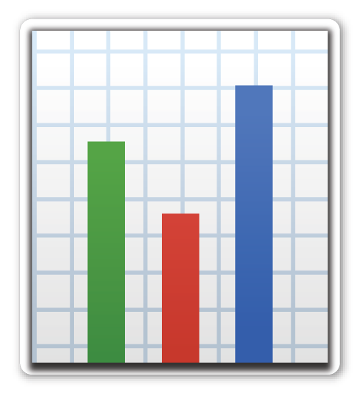








Most people think of
Most people feel

Slide 6
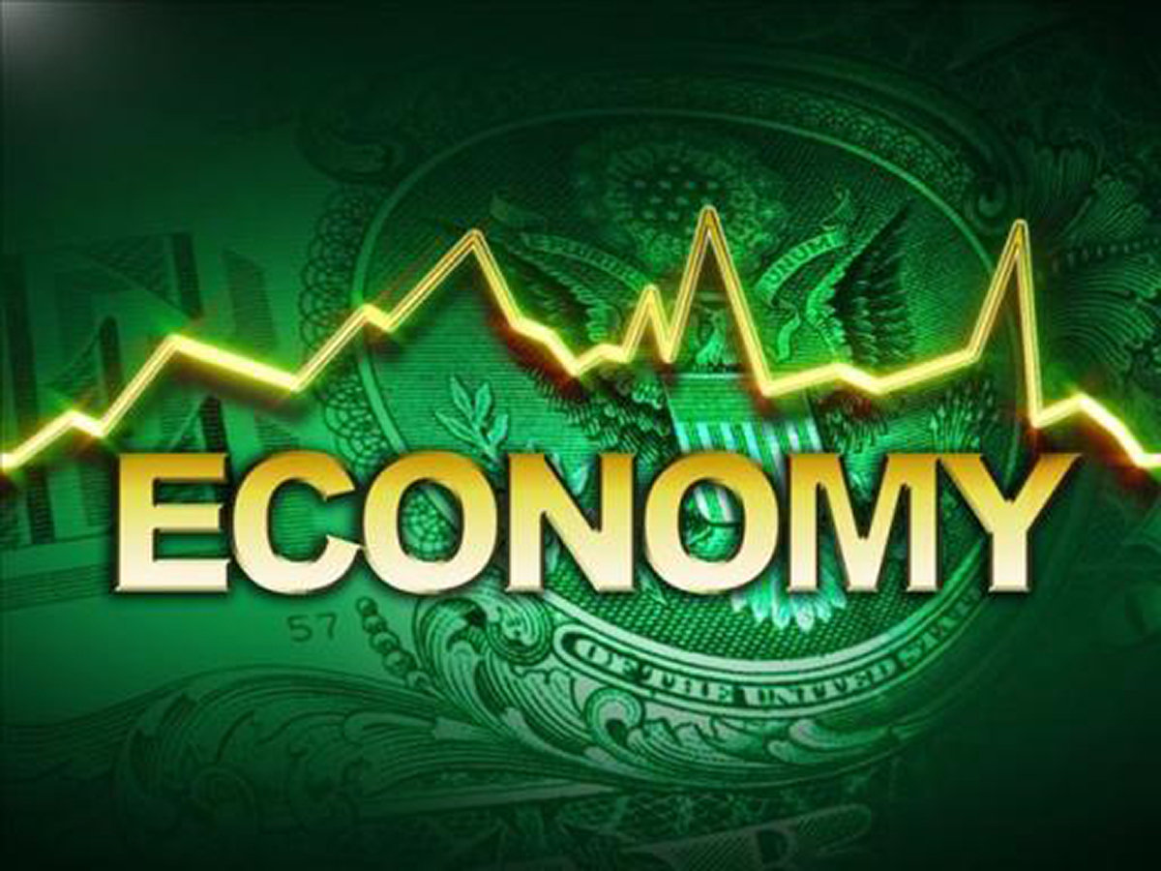

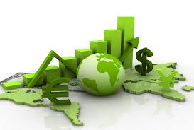

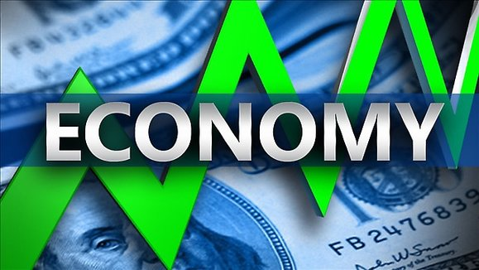
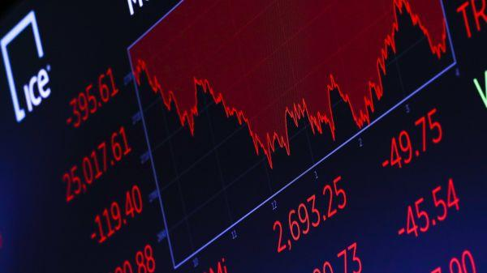
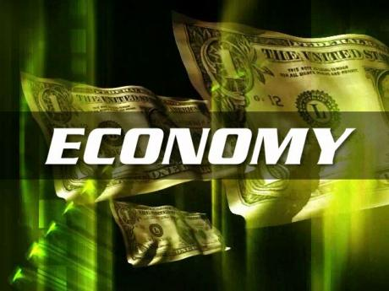

How much do you think the images help you understand what the economy is?
First page of Economy search on Google images
Notes:
These are some ways the economy is normally presented. It doesn’t give us much to go on and they are all the same.
The economy is often presented as an entity that becomes bigger/smaller over time and which is made up of lots of numbers.

Slide 7
What is the economy?
Economies can broadly be described as open systems of resource extraction, production, distribution, consumption and waste disposal through which societies provision themselves to sustain life and enhance its quality.
Notes:
One possible definition of the economy is as open systems… But who are behind these open systems?

Slide 8
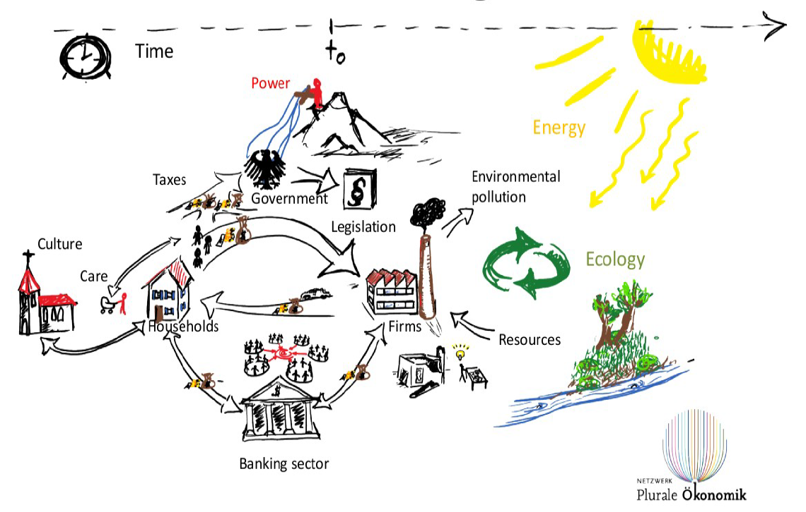
Who are the main actors in the economy?
Individuals
Organisations
Sectors
Global economic system
Notes:
The major actors and institutions of an economy is the government, big and small private companies, cooperatives, labour unions and employers associations, households, banks, regulatory and civil society organisations. We can divide them into these categories:
Individuals (e.g. all citizens each of whom make different types of contributions as carers, workers, volunteers etc)
Organisations (eg. Private Businesses, Government Departments, NGOs)
Sectors (for example, the energy sector, education sector etc)
Note that there is also a global economy made up of individual national economies.

Slide 9
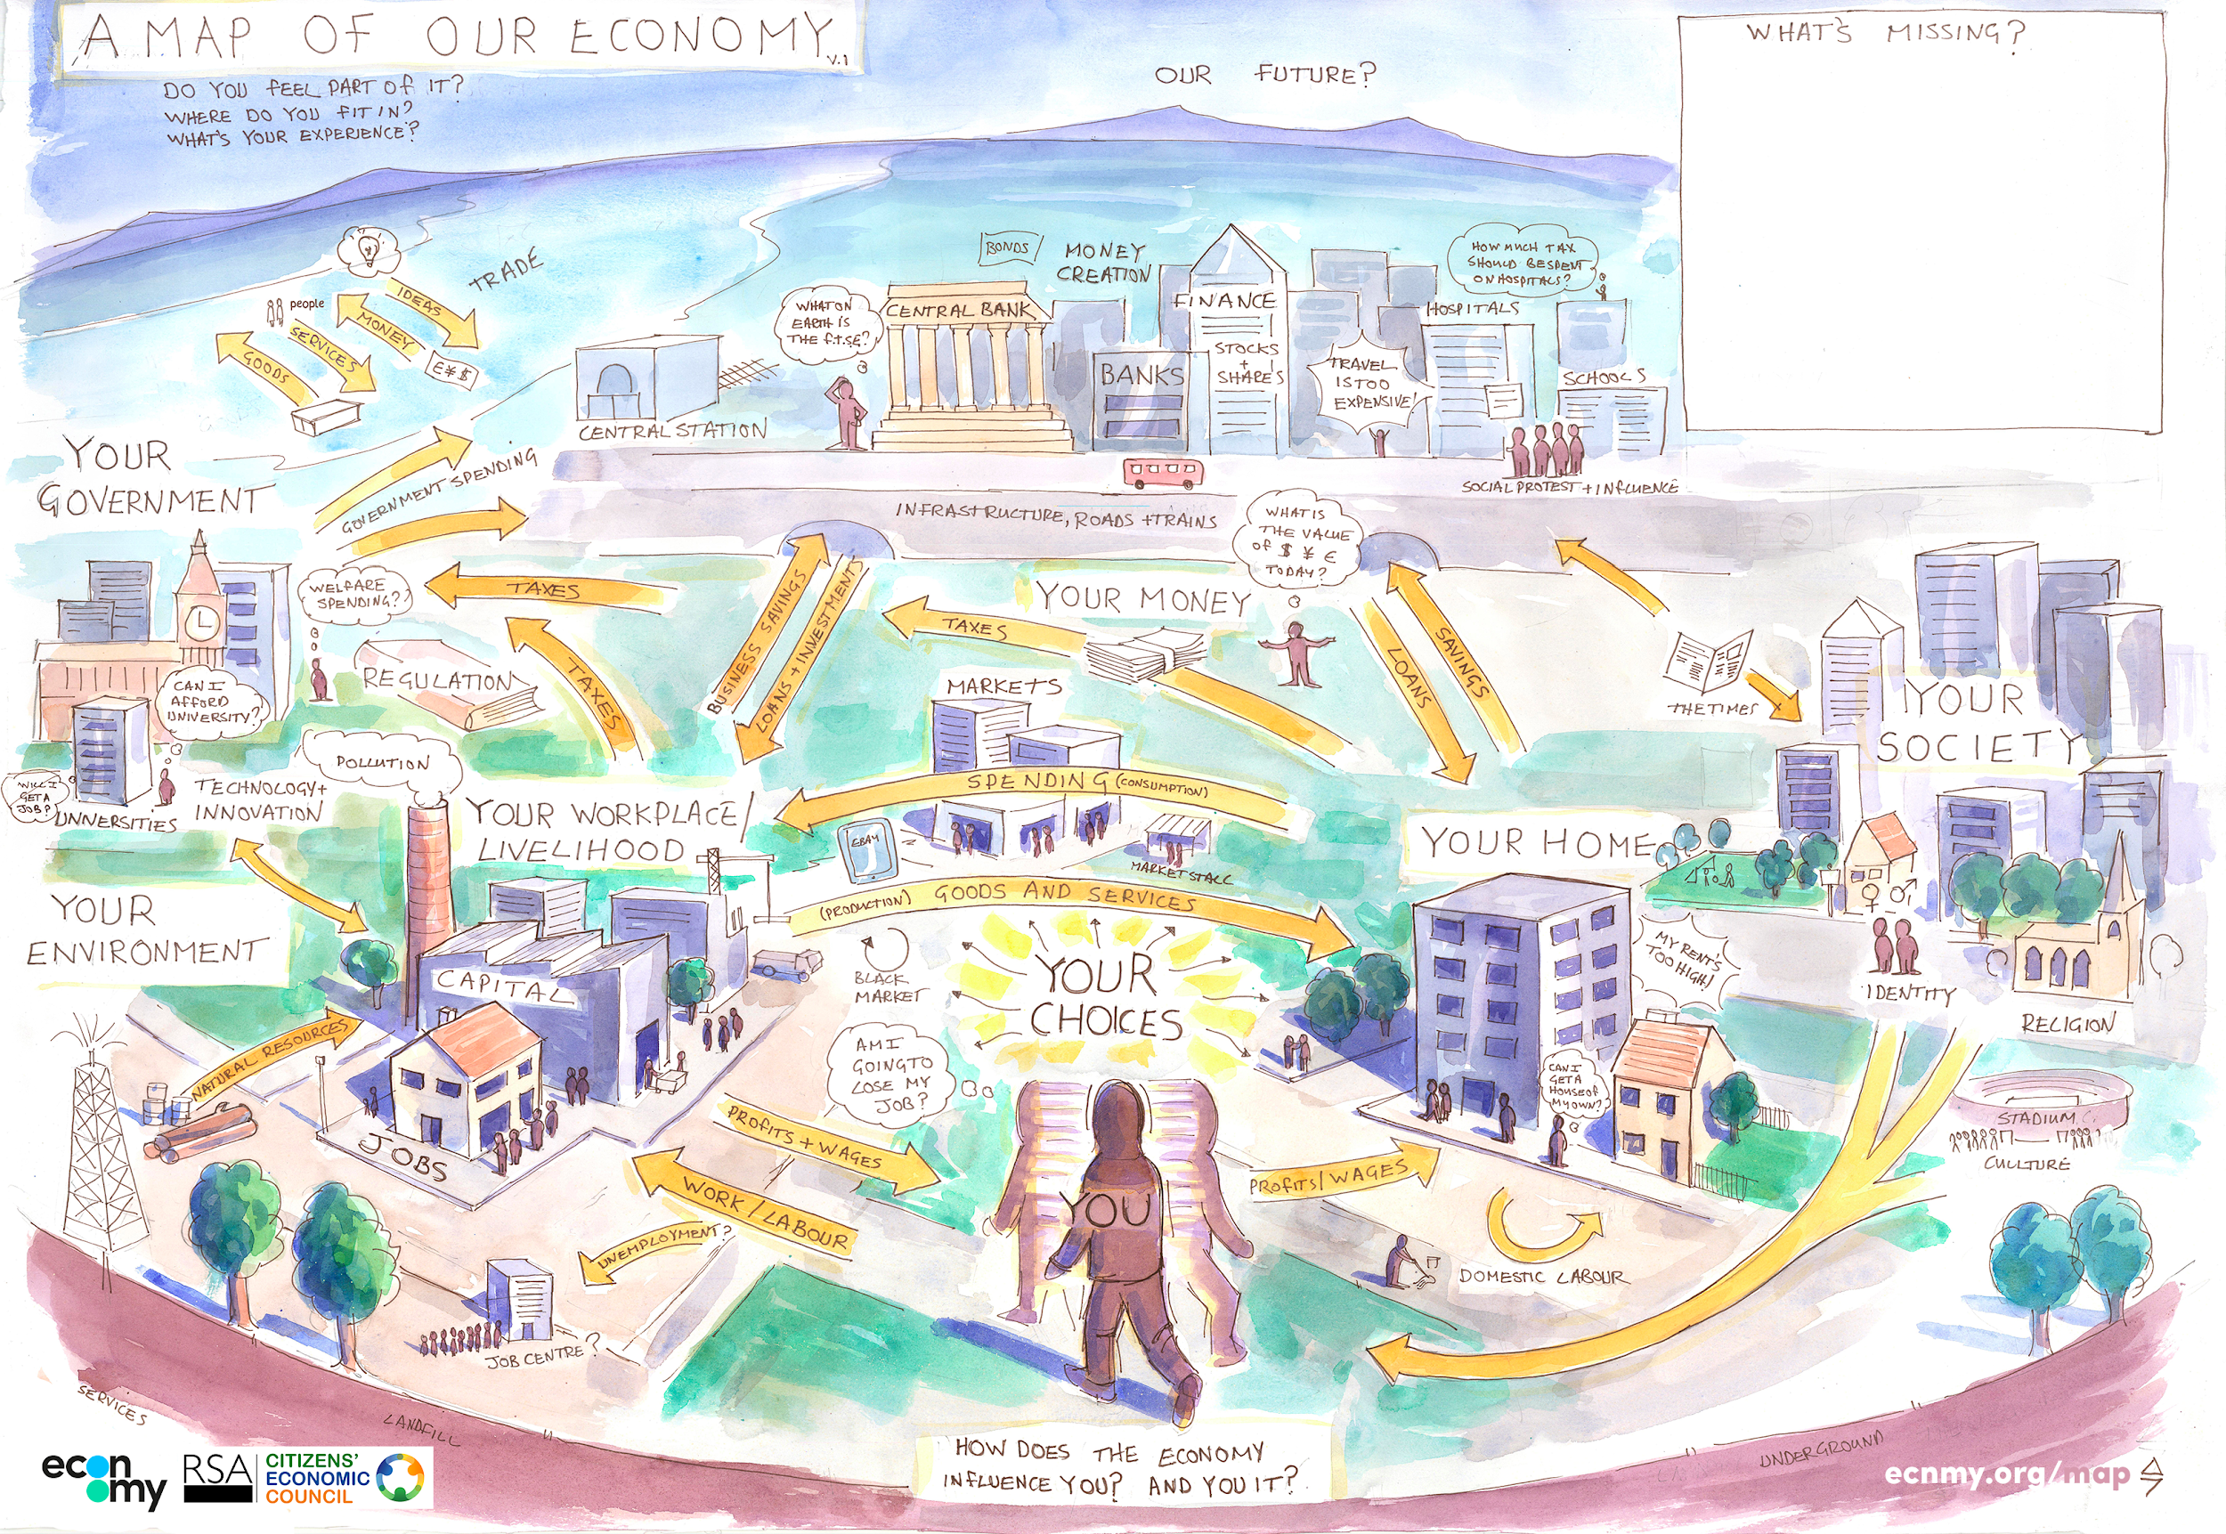
Notes:
The point is that economy is all around us. When you apply for a job, learn a skill, buy a drink or go on a trip, you’re making decisions which shapes the economy around you. The key thing is, so is everybody else. What part of your daily life is not included here?

Slide 10
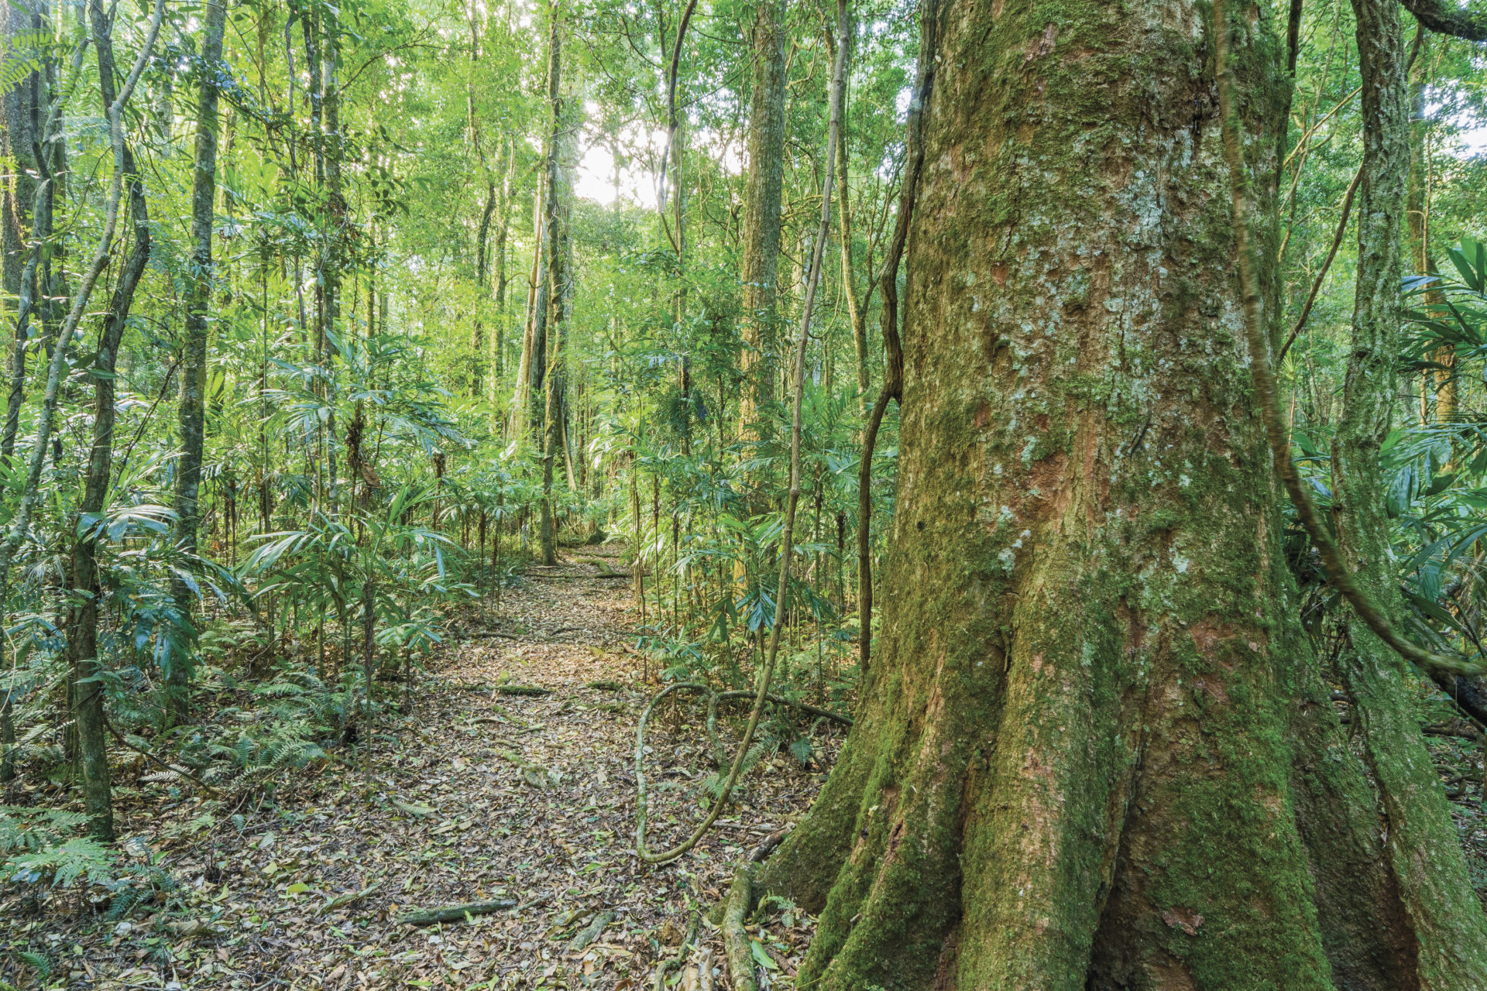
What is the economy?
Neither fully human-built nor fully independent
We co-shape this system, but unlike a building, it also leads a life of its own.

Slide 11
2. Ecological and Social Embeddedness of the Economy

Slide 12
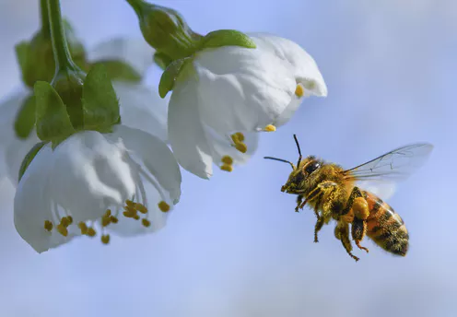
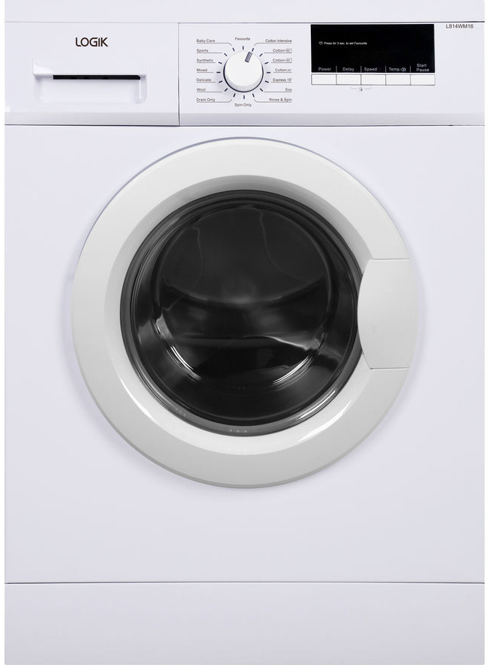
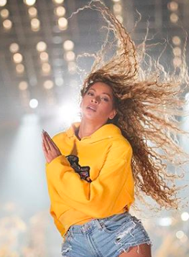
The economy is connected to things like...
Notes:
Unlike what we hear in the news about the economy, it is also connected to things we might not usually associate with it. For instance, bees, the washing machines, and Beyonce.

Slide 13
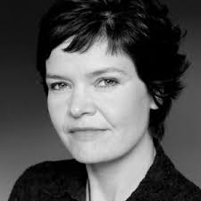
Kate Raworth - Environmental economics
We, and our economies completely rely on the environment, and not just for the obvious stuff - resources we might then make into goods - air, water, precious metals or wood for manufacturing.
But for the services it provides too. The natural ecosystem of bees pollinating flowers underpins the entirety of our food system. Most agricultural crops!
Here’s a list of all the food bees pollinate. How connected would you say bees are to the economy now?
Notes:
According the the economist Kate Raworth, economies rely on the environment. Some parts of the environment we use as resources for goods (air, water, precious metals, or wood). But the environment also provides us with services. For instance, bees pollinate flowers, which plays an important role in our food systems. Many of these are also staples in our diet such as potatoes.

Slide 14
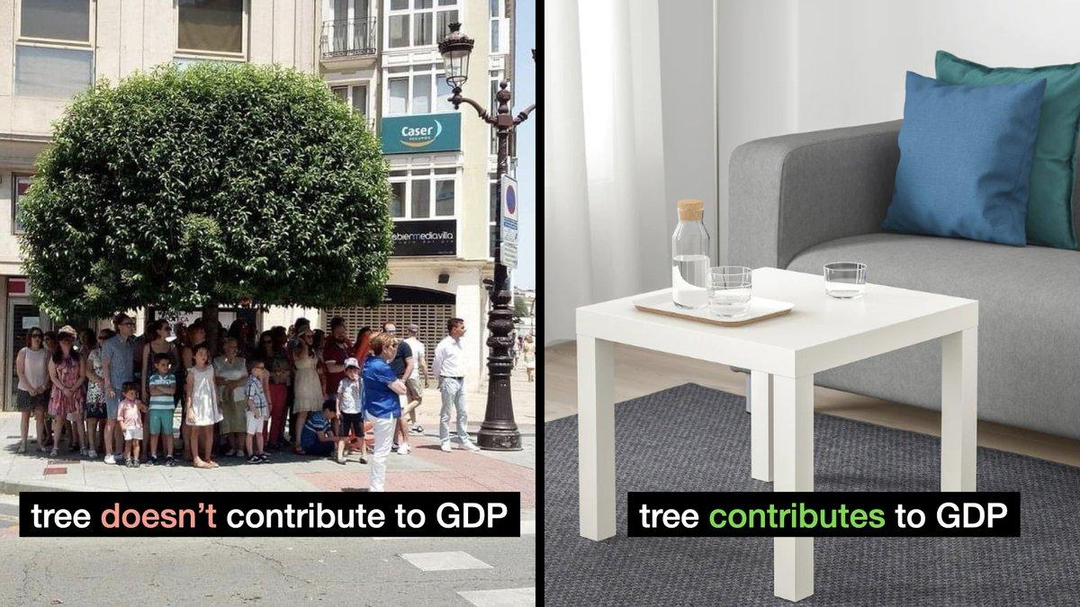
Notes:
GDP is a common way to measure economic activity, although it is mostly a measure of production. And as you can see in this picture, a tree only enters the GDP when it has been transformed/used in production. But a tree itself provides services, like shadow, air cleansing, providing us with fruits etc. Thus, trees is an example of things that are a part of the economy but will not be included in measures such as GDP despite its many services.

Slide 15
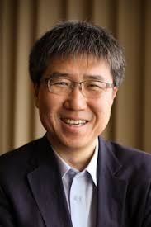
Ha Joon Chang: the washing machine – one of the most important inventions!
This is because it gave women who often spent a lot of time on unpaid household work (labour) more freedom to join the workforce which has changed their role in society.
Notes:
Ha Joon Chang argues that the invention of the technology of the washing machine changed the world (and the economy) more than the internet did!
https://www.theguardian.com/technology/2010/aug/29/my-bright-idea-ha-joon-chang

Slide 16
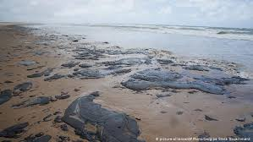
Oil spills?? Beyonce??
… also affect the economy. Any ideas how?
Notes:
Oil spills and Beyonce are also part of the economy. Oil spills for instance are counted as economic activity due to the clean up which is economically costly (labour, equipment etc). It will also have impact on the local economy (local fishing industry, tourism) as well as hugely costly for the environment (destruction of sea life and beaches).
https://www.pembina.org/blog/economics-of-an-oil-spill

Slide 17
ECONOMY
SOCIETY
ENVIRONMENT
Notes:
Thus, we can view the economy as a part of a much larger hole. The economy does not exist in a vacuum. It is embedded in the ecological and social world with much (and ever-changing) overlap and interaction. Without understanding what this embedding looks like, it is very hard to understand the economy itself.

Slide 18
ecosystems
materials
community
culture
energy
consumption
health
land
production
ECONOMY
SOCIETY
ENVIRONMENT
wealth
labour
governance
habitat
trade
policy
air
education
water
biodiversity
Notes:
Thus, we can view the economy as a part of a much larger hole. The economy does not exist in a vacuum. It is embedded in the ecological and social world with much (and ever-changing) overlap and interaction. Without understanding what this embedding looks like, it is very hard to understand the economy itself.

Slide 19
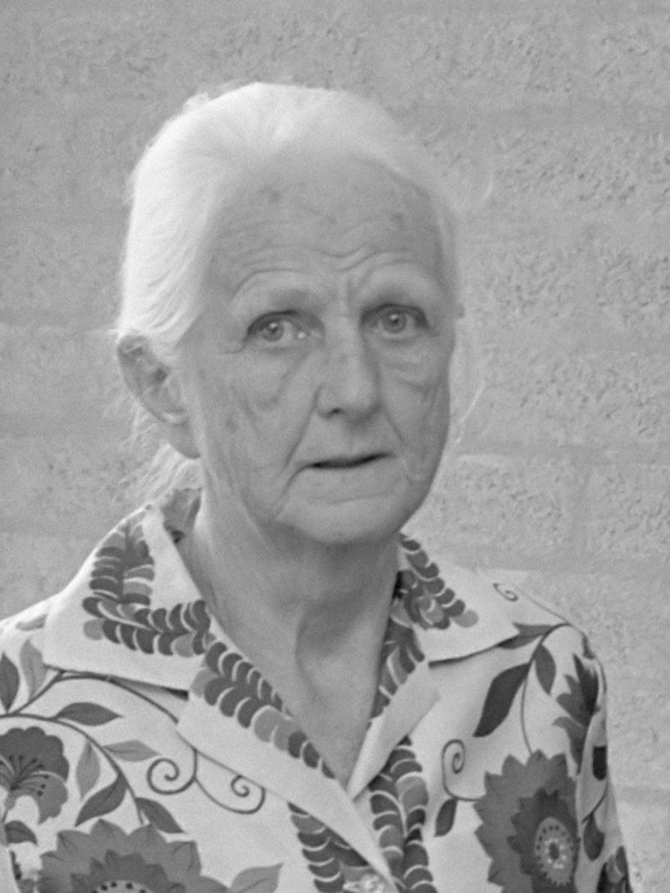
3. Reasons to Study the Economy
The purpose of studying economics is not to acquire a set of ready-made answers but to avoid being deceived by other economists
Joan Robinson
Notes:
Ask the student why they chose to study economics, or go in pairs and spend 1 minute explaining why they chose it.

Slide 20
4. The Main Current Societal Challenges
Notes:
An important role for economists is to help society understand and deal with many of its most difficult challenges. While the ‘goals of the economy’ discussed above are more or less timeless, the challenges in this section are specific to this generation. If future generations of economists are to fulfil this role, they need to be well acquainted with these challenges. In addition, knowing the various challenges our world is facing will help motivate students to apply themselves to more theoretical material, such as research methods and the details of theory. It will give them concrete issues to which they can apply these methods and theories and also guide them in their choice of electives and their own research subjects, further into the programme.

Slide 21
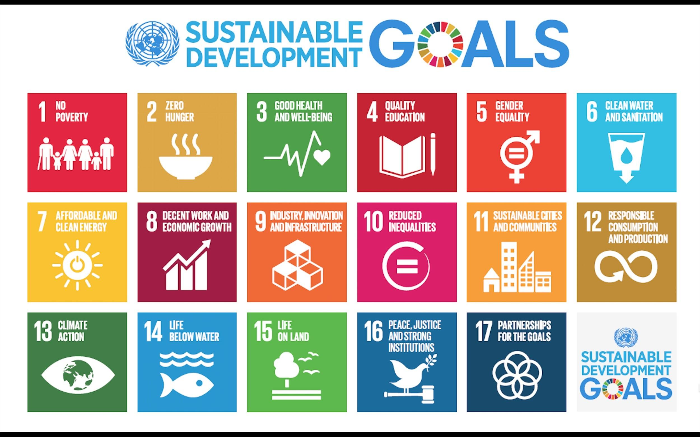
https://sdgs.un.org/goals
Notes:
What SDGs are most important and relevant for the economy? Go to https://sdgs.un.org/goals to briefly explore the 17 goals if in doubt and think how the different goals relate to the economy.

Slide 22
5. The Role of Economists in Society
Notes:
It has been mentioned a number of times already that economists have an important role to play in achieving the goals of the economy and dealing with the challenges of society; how do we do so?

Slide 23
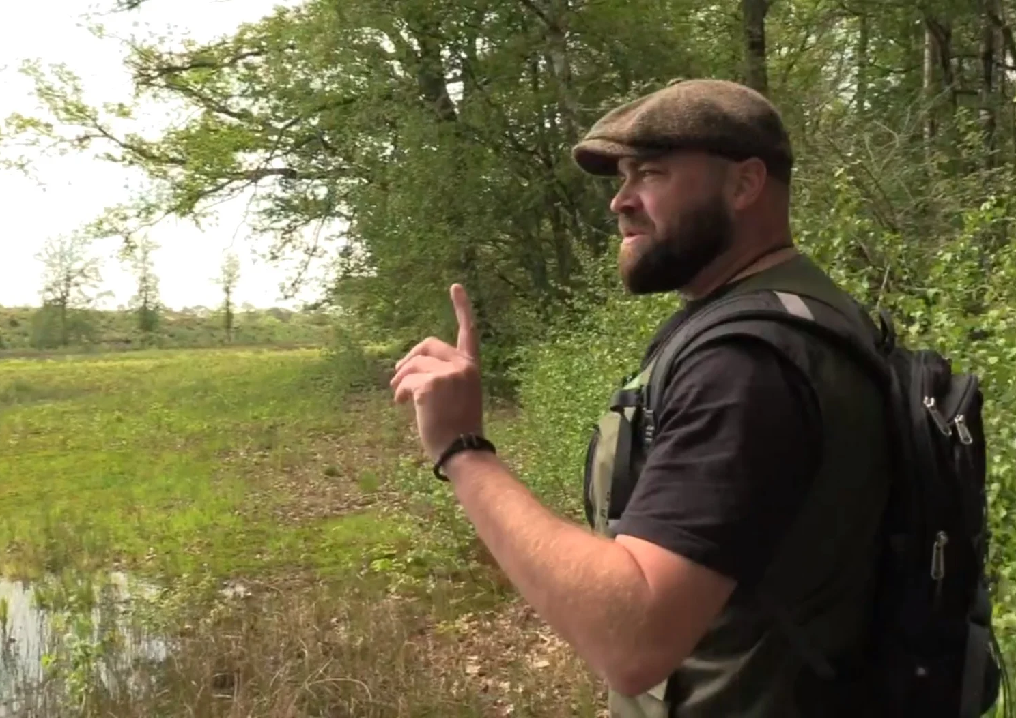
Economists are…

Slide 24
