Slide 1

A Critical Introduction to Economics
Slides based on the book by Jäger/Springler: Ökonomie der Internationalen Entwicklung. Eine kritische Einführung in die Volkswirtschaftslehre
Chapter 5:
Inequality and the distribution of income and wealth

Slide 2
Inequality and Distribution
Personal distribution of income and wealth (Gini coefficient): increasing inequalities
Functional distribution of income: increasing profit share
Primary and secondary distribution of income (redistribution by the state reduces inequality)
Inequality and distribution in different paradigms:
  Neoclassical economics
  Keynesianism
  Political economy

Slide 3
5.1.1 Neoclassical economics: general approach
Theory of marginal productivity explains income (and therefore distribution)
Differences in personal income due to different endowment of resources
Assumes a given distribution of factors of production (and homogenous capital)

Slide 4
5.1.2 Key-concepts in neoclassical economics
Foundations of neoclassical welfare economics
Welfare analysis, implications of state intervention

Slide 5
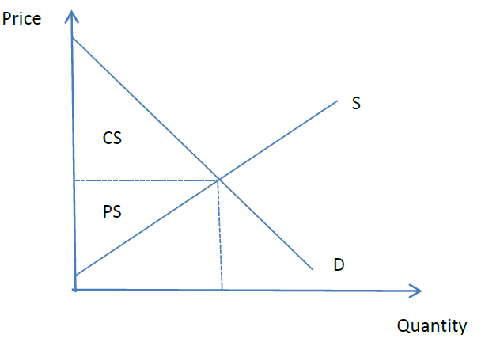
(1) Foundations of neoclassical welfare economics
Basic assumption: Utility cannot be compared between individuals
  Pareto criteria
  Pareto optimum
Consumer surplus
Producer surplus

Slide 6
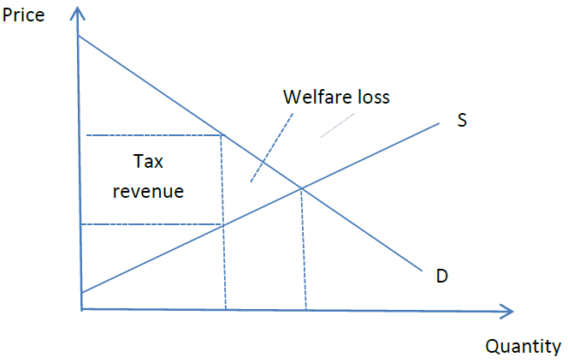
(2) Welfare analysis, implications of state intervention
Market equilibrium maximises welfare (sum of CS and PS)
State intervention reduces the quantity traded
  → welfare loss

Slide 7
5.1.3 Implications for economic policy
Market income (and therefore income distribution) is Pareto-optimal
State intervention (taxes on goods, price ceilings etc.) lead to a welfare loss
… but tax revenues are needed:
  Liberalism “with a human face”
  Poll tax
  Ramsey taxes

Slide 8
5.2.1 Keynesianism: general approach
Critique of neoclassical marginal productivity theory to explain the distribution of income
Determination of wages
  labour market is not a “normal” market but demand depends on profit expectations of firms (investment)
Accumulation of capital and interest rates
  Interest rates determined in financial markets (liquidity preference theory)

Slide 9
5.2.2 Key-concepts in Keynesianism
Interest rate crucial for functional distribution of income
Real wages depend on structures and monopoly rents at the goods market
MPC is different for wages and profits
  Workers spend what they earn
  Capitalists earn what they spend (due to the multiplier effect)

Slide 10
5.2.3 Implications for economic policy
State should redistribute income and wealth (inheritance tax) from capital to labour and high income earners to low income earns
  →increases demand and therefore output (due to different MPC)
Decrease the interest rate
  →in order to obtain full employment

Slide 11
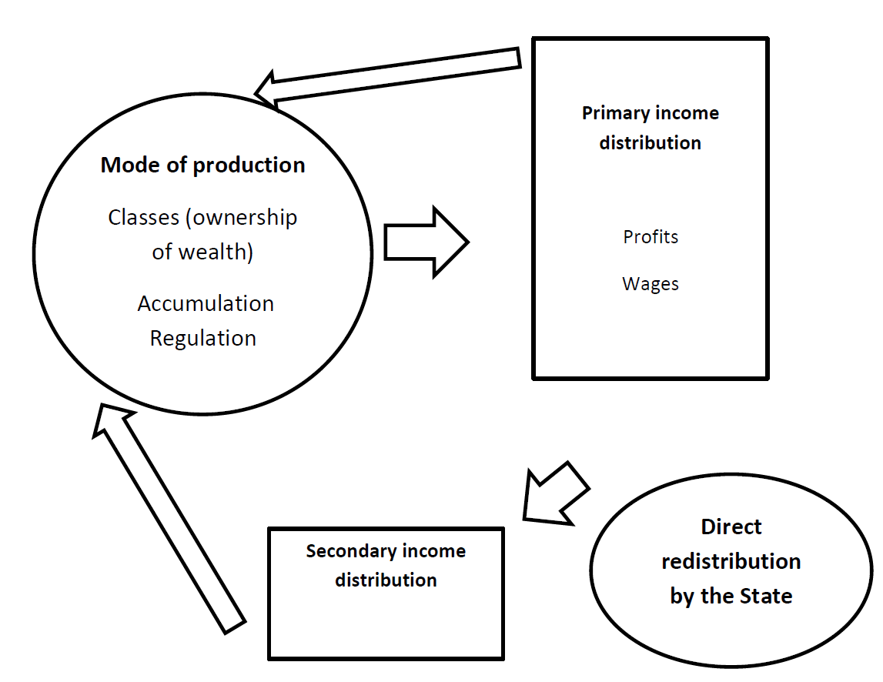
5.3.1 Political Economy: general approach
Inequality is an expression of social relations of production and reproduces them
Capitalism implies a very unequal distribution of wealth and income
The distribution of income and wealth is contested
Wealth is produced by labour
Capital is not “a thing” or productive but a social relation

Slide 12
5.3.2 Key-concepts in Political Economy
Determination of primary income distribution
Historical modes of production and distribution
The international and material dimension of inequality
Distribution and growth dynamics
Redistribution by the State

Slide 13
(1) Determination of primary income distribution
Labour saving technical progress (reserve army)
  Tendency that wages are determined by societal subsistence level
Contesting the level of the surplus value (and therefore the wage) within (or by changing) the wage relation
  Absolute surplus value
  Relative surplus value

Slide 14
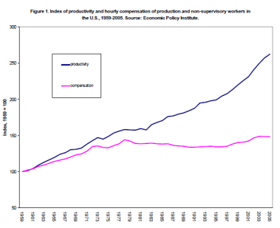
(2) Historical modes of production and distribution
Liberal / competitive wage relation (-1914)
  Stagnating wages
Fordist wage relation (1945-1970)
  Institutionalized compromise
  Increasing wages with productivity
Neo-liberal wage relation (1980-
  Erosion of Fordist wage relation
  Stagnating/decreasing wages

Slide 15
(3) The international and material dimension of inequality
Low wages in the periphery = higher wages and / or profits in the core of the world economy
Conflicts about the use of natural resources (material dimension):
  global oligarchic vs. democratic well-being

Slide 16
(4) Distribution and growth dynamics
Higher wages (redistribution of income) functional for intraverted growth models
Overaccumulation (due to over-exploitation) has caused recent economic crisis
Higer wages would be functional for an intensive dynamic growth regime

Slide 17
(5) Redistribution by the State
Fiscal policy (taxes, government spending) is at the centre of (class) conflict
Modern welfare state redistributes mainly within working class
Redistribution by the State reduces inequality substantially

Slide 18
5.3.3 Implications for economic policy
(Class) struggle over distribution of primary and secondary income and wealth
  New distributional patterns during periods of crisis (related to the specific mode of production resp. regime of accumulation)
Reduction of inequality as a central goal
  Philosophical debates as instruments for struggle
  Reduction of inequality in income, wealth and other multiple forms of inequality
  Lower degree of inequality is important for more democratic structures (instead of oligarchic structures)
Measures to reduce inequality
  Modify the wage relation (primary income distribution), balanced job complexes
  Increase redistributive function of the state (secondary income distribution)

