Slide 1

A Critical Introduction to Economics
Slides based on the book by Jäger/Springler: Ökonomie der Internationalen Entwicklung. Eine kritische Einführung in die Volkswirtschaftslehre
Chapter 4:
Growth, Development and Crisis

Slide 2
Growth, Development and Crisis
Measuring income and growth
Growth vs. development
Empirical overview of growth in a global historical perspective
Growth, development and crisis in different paradigms:
  Neoclassical economics
  Keynesianism
  Political economy

Slide 3
(1) The Measurement of GDP and growth
GDP (Gross Domestic Product) includes all items produced in the economy and sold legally on markets. It is:
  Sum of all value added in the economy (origin of GDP)
  Sum of all incomes in the economy (distribution of GDP)
  The market value of all final goods and services produced within a country in a given period of time (expenditure of GDP): Y = C + I +G + (X - M)
GDP per capita
GNP (Gross National Product)
Nominal / real GDP and nominal / real economic growth

Slide 4
(2) Growth vs. development
Economic growth = good and desirable
vs.
Economic growth can be problematic ≠ development
  Eurocentric idea of progress
  favours some societal interests /life styles over others
  Economic growth ≠ economic growth (growth for whom?)
  Problem of limited global resources

Slide 5
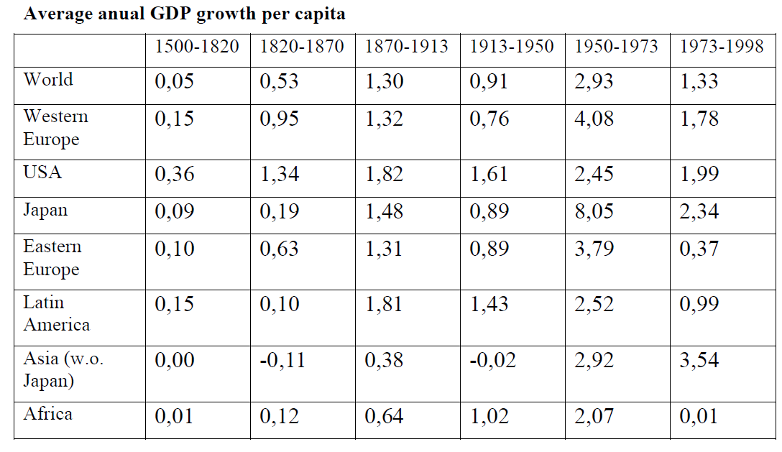
(3) Growth in a global historical perspective

Slide 6
Relative GDP per capita in world regions compared

Slide 7
4.1.1 Neoclassical economics: general approach
Long-run market equilibrium, stability
Saving is important for investment (capital goods)
Quantity of Labour and productivity is important for growth
Production function: Y = F(C,L)

Slide 8
4.1.2 Key-concepts in neoclassical economics (1)
Traditional approaches to explain long-run growth
Growth because increasing input factors and productivity (based on exogenous technology)
→ convergence

Slide 9
4.1.2 Key-concepts in neoclassical economics (2)
New approaches to explain long-run growth (new / endogenous growth theory)
Diminishing returns
Growth differences because of different use of technology and differences in human capital
→ convergence and divergence possible

Slide 10
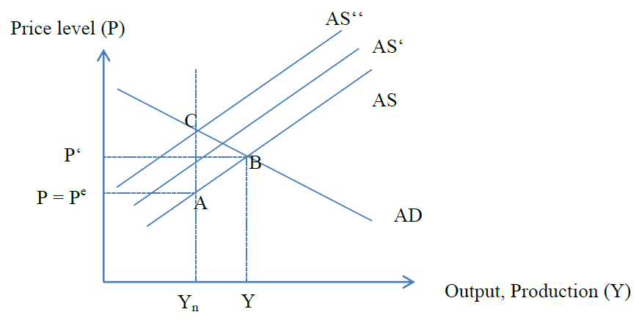
4.1.2 Key-concepts in neoclassical economics (3)
The analysis of short term economic fluctuations
AS-AD Model, based on monopolistic competition
Short deviation from equilibrium possible
→ tendency towards „natural“ output Yn

Slide 11
4.1.3 Implications for economic policy
Traditional growth theory:
  Markets do well
New growth theory:
  Improve technological development
  Investment in human capital
Increasing/stabilizing short term growth
  Structural reforms (deregulating labour and goods markets)

Slide 12
4.2.1 Keynesianism: general approach
No growth equilibrium but path dependency
Business cycle fluctuations are endogenous
Investment as the key to growth and fluctuations
Critique of the neoclassical assumption of homogenous capital

Slide 13
4.2.2 Key-concepts in Keynesianism
The Keynesian growth model
Actual rate of growth
Natural rate of growth (that leads to full employment)
Desired rate of growth (maximal utilization of stock of capital)
Disequilibrium at the goods market → difference between actual, natural and desired rate of growth
Verdoorn’s law (growth of output → growth of productivity)
Hyman Minsky’s explanation of crisis

Slide 14
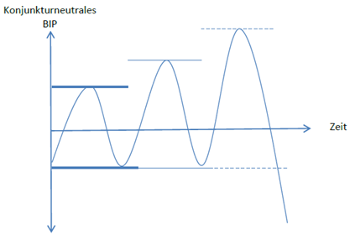
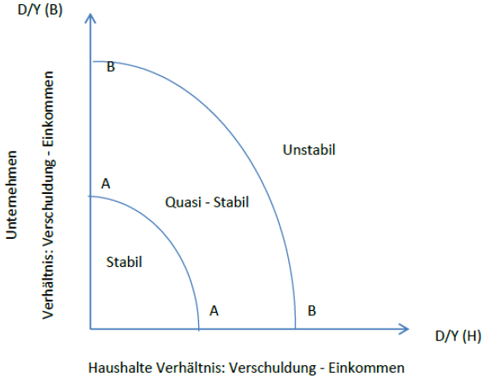
(1) Hyman Minsky’s explanation of crisis (1)

Slide 15
(2) Hyman Minsky’s explanation of crisis (2)

Slide 16
4.2.3 Implications for economic policy
Avoid Financial Crisis
„Big Government“/Functional Finance
Labour market intervention: employer of the last resort
Discretionary monetary policy (see chapter 6)
Lender of last resort
Large public sector and financial sector regulation

Slide 17
4.3.1 Political Economy: general approach
Imperative to accumulate → dynamic capitalist development
Contradictions of capitalist mode of production
  →cyclical crisis
  →structural crisis (overaccumulation, overproduction, profit squeeze, tendency of the profit rate to fall)
Economic growth is a contested goal (accumulation by dispossession)
Consumption fetishism vs. the “good life for all”

Slide 18
4.3.2 Key-concepts in Political Economy
Regulation theory to analyse growth and crisis
  Why are there periods of dynamic and stable growth despite the contradicitons in capitalism?
Historical growth regimes

Slide 19
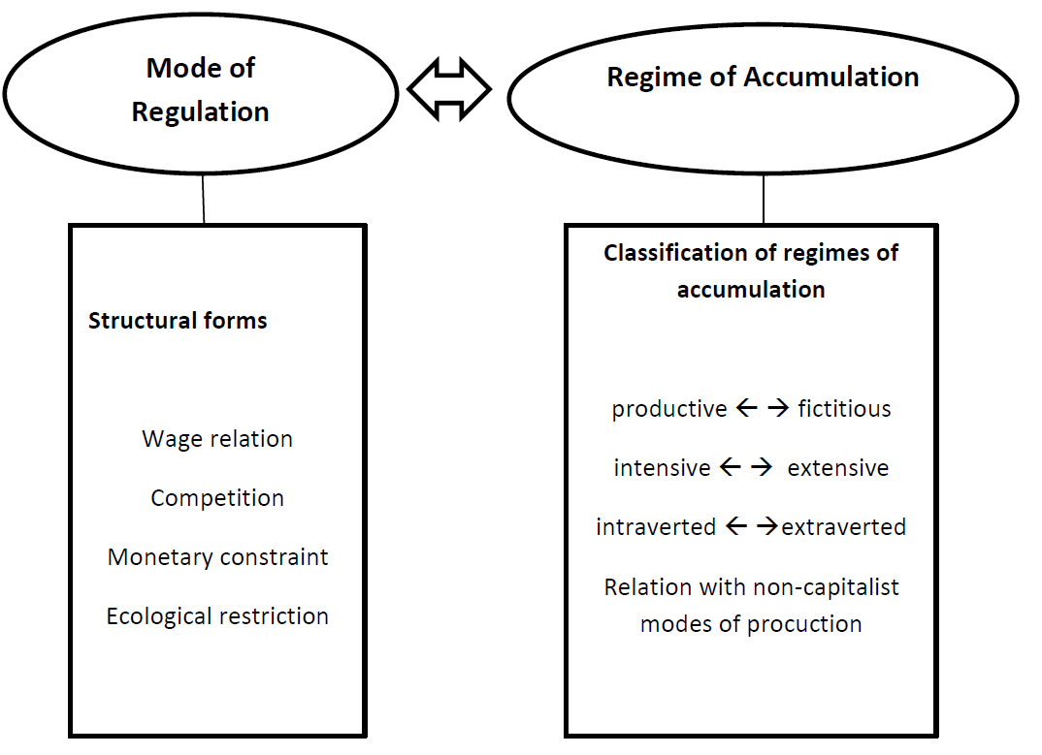
(1) Regulation theory to analyse growth and crisis

Slide 20
(2) Historical growth regimes
Fordist growth regime (1945-1970)
  productive, intensive, intraverted
Crisis
Finance-led growth regime (1980-2007)
  fictitious, extensive, extraverted
Crisis (2008-)

Slide 21
4.3.3 Implications for economic policy
Goals regarding economic growth
  Overcome capitalist mode of production (in the long run)
  Stabilize a more favourable mode of capitalist production (radical reformism):
    Coherence between accumulation and regulation
    De-commodification
    Societal discussion about desired forms of growth instead of growth fetishism (good life for all)
Determinants for growth policies
  Class struggle within the context of specific modes of production (more open in periods of structural crisis)
  Effect of growth policies (changing aspects of structural forms) on growth depends on the specific context

